Slide 1
Old North End
Neighborhood Parking
Neighborhood Parking Kickoff
13 June 2019
Angie Martell, Associate Transportation Planner
Tim Roberts, Principal Transportation Planner

Slide 2
Overview
Why We Are Here
Parking Program Option
Identify Specific Concerns
Develop Action Steps

Slide 3
Why We Are Here
Citizen requests for action regarding parking
Facilitate a meeting and develop a plan of action

Slide 4
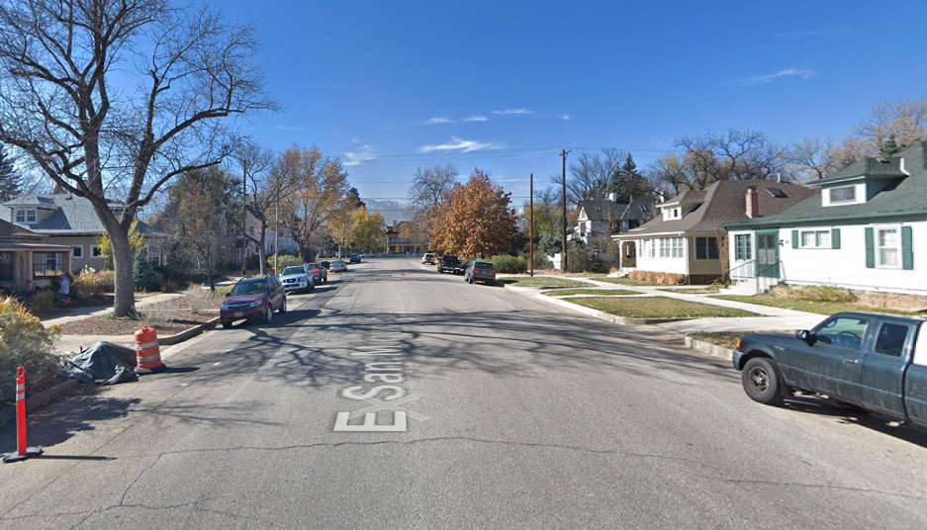

Slide 5
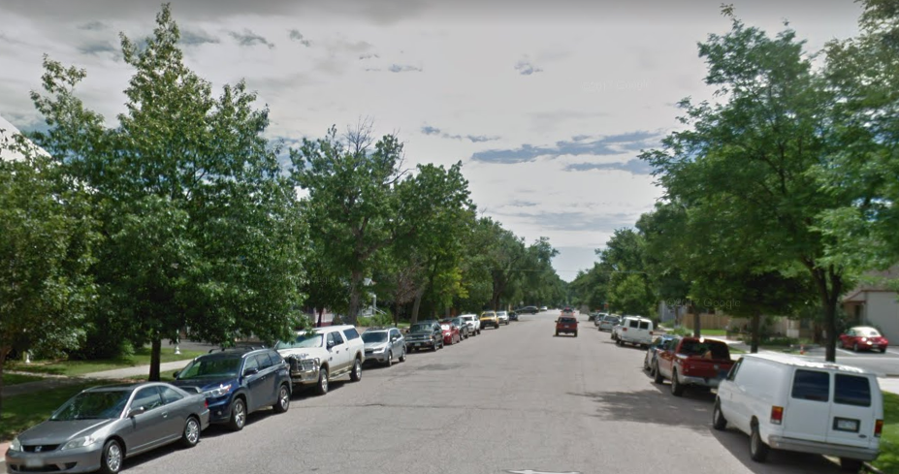

Slide 6
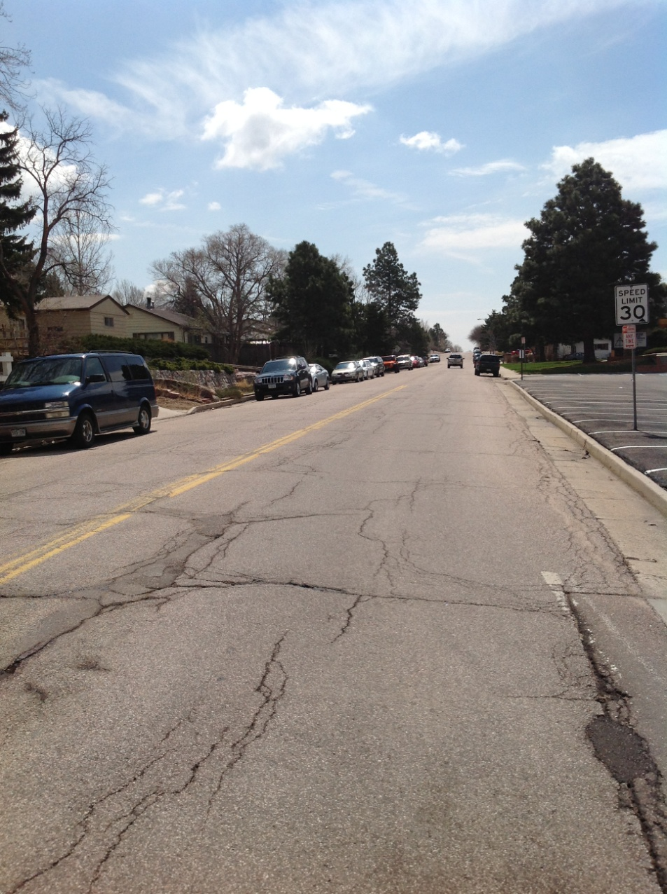
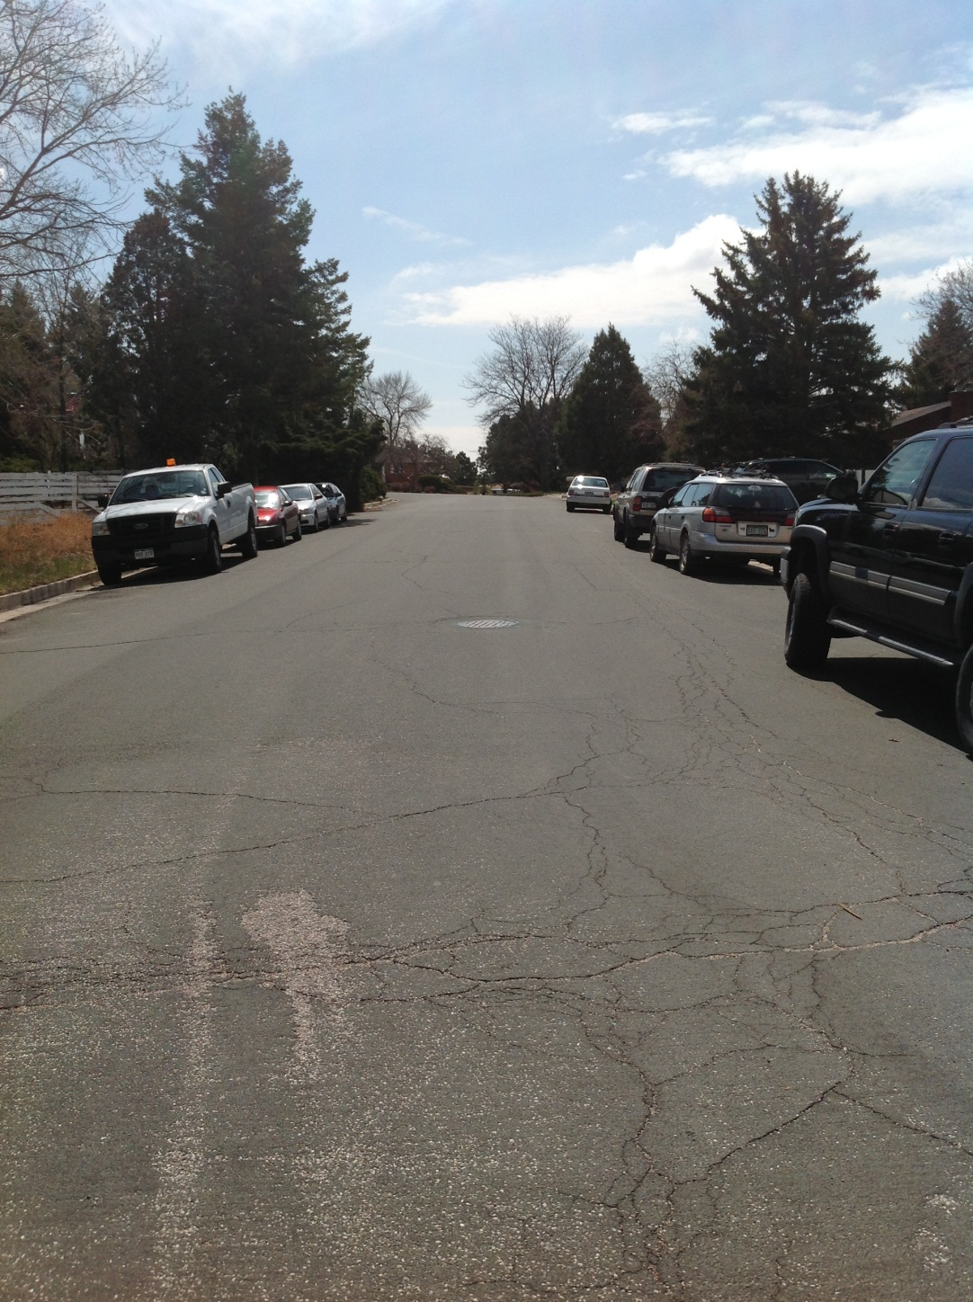
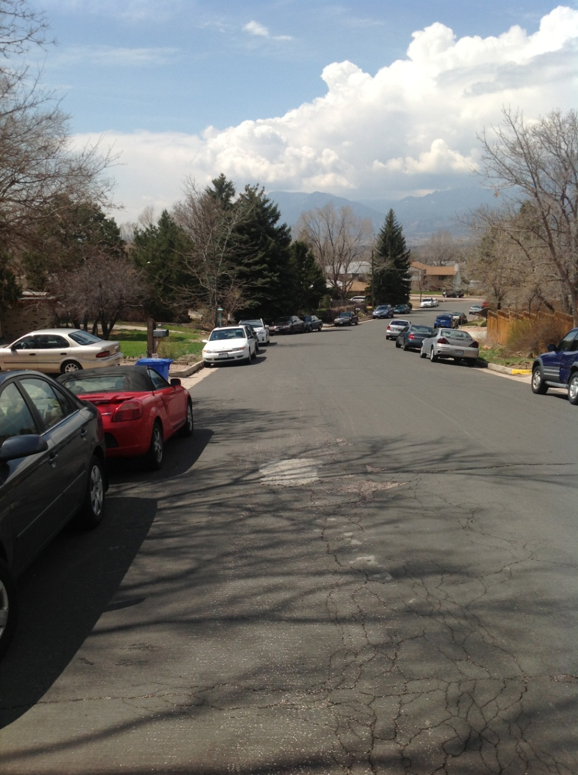
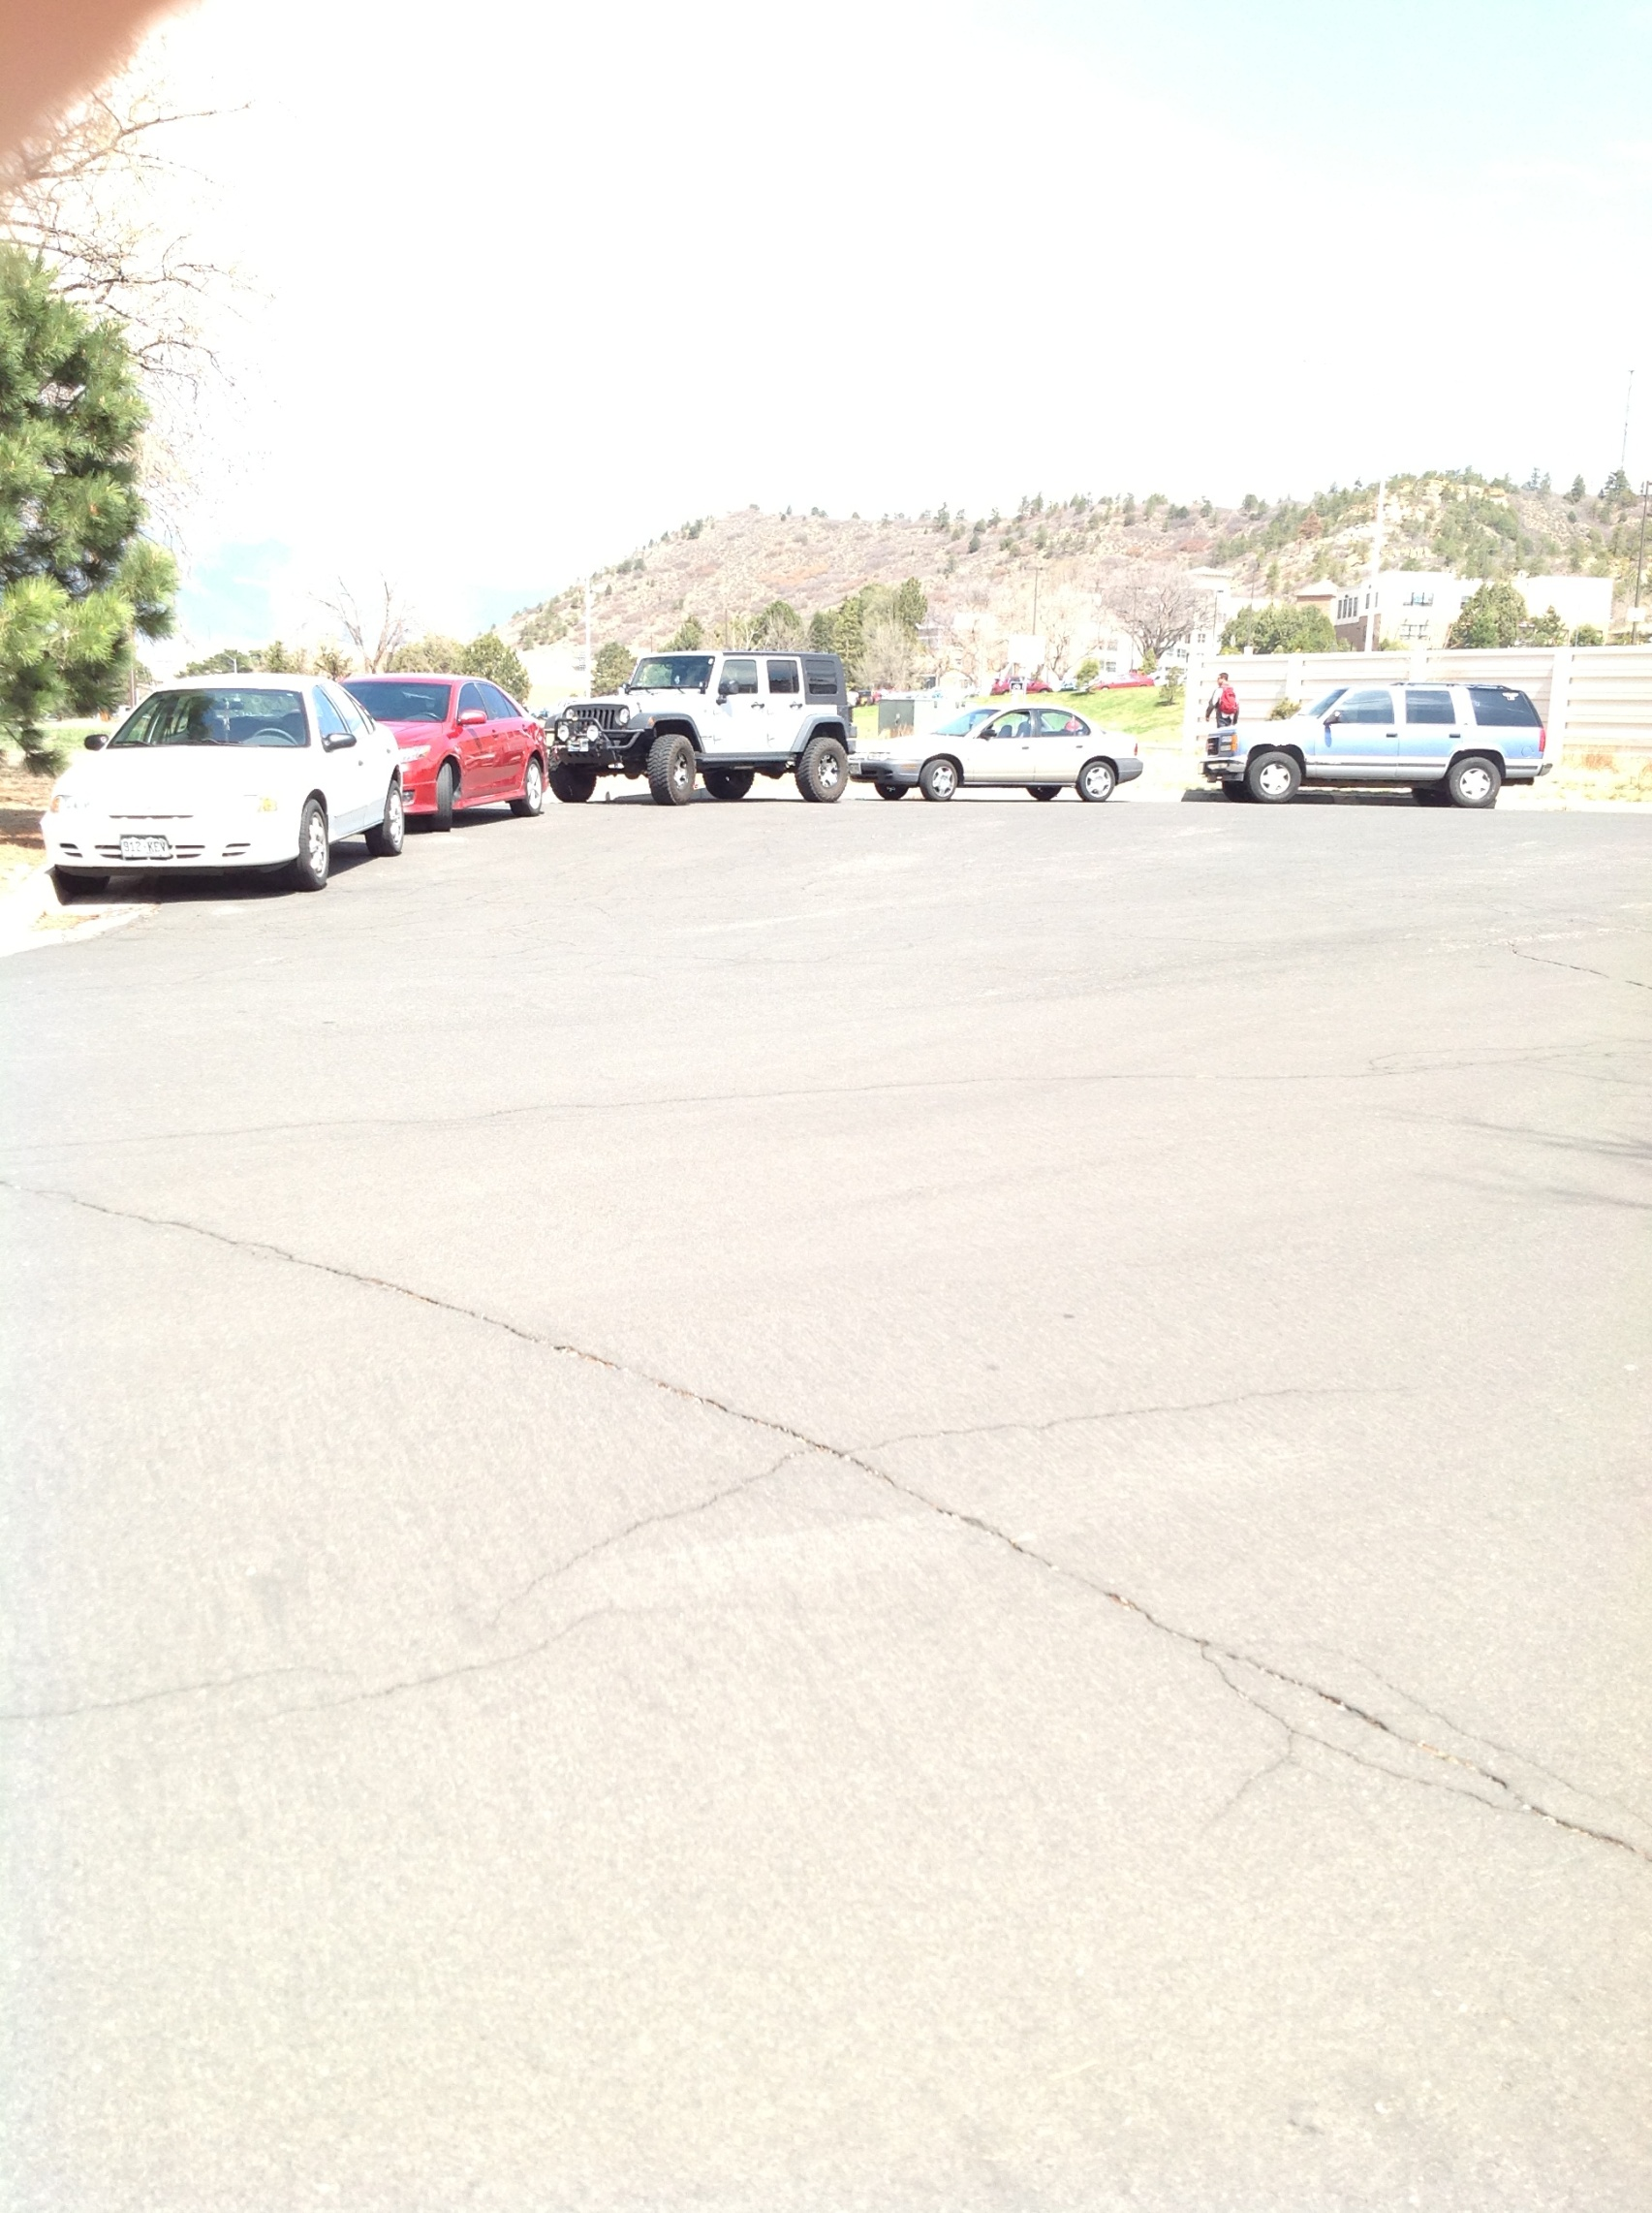
Cragmor Neighborhood Parking

Slide 7
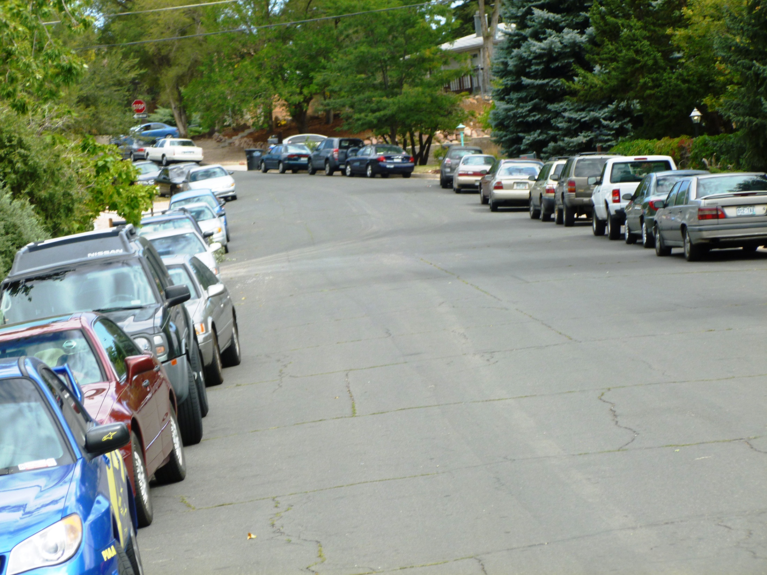
Notes:
This is the photo used in the Colorado Springs Gazette article about the issue. Clearly, there is a problem!

Slide 8
Process
Separate process for area north of Uintah Street
Separate meetings for areas east and west of the alley between Tejon Street and Nevada Avenue
Develop action plan based on meeting input

Slide 9
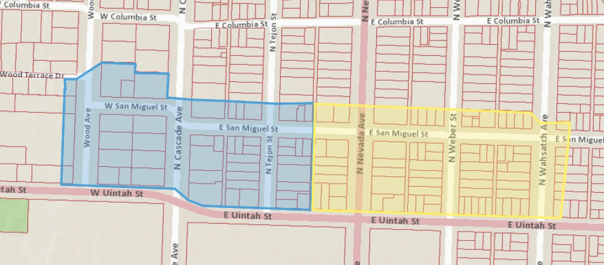
North of Uintah Street Study area

Slide 10
Meetings
June
 |  |  |  |  |  | 1
2 | 3 | 4 | 5 | 6 | 7 | 8
9 | 10 | 11 | 12 West ONEN | 13 East ONEN | 14 | 15
16 | 17 | 18 | 19 | 20 | 21 | 22
23 | 24 | 25 | 26 | 27 | 28 | 29
30

Slide 11
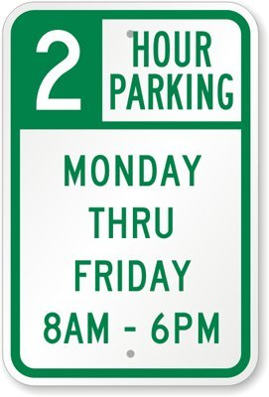
Time Managed Parking
Notes:
This type of system is useful near public areas such as parks, shopping centers, and schools. A time managed system places a limit on the length of time that a car is allowed to be parked within the area. Length of time can vary, days of week can vary, and holidays can be restricted. This is the most flexible option in our toolbox.
Signs will indicate when and for how long non-residents will be allowed to park on the streets

Slide 12
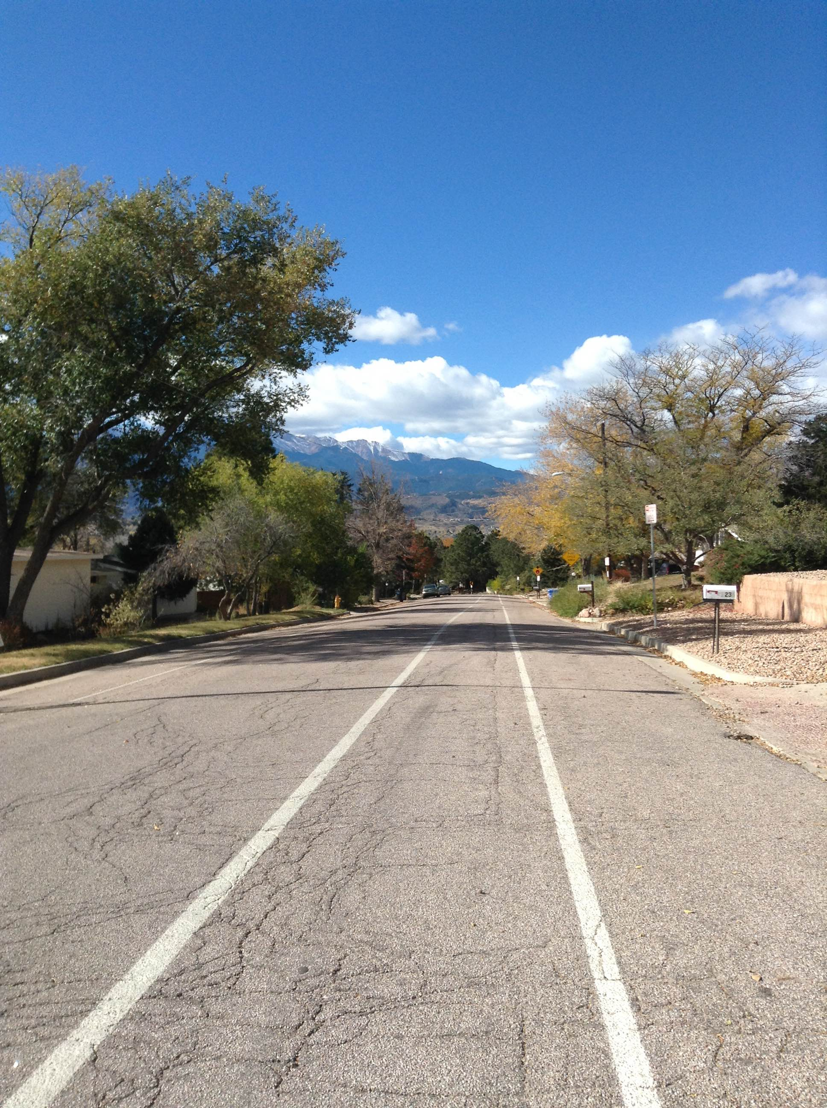
Notes:
Add new photo

Slide 13
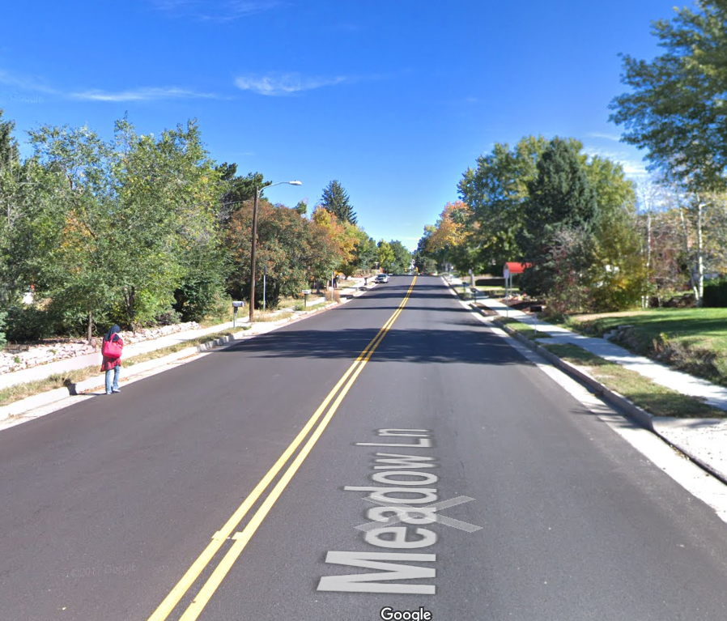
Notes:
Add new photo

Slide 14
Timeframe
Process: June/July
Implementation: July
Notes:
These are just some ideas to get you thinking about some of the options out there. We will be meeting with various block groups to find out what works the best for everyone. So bring your ideas to those meetings.

Slide 15
Concerns and Action Plan
Notes:
These are just some ideas to get you thinking about some of the options out there. We will be meeting with various block groups to find out what works the best for everyone. So bring your ideas to those meetings.

Slide 16
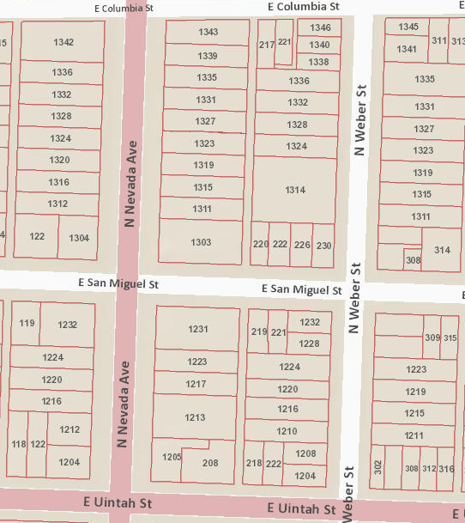

Slide 17
