Slide 1



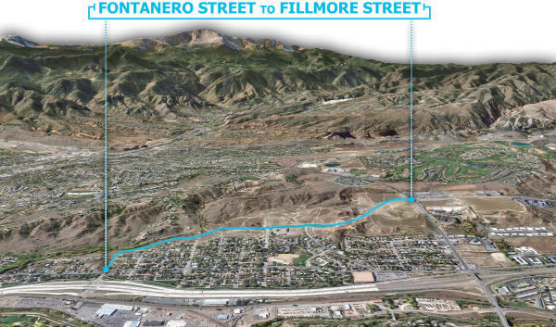
March 10, 2021
Centennial Boulevard Extension

Slide 2

Digital Meeting Guidelines
To avoid any disruptions or activities that otherwise delay or interfere with the meeting, participant microphones and videos will be disabled
Only the presenters will be sharing their screens
Kindly avoid any disruptions or activities that delay or interfere with the meeting
Time is designated at the end of the presentation for questions
    Use the Q&A function on the screen to type in your question
    Those participating by phone may text questions to 719-339-4109
    Provide your full name
Please limit questions and comments to the topic of tonight’s meeting.
We will attempt to answer all questions. Those questions that don’t get addressed due to time constraints can be emailed to: Monica@bachmanpr.com

Slide 3
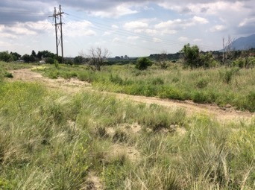
Agenda
Project Team
Public Outreach/Information
Project Benefits
Project Background
Construction Schedule
Corridor Map/Project Overview
Q&A

Slide 4
Project Team
Aaron Egbert, City Project Manager
Jason Bonini, AECOM Design Consultant Project Manager
Joe Roerkohl, AECOM Deputy Project Manager
Wes Suchsland, AECOM Design Manager
Lisa Bachman/Monica Ramey, Bachman pr, Public Outreach/Information

Slide 5
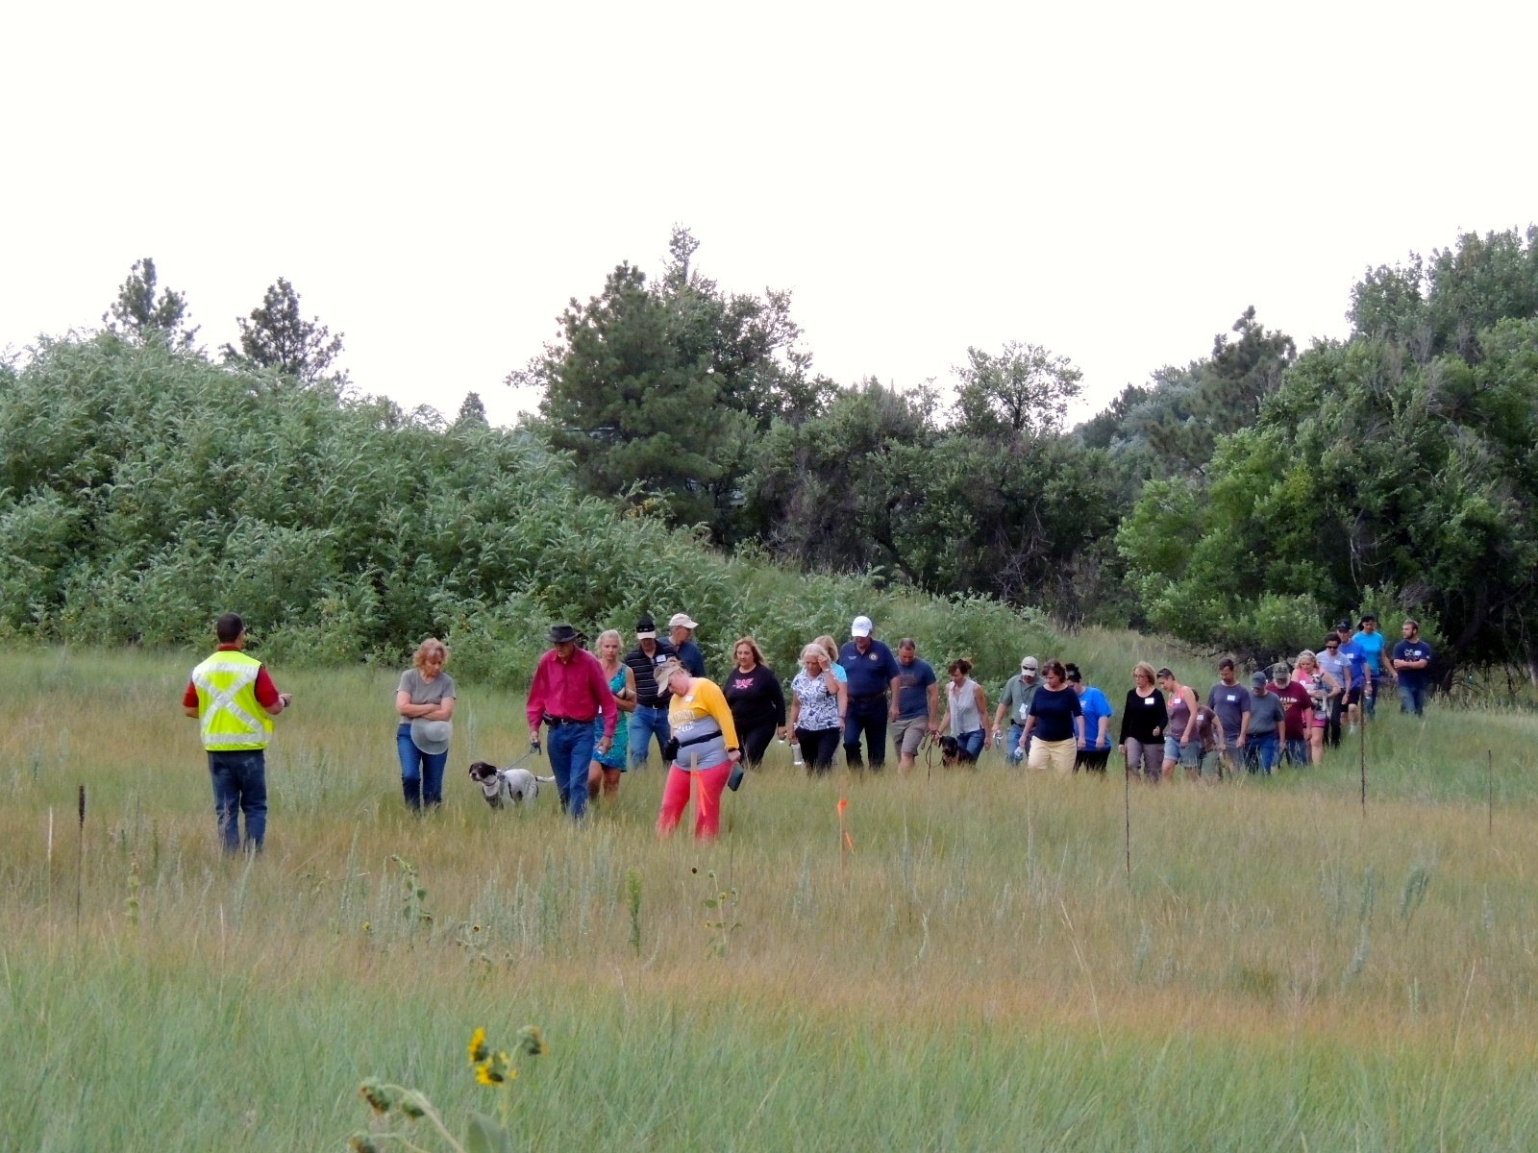
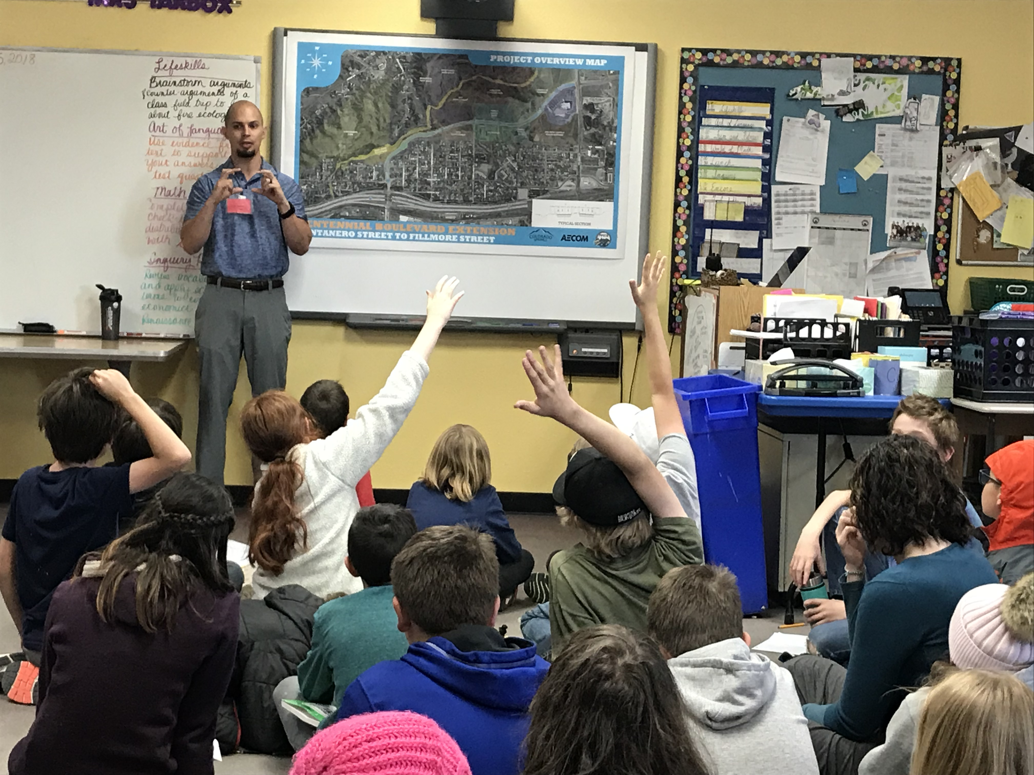
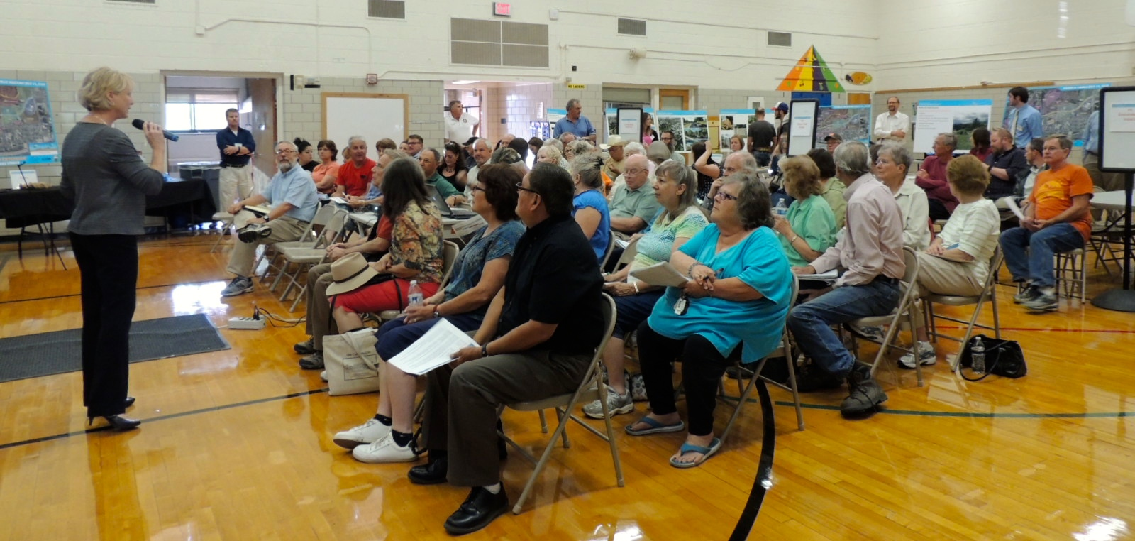
Public Outreach/Information
Website and e-newsletters
Stakeholder Outreach
One-on-One Meetings
Virtual Public Meetings
  March 10, 2021
  May/June 2021
Ongoing eNewsletter Project Updates throughout construction
Website: ColoradoSprings.gov/CentennialBlvdExtension

Slide 6
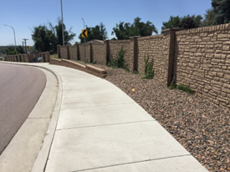
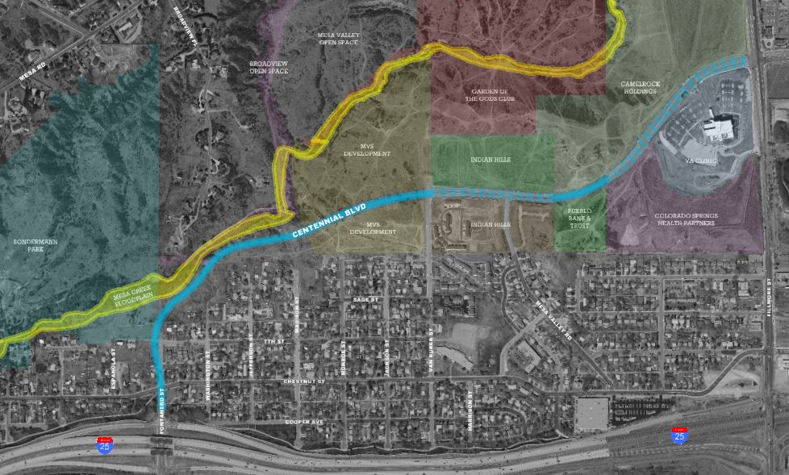
Project Benefits
Provide much needed connectivity and mobility options to the west side of Colorado Springs
Alleviate traffic congestion along Fillmore Street and Chestnut Street.
Enhance access to future and existing
residential developments, recreational
areas, and the Veterans Affairs Clinic
Improve quality of life for west side
residents

Slide 7
Project Background
Planned extension of Centennial Boulevard by the City since 1980’s
Originally a six-lane principal arterial, now a four-lane minor arterial
2015-2017 – Design and Public Involvement
Phase 1 Construction - Complete. Built missing segment from Fillmore Street to Van Buren Street in 2019.
Phase 2 Construction -
  MVS Voluntary Clean-Up (VCUP) is nearly complete.
  Construction of Centennial Boulevard extension from Van Buren Street to Interstate-25, including utility and drainage infrastructure, paving, pedestrian facilities, lighting, and landscaping.
  Construction north of Van Buren Street includes final striping, signage, pedestrian facilities, pavement rehab, lighting, and landscaping.

Slide 8
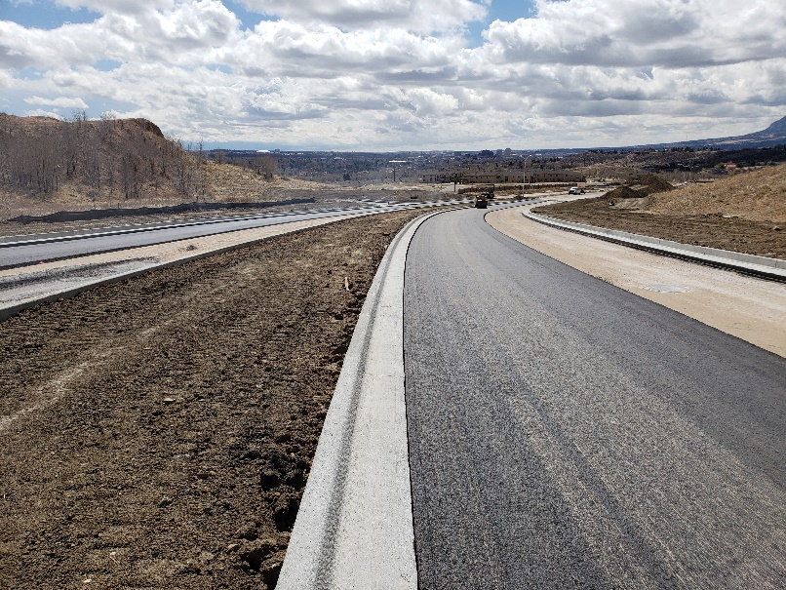
Complete: Overhead electric transmission lines moved underground
Feb/Mar 2021: MVS voluntary clean-up completed
Apr 2021: Contractor selection by the City
May/June 2021: MVS property grading work completed 7th Street to the northwest
Spr/Summer 2021: Road project construction start
2022/2023: Road project construction completed
Construction Schedule

Slide 9
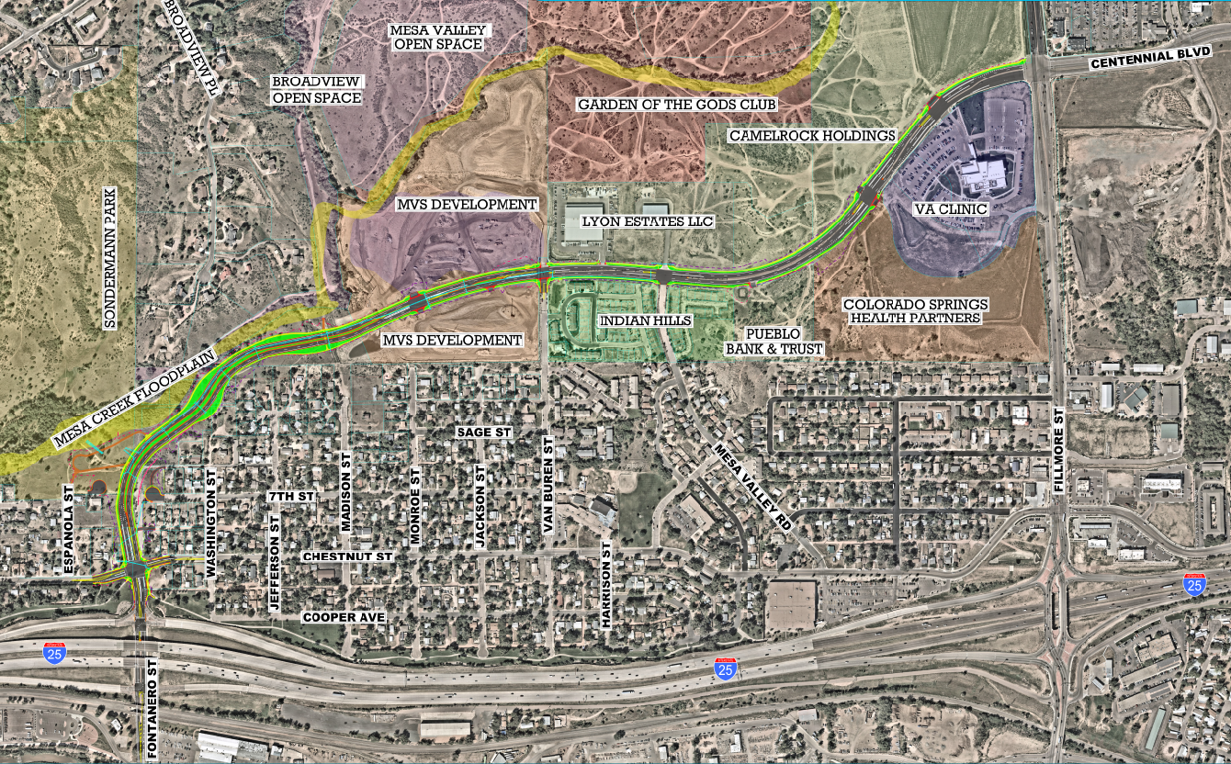
Corridor Map

Slide 10
Q&A
If participating by phone:
  Text your question to 719-339-4109
If participating online through MS Teams LIVE:
  Type your question into the Q&A function by clicking the icon on the screen
Ongoing construction eNewsletter updates and tonight’s PowerPoint presentation available on the project website:
Website: ColoradoSprings.gov/CentennialBlvdExtension

Slide 11
THANK YOU
Lisa Bachman and Monica Ramey, Public Involvement
lisa@bachmanpr.com, monica@bachmanpr.com
Aaron Egbert, City of Colorado Springs Project Manager
aaron.egbert@coloradosprings.gov
More information to come for May/June Public meeting with Contractor
Learn more throughout construction
Website: ColoradoSprings.gov/CentennialBlvdExtension

Slide 12
Website: ColoradoSprings.gov/CentennialBlvdExtension
To sign up to receive project updates by e-mail, send a request to monica@bachmanpr.com

