Slide 1


CDBG Public Facilities and Infrastructure
Applicant Presentation
September 25th 2020
City of Colorado Springs
Community Development Division
Presented by: Naomi Clark
Naomi.clark@coloradosprings.gov
Phone: 719-385-6609
Notes:
Good Afternoon,
My name is Naomi Clark and I am a team member with the Community Development Division for the City of Colorado Springs. This presentation is for the 2020 Community Development Block Grant for Public Facilities & Infrastructure funding.
Today’s presentation will provide detailed guidance and information needed for organizations to successfully determine their eligibility to apply for these funds.

Slide 2
Agenda
1. Funding and Grant Overview
2. Funding Priorities and Eligibility Requirements
3. Meeting a National Objective and Environmental Review
4. Federal Uniform Guidance and Construction requirements
5. Record Keeping Requirements
6. Application Information
Notes:
For today’s presentation we will start out with a brief overview of the Public Facilities and Infrastructure grant opportunity and overview of the Community Development Block Grant program. We will then provide information on the City of Colorado Springs priorities for the currently available grant funding, and speak about the elements to determine if a submitted project is eligible.
From there we will discuss how an applicant can determine of which national objective their project may fall within, and provide information on the process of determining the type and need for an environmental review. After, we will provide information on adherence to federal regulation and guidance for financial management control, construction regulations required to awarded applicants, and move on to information about reporting and record keeping requirements.
We will then end with information on what to consider before submitting an application, application information and requirements, and grant review details. So let’s get started!

Slide 3

Funding Overview
The Community Development Division is pleased to announce the start of the application period for CDBG Public Facilities and Infrastructure proposals for the 2020-2021 program year.
Who is eligible to apply?
Non-profit 501 (c) 3 organizations
Faith-based organizations
Public agencies
Funding Availability
Public Facilities and Infrastructure
$1,000,000
Minimum request amount
$ 250,000
For more information please visit: www.coloradosprings.gov/community-development
Notes:
The Community Development Division is pleased to announce the start of the application period for CDBG Public Facilities and Infrastructure proposals for the 2020-2021 program year.
For this funding cycle the City has made $1 million dollars available to be awarded in our community for eligible projects, with a minimum project ask of $250,000. Along with this presentation for additional details on the funding availability please visit our website link (www.coloradosprings.gov/community-development) for details.

Slide 4
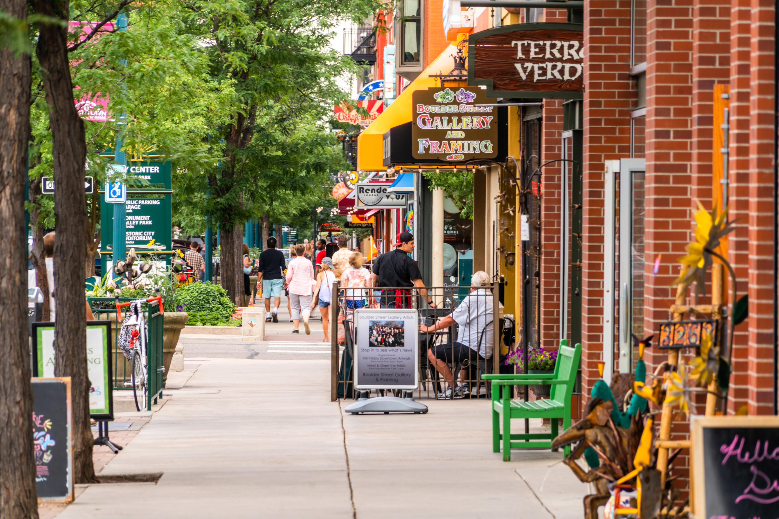
Community Development Block Grant
Community Development Block Grant (CDBG) funds are provided by the U.S. Department of Housing and Urban Development (HUD) in order to improve local communities by providing decent housing, improved infrastructure, public facilities and services, and improved economic opportunities. Federal law requires that these housing and community development grant funds meet a national objective by benefitting primarily low- and moderate-income residents, preventing or eliminating slums or blight, or by meeting an urgent need from a declared disaster.
The Community Development Division manages the City of Colorado Springs entitlement funds from the U.S. Department of Housing and Urban Development. Our mission is to create strong, sustainable, inclusive communities and quality affordable homes for all people in Colorado Springs.
For more information please visit: https://coloradosprings.gov/community-development
Notes:
The Community Development Block Grant Program (CDBG) was authorized under Title I of the Housing and Community Development Act of 1974. The focus of the program is to help develop viable urban communities, provide decent and suitable housing, and to expand economic opportunities to principally low-and moderate-income communities.
The Community Development Division manages the City of Colorado Springs entitlement funds from the U.S. Department of Housing and Urban Development. Our mission is to create strong, sustainable, inclusive communities and quality affordable homes for all people in Colorado Springs. To accomplish this, we manage multiple programs under CDBG: Public Services, Public Facilities and Infrastructure, Affordable Housing, and Economic Development. This application window is specifically for Public Facilities and Infrastructure.

Slide 5
Funding Priorities
1. Projects expanding access for people with disabilities
2. Projects identified in City or partnering organizations’ plans
These are projects that create or expand accessibility can include, but are not limited to:
ADA improvements for sidewalk, curb improvements, or trails
Facility improvements to meet ADA standards
Transit infrastructure
The Community Development Division aims to use Public Facility and Infrastructure funds to support already publicly vetted plans that serve to benefit vulnerable communities. Examples of these types of plans include, but are not limited to:
  PlanCOS
  HomeCOS
  Mill Street Neighborhood Plan
  Age Friendly Colorado Springs
  Academy Boulevard Corridor: Great Streets Plan
Notes:
For each grant cycle the City outlines the funding priorities for awarding to ensure funds are impactful and effective within our community. For the current CDBG Public Facilities and Infrastructure grant funding the City has outlined the following priorities:
The first priority are those projects that expand access for people with disabilities. These will be projects that expand or create opportunities for increased accessibility, and can include but are not limited to:
Curb improvements, trails, and ADA compliant sidewalks
Improvements to facilities to assist in meeting ADA standards
And transit infrastructure such as stops, signage, right-of-way improvements, and furnishings
The second priority are those projects identified in City or partnering organizations’ plans. This priority aims to utilize grant funds to support plans that have already undergone a robust public process, and serve our most vulnerable communities. Examples of these types of plans include:
PlanCOS
HomeCOS
The Mill Street Neighborhood Plan
Age Friendly Colorado Springs
And the Academy Boulevard Corridor: Great Streets Plan
Both of these priorities are meant to reach as many citizens within our community, particularly those within vulnerable communities, and to help bolster projects that our citizens have vetted and advocated for.

Slide 6
CDBG Public Facilities & Infrastructure:
Project Eligibility
Who may apply?
Non-profit 501 (c) 3 organizations
Faith-based organizations and/or;
Public Agencies
What is considered a public facility/infrastructure?
All facilities and infrastructure that are publicly owned or owned by a non-profit. Regardless of ownership, facilities must be open to the public during normal working hours.
Project Requirements
Be located within the Colorado Springs limits Serve low-income communities by being located in a majority LMI (51% or over) Census tract and/or Serve populations presumed to be low-income such as: People experiencing homelessness Victims of domestic violence Seniors Migrant Workers Refugees Disabled adults
Eligible Types of Projects
Broadband access Infrastructure improvements (construction or installation) including, but not limited to streets, curbs, and water and sewer lines; Neighborhood facilities including, but not limited to public schools, trails, libraries, recreational facilities, parks, playgrounds; Improvements for facilities for persons with special needs such as people experiencing homelessness, victims of domestic violence, seniors, migrant workers, refugees, disabled adults, etc.
Notes:
Now lets discuss some basic eligibility requirements and project information specific to the CDBG Public Facilities and Infrastructure grant program.
Who is eligible to Apply?
At this time Organizations whom qualify as either a:
Non profit 501 (c) 3 organizations
Faith based agency and/or-
Public Agency are eligible to apply for these grant funds.
Now you may ask what is considered a public facility/Infrastructure?
All Facilities and infrastructure that are publicly owned or owned by a non profit. Regardless of ownership regulations stipulate that the facility must be open to the public during normal working hours.
In addition to those requirements projects must also be:
Located within Colorado Springs city limits, of which 51 % of those served must be in a low income community and be located within a majority low-moderate income census tract, and serve population presumed to be low income such as:
People experiencing homelessness
Victims of domestic violence
Seniors
Migrant workers
Refugees and
Disabled adults
Now what types of projects could be eligible for this funding? Some of the eligible projects could include:
Broadband access
Infrastructure improvements (construction or installation) including, but not limited to streets, curbs, and water and sewer lines
Neighborhood facilities including, but not limited to public schools, trails, libraries, recreational facilities, parks, playgrounds
Improvements for facilities for persons with special needs such as people experiencing homelessness, victims of domestic violence, seniors, migrant workers, refugees, disabled adults, etc.
It is important to note that before an organization wishes to proceed with their application, contact is made with the community development team on the type and scope of the proposed project.

Slide 7
Low-Moderate Clientele (LMC) Benefit
At least 51% of clients served qualify as LMI Documentation: Intake forms, verification of clients’ family size and income.
Having income eligibility requirements that limit the service to persons meeting the LMI income requirement. Documentation: agency’s procedures, intake/application forms, etc.
Providing services to groups primarily presumed to be LMI such as abused children, battered spouses, elderly persons, severely disabled adults, etc.
Being of such a nature and in a location that it may be concluded that the activity’s clientele are LMI. Examples: Homeless shelters, refugee housing, etc.
Low-Moderate Area (LMA) Benefit
Projects that take place in a primarily low-income, residential census tract
Service area that serves primarily low-income residents. Documentation: maps showing project service areas, LMI census tract verification
If the public facility serves a primarily residential area, it must meet LMA benefit criteria even if it is also providing jobs for low-and moderate-income residents.
Most infrastructure projects will fall within this national objective.
Meeting a National Objective
Notes:
Now let’s talk about meeting a national objective. The CDBG program’s entire mission is to serve low-income communities. All CDBG Public Facilities and Infrastructure funding requests received by the City must meet the objective of benefitting low to moderate income (LMI) persons. There are different standards by which jurisdictions and their subrecipients can meet this, depending on the program and activity types. In the application, we’ll ask you to choose which benefit your program fits:
Low-Moderate Clientele benefit
These are projects that meet or serve the following:
At least 51% of clients served qualify as LMI, as evidenced by documentation and data concerning the beneficiaries family size and income.
There are income eligibility requirements that limit the service to persons meeting the LMI income requirement. This can be evidenced by the administering agency’s procedures, intake/application forms and other sources of documentation.
Services are provided to groups primarily presumed to be LMI such as abused children, battered spouses, elderly persons, severely disabled adults, etc.
AND, projects are of such a nature and in a location that it may be concluded that the activity’s clientele are LMI.
The second national objective ( and to note the objective that almost all applicants for grant funding will fall within) is the Low-Moderate Area Benefit. Under this objective projects will:
Take place in a primarily residential census tract
Keep records of the qualifying activity( boundaries of service area, documentation that the area is primarily residential in nature, and income characteristics of households in the service area) and lastly;
If the public facility serves a primarily residential area, it will meet area benefit criteria even if it is also providing jobs for low-and moderate-income residents.

Slide 8
Meeting a National Objective
Low-Moderate Income Clientele (LMC) Benefit
Who is considered LMI? Client income eligibility is determined by HUD’s annually updated income limits. For more info, visit https://www.huduser.gov/portal/datasets/il.html. Choose current “IL Documentation” button and search by Area/MSA.
Low-Moderate Income Area (LMA) Benefit
How do I identify an LMA area benefit? Area benefit is defined by HUD’s outlined service map areas and guidance on area benefit determination. For more information on how to demonstrate an LMA benefit please visit: https://www.hudexchange.info/programs/acs-low-mod-summary-data/ . To access data on HUD LMA service areas please visit: https://hud.maps.arcgis.com/home/item.html?id=ffd0597e8af24f88b501b7e7f326bedd
Notes:
There are several resources for organizations to determine which national objective their proposed project may fall within. For example: Client income eligibility is determined by HUD’s annually updated income limits. Information on these limits is located on the link above under IL documentation, and by searching by area.MSA.
For those projects that fall within the Low-moderate income area benefit, HUD outlines service map areas and guidance on benefit determination. We encourage you to provide your own service area map, and to utilize the mapping tools provided here to verify that it falls within CDBG-eligible census tracts. if you require additional guidance and assistance in doing so, please reach out to us before submitting your application.

Slide 9

Grant Overview for Applicants
2 CFR 200 Part F
In addition to adherence to 2 CFR part 200, projects must also adhere to federal regulations involving the processes involving acquisition, design (or other professional services) and construction. These regulations include:
Uniform Relocation Act
Davis Bacon Labor Standards
Section 3 and M/WBE Outreach
Environmental reviews
This Subsection of Chapter 2 of the Code of Federal Regulations specifically outlines the uniform administrative requirements, cost principles, and audit requirements for federal awards. This regulations provides guidance on:
Internal controls
Standards for financial management
Cost principles
Audit requirements
Procurement standards
Conflict of Interest
Program income
Direct and indirect costs
For more information please visit HUD guidelines on 2 CFR 200 Part F: https://www.hud.gov/sites/documents/CFR200.PDF
Do you need to:
relocate tenants,
hire firms,
break ground, or
bid your project?
Notes:
For all applicants and awardees it is important that they have taken the time to review the Overview for grant awardees. This is a subsection of chapter 2 of the Code of Federal Regulations specifically outlines the uniform administrative requirements, cost principles, and audit requirements for federal awards. If this sounds foreign to you in your role, you might need to sit down with your finance officer or CPA to go over this guidance and be sure that your organization complies.
These regulations go over:
Internal Controls
Standards for Financial Management
Cost Principles
Audit Requirements
Procurement Standards
Conflict of Interest
Program Income
Direct and Indirect Costs
It is critical that applicants understand these requirements in order to receive a federal award.
In addition to adherence to 2 CFR 200 part F, projects must also adhere to federal regulations involving the processes of acquisition, design( or other professional services) and construction. CDBG grants are reimbursement grants. Even after award, no reimbursement request will be approved unless proper procedures were followed every step of the way, from how a project was bid out to whether your construction contractor submitted their certified payroll.
Regulations to get familiar with before applying include the following. Please note that upon award, staff will go through these procedures in much more detail for you and your project manager.
Uniform Relocation Act - these regs shape the process for projects that may temporarily or permanently displace people. For example, if you need to rehab residential units that will put the tenants out for a bit, you need to understand the notification process, housing standards, and general responsibilities for all parties. The URA comes into play for a variety of scenarios, so if you have any questions about yours, please reach out to us to schedule a separate appointment prior to submittal.
Davis Bacon Labor Standards – Davis Bacon Labor Standards are in place to assure prevailing wage rates are used to pay workers competitive and transparent wages. These regs affect the bidding process and monitoring of construction.
Section 3 Outreach – It is important to market and award these contracting opportunities in an equitable way that benefits firms and contractors that employ neighborhood residents where the project is taking place or is owned by neighborhood firms and/or by minority- or women-owned enterprises.
Environmental reviews – we will cover that in the next slide.

Slide 10
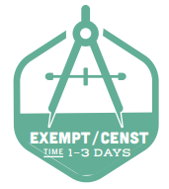
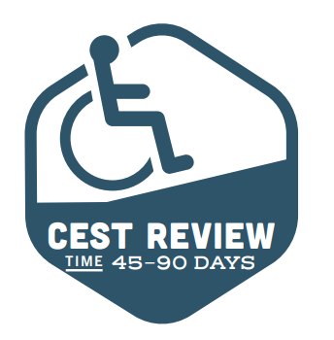
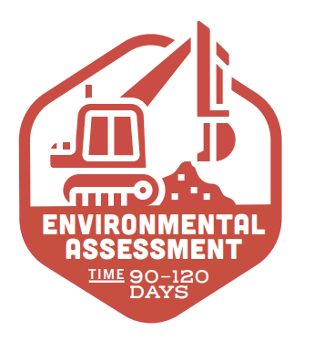
ENVIRONMENTAL REVIEWS
VERY IMPORTANT:
If you are thinking about applying for public facilities funds, DO NOT demolish anything, start digging on your site, or start construction without taking to staff. This could disqualify you for HUD funds.
What is an environmental review?
An environmental review considers the potential impact a proposed project could have on the surrounding area, and the impact the surrounding area could have on the proposed project.
How do I know if our organization needs to complete an environmental review?
All HUD-funded activities are subject to some level of environmental review. The more digging and heavy construction activity proposed, the more in depth the environmental review.
What is the purpose of this review?
This review ensures that HUD-funded projects are in compliance with the National Environmental Policy Act (NEPA) and related federal, state, and local laws.
What type of environmental review will our project need?
The type and scope of the project will determine the level of environmental review required. Review the Environmental Review Overview for more information on environmental review levels. The Environmental Review Overview can be found at www.coloradosprings.gov/community-deevelopment
Notes:
VERY IMPORTANT:
If you are thinking about applying for public facilities funds, DO NOT demolish anything, start digging on your site, or start any construction without taking to staff. This could disqualify you from receiving HUD funds. Now you ask, why can this disqualify you? Depending on the activities proposed, sites and buildings need to go through a thorough historic preservation and tribal consultation process. Even if you don’t think something is historic, this check is necessary before beginning ANY construction activities.
What is an environmental review?
An environmental review considers the potential impact a proposed project could have on the surrounding area, and the impact the surrounding area could have on the proposed project.
What is the purpose of this review?
This review ensures that HUD-funded projects are in compliance with the National Environmental Policy Act (NEPA) and related federal, state, and local laws.
How do I know if our organization needs to complete an environmental review?
All HUD-funded activities are subject to some level of environmental review. The more digging and heavy construction activity proposed, the more in depth the environmental review.
What type of environmental review will our project need?
The type and scope of the project will determine the level of environmental review required. Review the Environmental Review Overview for more information on environmental review levels. The Environmental Review Overview can be found in the Public Facilities NOFA announcement page at www.coloradosprings.gov/community-development

Slide 11
Record Keeping and Reporting
Types of records/documentation subrecipients need to keep:
Administrative records
Financial records
Project/case file records
How long must records be kept?
Records must be maintained for the duration of the awarded grant plus 6 years. At any time the City of Colorado Springs reserves the right to request these records for review.
Requests for reports may be:
Monthly
Quarterly or;
Yearly
Additionally monitoring documentation may be requested upon desk or in person visits.
How are records to be kept?
Records are to be:
Accurate
Complete and;
Orderly
Notes:
Record Keeping
HUD requires that the City of Colorado Springs keep records on file that are accurate, complete, and orderly. As such, all awarded organizations are also responsible for maintaining their records in the same accurate, complete, and orderly fashion. Subrecipients are responsible for maintaining records in at least 3 major categories:
Administrative Records
Financial Records
Project/Case Files
IMPORTANT: These records must be maintained for the duration of the awarded grant plus 6 years. At any time the City of Colorado Springs reserves the right to request these records for review.
Reporting
Requests for reports may be:
Monthly
Quarterly
Monitoring documentation request
Applicants should understand that if awarded their performance in maintaining accurate, complete, timely, and orderly reports and records will be evaluated as a part of not only the award process, but continued opportunities for funding in the future.

Slide 12
Before Submitting your Application
Has our organization applied for funding before? What were some of the challenges and triumphs in the administration of those funds? | Will we be able to gather all the required documentation for the application and if awarded approval by the specified deadlines? | Does our organization have the cash flow to manage a reimbursement grant?
Is this financially feasible? Have we explored all our options for funding outside of HUD grant programs? If we are not approved for grant funding how would we fill the gap? | For acquisition projects: Will this project displace anyone and have we reviewed the Uniform Relocation Act requirements before starting this project? | Can we commit to procuring this project by federal standards and following all Davis-Bacon labor regulations
Are we able to make a case for meeting the national objective and how specifically will that impact the Colorado Springs community? How many people will be served by these funds? | If awarded, how ready is our organization to start the proposed project? Can we complete it in a reasonable amount of time? | Are we prepared to handle reporting, audit, fiscal, and monitoring requirements for utilizing federal funds? If we were to lose support staff in these areas, do we have a backup plan for staying compliant?
Notes:
There are many considerations we ask organizations and agencies to weigh before submitting an application. These include things such as:
Has our organization applied for funding before? What were some of the challenges and triumphs in the administration of those funds?
For acquisition projects: Will this project displace anyone and have we reviewed the Uniform Relocation Act requirements before starting this project?
Are we prepared to handle reporting, audit, fiscal, and monitoring requirements for utilizing federal funds? If we were to lose support staff in these areas, do we have a backup plan for staying compliant?
And Is this financially feasible? Have we explored all our options for funding outside of HUD grant programs? If we are not approved for grant funding how would we fill the gap?
We encourage applicants to work with the boards, finance, programming and/or grant staffing teams to facilitate a discussion about these considerations before submitting an application. In doing so this will allow all members of the organization to gain a full picture of the project, funding, time commitment, and resources available to manage a HUD funded project. This may also help determine if this type or grant funding is appropriate for the organization as a whole.

Slide 13
IMPORTANT: BEFORE you enter or submit an application, please attend one of the three office hour sessions to discuss basic eligibility information, and schedule a separate phone call with the community development division to discuss the details of the project.
Notes:
CDBG Public Facility and Infrastructure projects have a high impact not only on our citizens and dynamics of our community, but upon the physical environment and well being of our landscape as well. As such, being good stewards of this funding to be impactful to our citizens, but having minimal impact to our beautiful landscape is important. The community Development division highly encourages any organization or agency that is interested in applying for funds to:
First, sign up for one of three office hours sessions to be help virtually. These sessions are specified to be open to all applicants and provide a platform to answer basic eligibility and guidance questions.
Second, and more important, we encourage organizations to speak with CDD staff about the scope and details of their proposed project BEFORE submitting an application, committing funds, or performing environmental reviews IF such project will depend on HUD grant funds. The nature of these projects are very detailed and very extensive (in most cases) and City staff would like to field specific project/organizational questions as soon as possible.

Slide 14
Submitting An Application
Neighborly Software
SAM registration
DUNS #
Please visit https://portal.neighborlysoftware.com/coloradospringsco/Participant to register for your online profile and complete the grant application. IMPORTANT: All grant applications must be submitted through the online portal. No paper applications accepted.
All applicants must be registered under the system for award management to do business with the U.S. government. Please visit: www.SAM.gov to register your organization.
All Applicants must have a registered DUNS number to be a grant awardee. Please visit: https://fedgov.dnb.com/webform/ to check or receive your DUNS number.
Notes:
Neighborly: All applicants must register through the city’s online grant application platform Neighborly software. Please visit https://portal.neighborlysoftware.com/coloradospringsco/Participant/Login to register for your online profile and complete the grant application. IMPORTANT: All grant applications must be submitted through the online portal. No paper applications accepted.
SAM registration: All applicants must be registered under the system for award management to do business with the U.S. government. Please visit: www.SAM.gov to register your organization.
DUNS #: All Applicants must have a registered DUNS number to be a grant awardee. Please visit: https://fedgov.dnb.com/webform/ to check or receive your DUNS number.
These are some of the very first checks for eligibility that staff conducts before moving projects on for external review, so make sure your registration is active and up to date. Important: We highly recommend you complete your SAM.GOV registration as soon as possible due to backlogs as a result of COVID-19.

Slide 15
Submitting an Application
Digital Office hours:
Oct. 5th: 10:00am-11:30am
Oct. 7th : 1:30pm-3:00pm
October 9th: 9:30am-11:00am
Applicant presentation available on September 28th at 5pm
Notices of Award or Denial for all applicants will occur approximately 5-7 business days after the Application review has completed.
Notice of Funding Availability Release
September 25th 2020
Submission Deadline
&
Application Review
The notice of funding availability release and Neighborly Portal access begins. For more details visit:
www.coloradosprings.gov/community-development
Applications are due on October 16th 2020 by 11:59pm MST.
Grant application review will begin on October 19th and last up to 8 weeks.
Applicant Presentation
& Office Hours
Applicant Status Notifications
Notes:
Please see the following timeline which provides an overview of the grant funding process.
On September 25th the Notice of Funding Availability became available on the Community Development website within the announcements section on the right hand side of the webpage. Please take a moment to review this information. Additionally all resources, to include this presentation, the applicant guide, and the environmental review guide will be available on this webpage as well.
Digital office hours
Oct. 5th: 10:00am-11:30am
Oct. 7th : 1:30pm-3:00pm
October 9th: 9:30am-11:00am
Applicant presentation available on September 29th at 5pm
Applications are due October 16th by 11:59pm MST. No paper applications will be accepted and no exceptions. The grant application review process will begin on October 19th and last approximately 8 weeks. We understand the urgency of notifying applicants on the status of their funds, and ask for the opportunity to fully complete the review process.
Once applicants are selected for approval or denial notifications via mail and email will be sent to all those who applied.

Slide 16
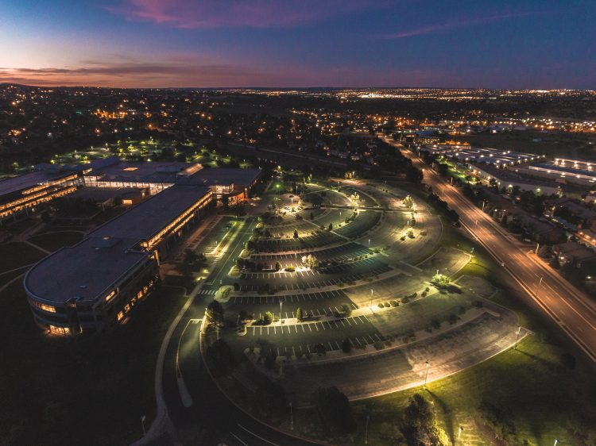
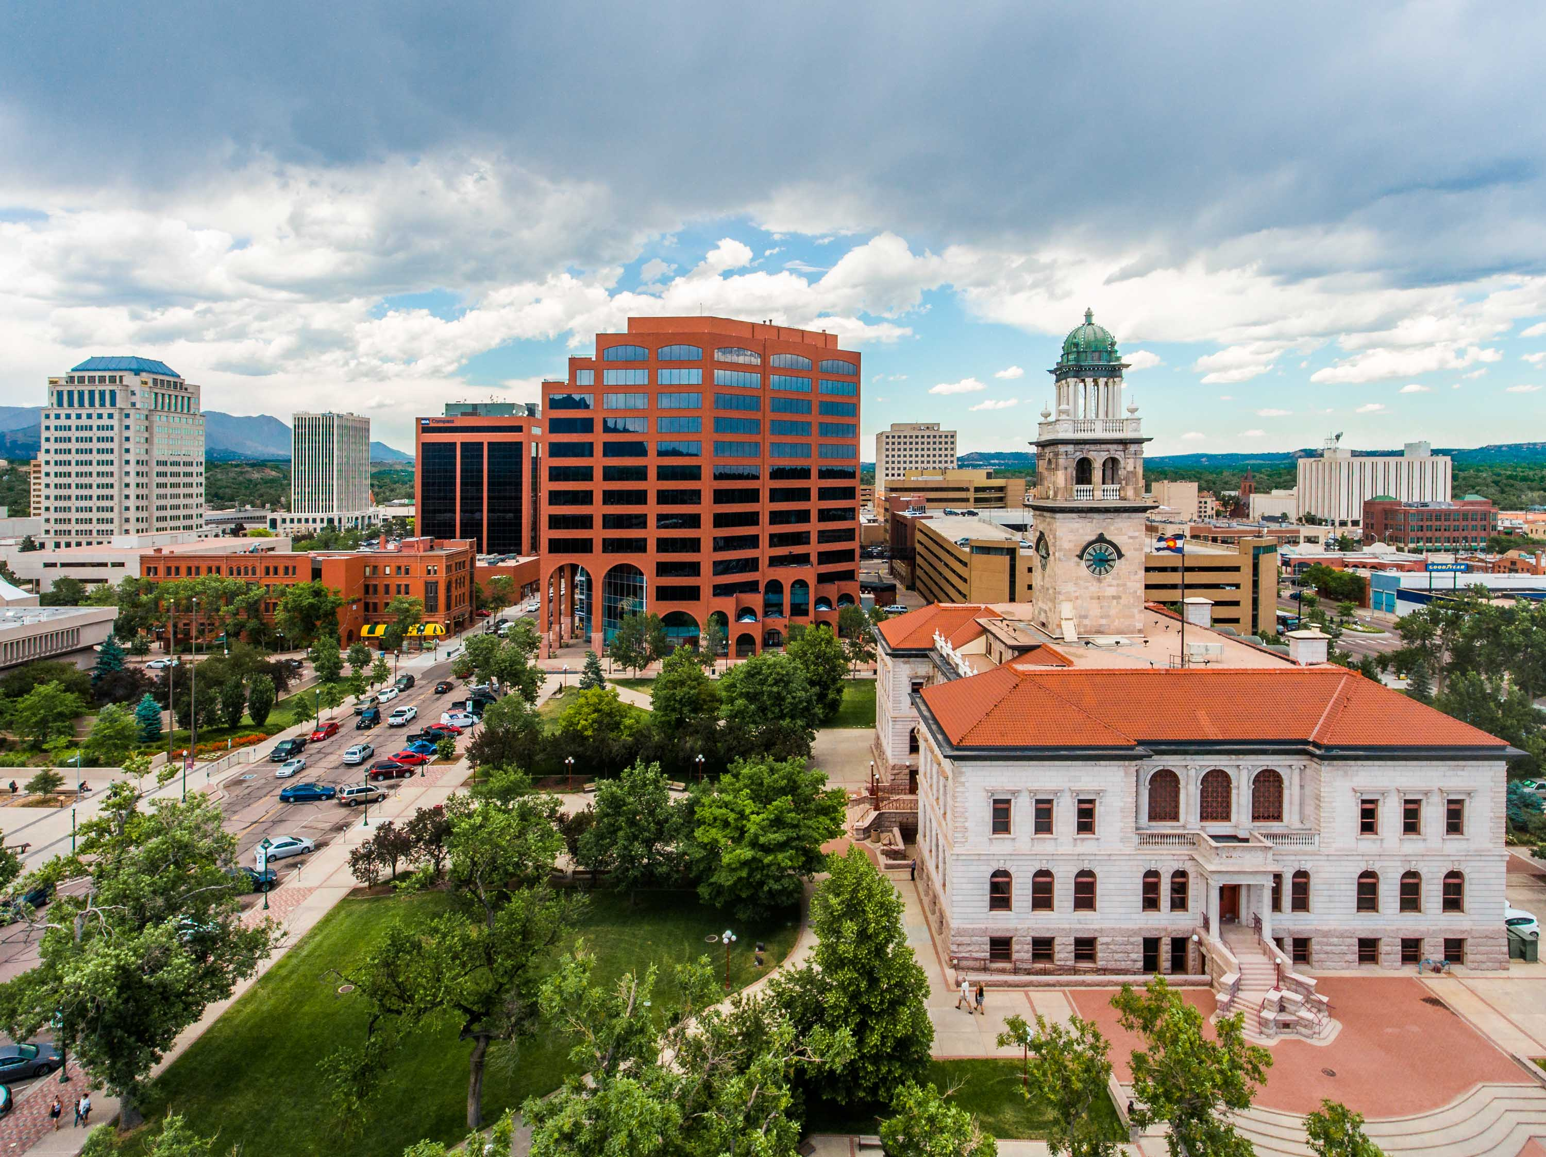
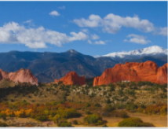
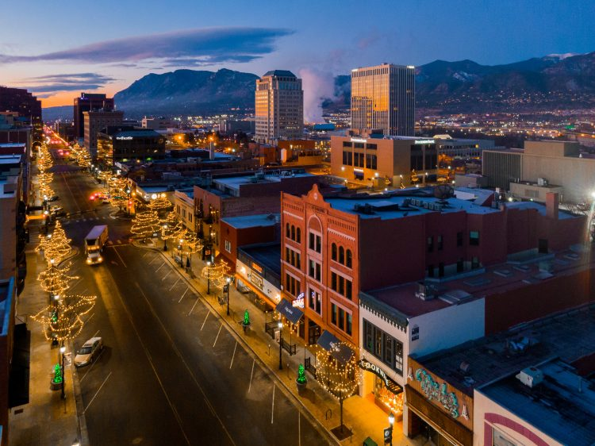
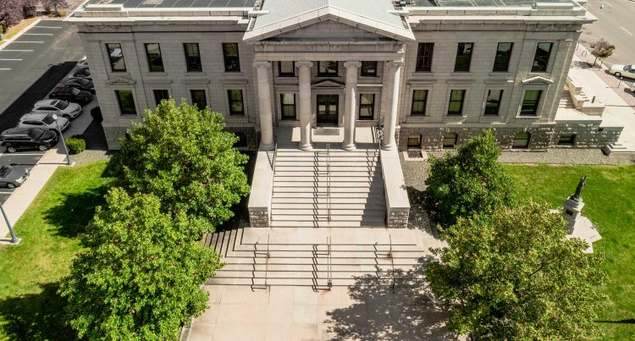
Grant Application Review
Does the facility/infrastructure project meet one of the outlined City Priorities?
Are there measureable outcomes?
Does it meet a national objective?
Is the project and/or associated costs eligible?
What is the measureable outcome?
What is the experience of the project manager?
Is this project financially sustainable and feasible?
There are several factors that both internal and external review teams consider when selecting and application for award. Some of the factors considered are:
What is the need/justification for the facility or infrastructure project?
Does it expand accessibility?
Does the application provide a detailed project description?
Notes:
Once an organization submits an application, what exactly will both internal and external review committees consider to approve your request? Below are some review criteria by which your applications are scored:
How well does your request align with the funding priorities outlined by the city?
By Meeting national objective and eligibility means you can correctly document that you serve low-income residents and that your costs are allowable under CDBG regs.
Project Description- this is where you make your case. Who else is doing this work? What are the consequences of not funding your program?
Be specific about what you’re asking for and how it fits with a larger project
It’s a good idea to have Measurable Outcomes, but make sure they align with HUD outcome measures. Does the project have measurable outcomes?
Accessibility – are your services and facilities accessible to anyone who qualifies? How does this expand accessibility for our community?
Experience/Past Performance – The ability to handle different funding streams is important as well as meet HUD and City guidance. How has the organization performed in the past? Were they timely? Were there any unresolved issues? What is the experience of the project manager?
Is this project financially sustainable and feasible?
And lastly, is the project eligible and/or are the costs associated with the project eligible?

Slide 17

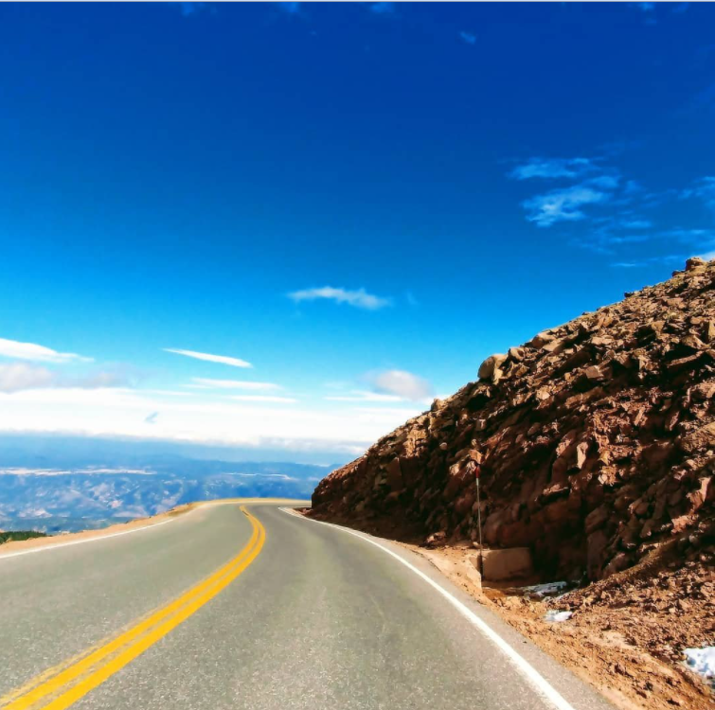
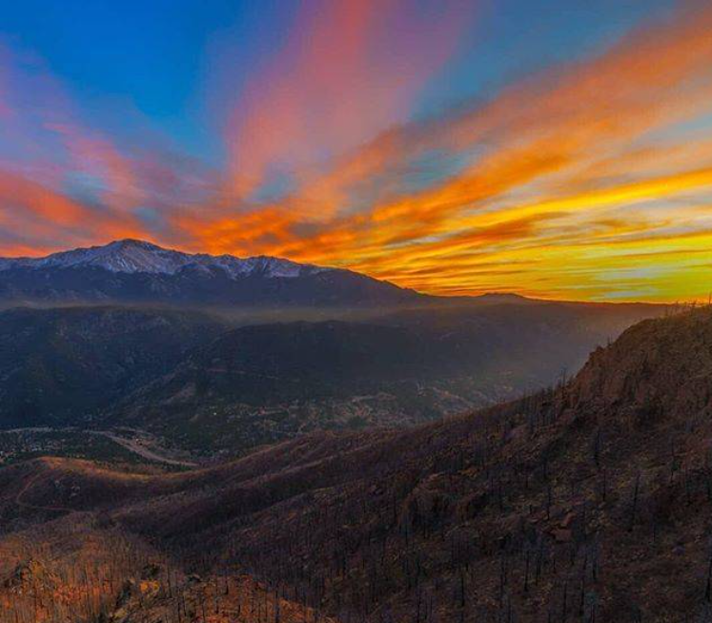
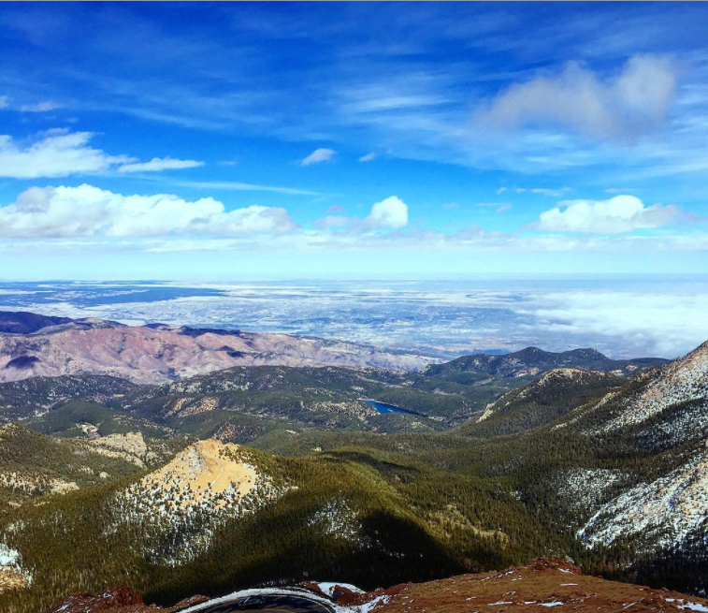
Thank you and Our Team
Catherine Duarte
Rose Lyda
Naomi Clark
Senior Analyst
Community Development Division
Rose.lyda@coloradosprings.gov
719-385-5340
Senior Analyst
Community Development Division
catherine.duarte@coloradosprings.gov
719-385-6876
Compliance Analyst II
Community Development Division
naomi.clark@coloradosprings.gov
719-385-6609
Notes:
On behalf of the Community Development Division, I want to thank you for taking the time to view this presentation. If you have any questions please feel free to contact any of our team members.

Slide 18
CREDITS
Presentation content, materials, resources, and information by: Naomi Clark- Compliance Analyst Community Development Division. City of Colorado Springs. Naomi.clark@coloradosprings.gov
Presentation template by Slidesgo
Icons by Flaticon
Infographics by Freepik
Images created by Freepik and mrsiraphol -Freepik
Author introduction slide photo created by Freepik
Text created by Freepik.com

