Slide 1
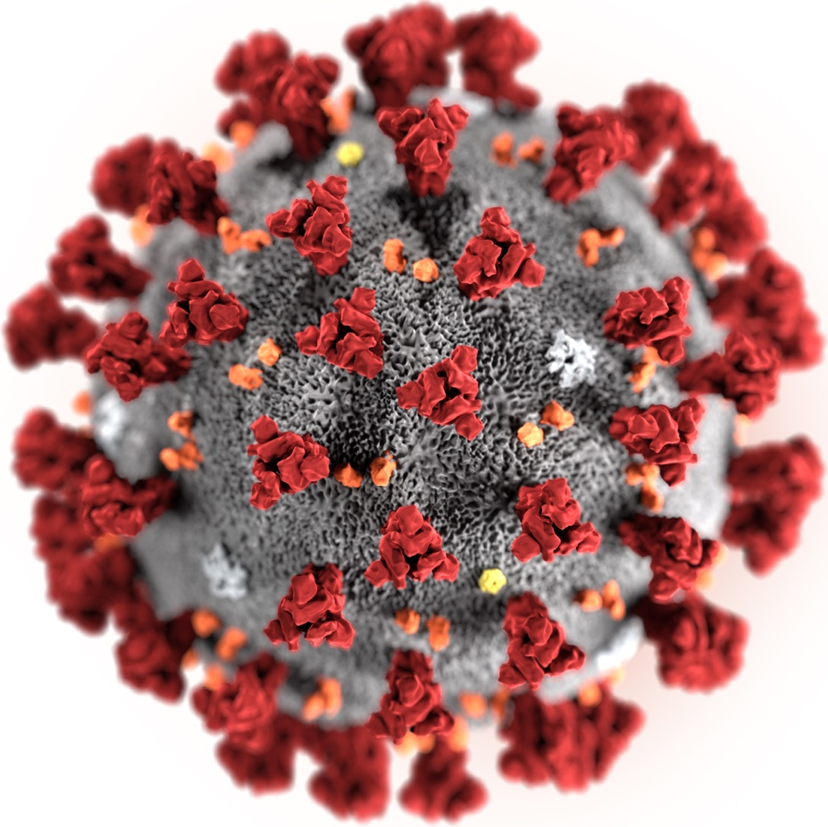

Colorado Springs City Council
COVID-19 Update
Presented by: Susan Wheelan, El Paso County Public Health Director and Dr. Leon Kelly, El Paso County Public Health Deputy Medical Director/El Paso County Coroner
Compiled with assistance from: Dr. Robin Johnson, El Paso County Public Health Medical Director and the Public Health Data and Analytics Office
To: El Paso County Board of County Commissioners
Date: April 14, 2020

Slide 2
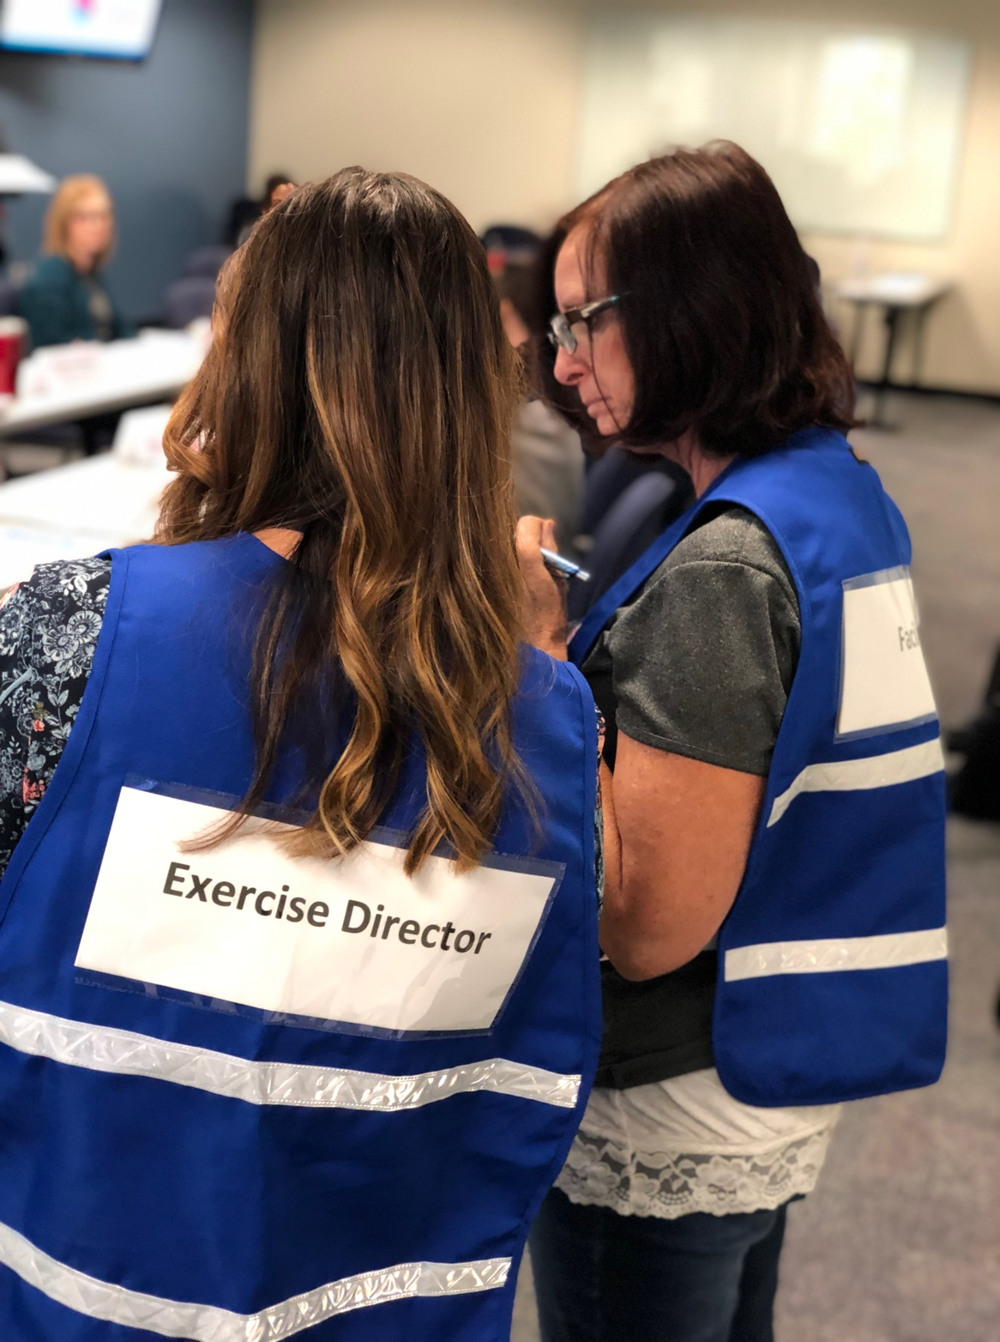
Where we are now
How Public Health Prepares for Emergencies: Robust Planning
Emergency preparedness and response is a key priority for Public Health
Public Health developed numerous preparedness and response plans after 9/11
All Public Health staff are required to complete incident command system and emergency preparedness training during the first three months of hire, and additional trainings as related to their role
Exercises are conducted to learn lessons and continually improve upon plans with state and local partners – including the Southcentral Healthcare Coalition
Nearly half of Public Health staff (78, or 49.5%) have been re-assigned to COVID response activities to mount and sustain robust COVID-19 response
Prevent • Promote • Protect
www.elpasocountyhealth.org
Notes:
Emergency preparedness and response is a key priority for Public Health. Part of preparedness is having plans and testing plans, with partner agencies. We began developing numerous preparedness and response plans after 9/11.
All staff are required to complete incident command system (ICS) and emergency preparedness training during their first 3 months of hire with the rationale that any employee could be activated to respond to a public health emergency outside of their normal duties at anytime We’ve conducted numerous exercises such as the 2017 PHED EX – Public Health Exercise in Dispensing – the focus was on distribution of the National Strategic Stockpile – we tested our ability to get supplies to regional partners and at the same time to local partners. That is just one of the relevant exercises and is also important to about abilities when we have a vaccine and hold Points of dispensing clinics.
Our Communicable Disease and Emergency Preparedness staff – which includes about 10 employees responsible for monitoring, limiting and stopping the spread of more than 60 reportable diseases – one being COVID-19 in El Paso County and our Emergency Preparedness staff are responsible for the southcentral region of Colorado - they have been monitoring the situation since late 2019 with the Southcentral Health Coalition and helping to lead this response.
To mount a robust, sustainable response to COVID-19 we’ve folded in additional staffing totaling nearly 80 members to date serving as part of the Pikes Peak Regional Office of Emergency Management. The current COVID-19 response demonstrates proactivity in implementing plans and utilizing our training to protect the community’s health, with an "all hands on deck" approach.
DON'T PLAN TO MENTION – just as example: We’ve conducted numerous Emergency Preparedness and Response planning events such as the 2017 PHED EX – Public Health Exercise in Dispensing – the focus was on distribution of the Strategic Stockpile – we tested our ability to get supplies to regional partners and at the same time local partners. A big win was getting supplies to our regional partners within 4 hours. We trained staff on inventory management, we also increased our closed PODs agreements and practiced ordering with over 40 agencies including El Paso County, USAA and Evans Military hospital.

Slide 3
Place Holder - FEMA Testing
COVID-19 Response Highlights
El Paso County Public Health
Planning and Response: Public Health has been leading the charge in organizing partners, including those from the Emergency Coordination Center (ECC), Incident Command System (ICS), Continuity of Operations planning, Emergency Preparedness, Coroner’s Office, Pikes Peak Regional Office of Emergency Management (PPROEM) and the Joint Information Center (JIC).
Disease Control: Working around the clock to investigate and conduct contact tracing of cases, issue isolation and quarantine letters, and identify proactive strategies for high-risk populations.
Data analysis and research: Public Health Data team has been developing models and projections, working actively with hospitals, researching and studying COVID-19, guiding science and data-driven decisions.
  This week we will be launching a new data dashboard live on our public-facing website
Communication: Presenting accurate, transparent and credible information in this unprecedented pandemic and fast-paced, evolving situation.
Education: Educating partners, citizens, businesses and people about etiology, epidemiology and appropriate standards of response to COVID-19.
Prevent • Promote • Protect
www.elpasocountyhealth.org

Slide 4
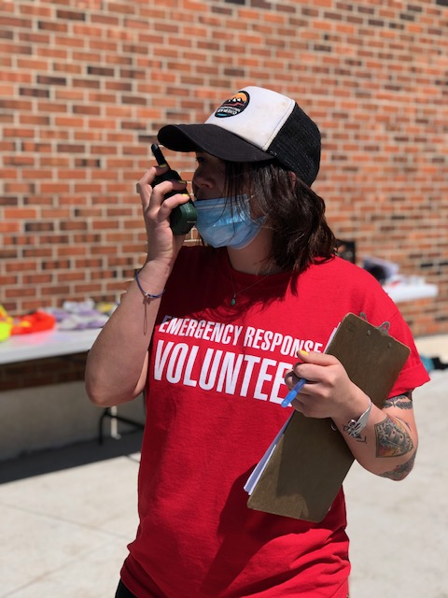
COVID-19 Response Highlights
Collaboration
Public Health Partners in the Community
Pikes Peak United Way: Providing staff for the highly-utilized public call center for El Paso and Teller Counties. Providing financial assistance to residents including through the PPUW and Pikes Peak Community Foundation Emergency Response Fund.
PPROEM: Facilitating PPE (personal protective equipment) and cloth mask donation drives for first responders and emergency staff.
Local Food Assistance: The Salvation Army, COSILoveYou, Pikes Peak United Way, Care and Share Food Bank, Colorado Springs Food Rescue and Silver Key providing a variety of food assistance programs to those in need and the elderly.
Prevent • Promote • Protect
www.elpasocountyhealth.org

Slide 5
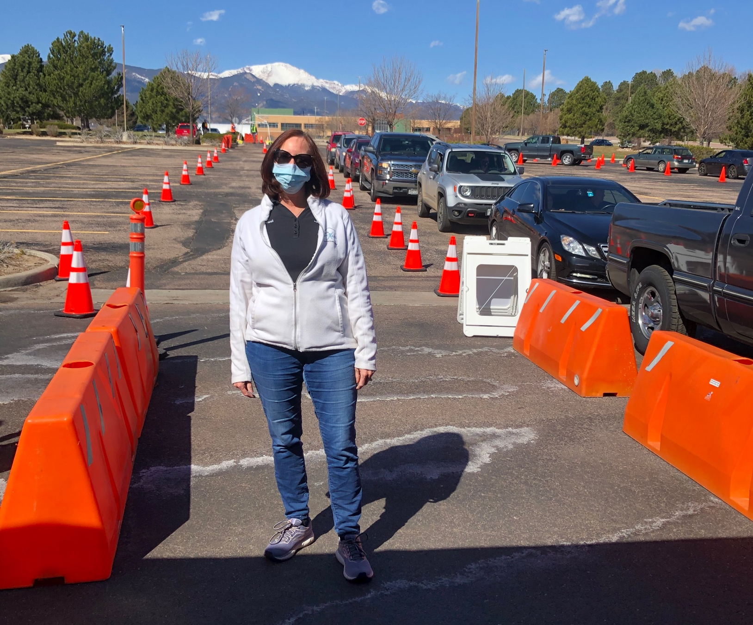
COVID-19 Response Highlights
Collaboration
Public Health Partners in the Community
Coroner’s Office: Ten Coroner’s investigators assisting in epidemiological investigations and Dr. Leon Kelly serving as Deputy Medical Director.
UCCS Beth-El College of Nursing: 35 students and 5 faculty members supporting epidemiological investigations and disease control measures.
UCHealth: Hosted first local testing site and now FEMA-sponsored site, which was recognized by White House. Expanded testing for high-risk populations (health care workers, first responders, those over the age of 65)
Prevent • Promote • Protect
www.elpasocountyhealth.org

Slide 6
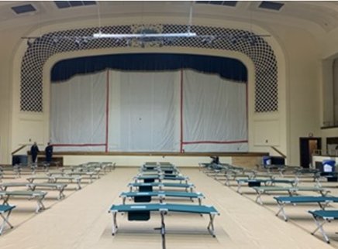
COVID-19 Response Highlights
Collaboration
Public Health Partners in the Community
Homeless Isolation Center: City of Colorado Springs, Public Health, El Paso County and Community Health Partnership working together to set up Homeless Isolation Center in City Auditorium.
Local Schools: Facilitating e-learning for students, providing technology tools to continue learning from home, providing free meals to students.
Business & Employment Resources: Pikes Peak Small Business Development Center, Colorado Springs Chamber & EDC, and Pikes Peak Workforce Center assisting local businesses and individuals with coaching, financial assistance and employment services.
Prevent • Promote • Protect
www.elpasocountyhealth.org

Slide 7

Prevent • Promote • Protect
www.elpasocountyhealth.org
Notes:
Innovation – passionate people helping in every way they can -
A BIG thank you and – these are the heros of the community
Not to the status check in with data and what we are experiencing and what the future holds...

Slide 8
Where we are now
COVID-19 numbers as of 4 p.m. April 13
Cases | Deaths
665 | 39
7,691 | 308
577,307 | 23,219
1,911,407 | 118,854
COVID-19 cases and deaths. Data from JHU-JSSE Interactive Map (13-April-2020), CEDRS (13-April-2020) and CDPHE (13-April-2020)
Prevent • Promote • Protect
www.elpasocountyhealth.org

Slide 9
points sized by total deaths
higher case rate up
higher death rate to the right
COVID-19 Global Cases/100,000 vs Deaths/100,000 – 13-Apr-2020. Data from JHU-JSSE Interactive Map (13-April-2020) , analyzed by El Paso County Public Health Data and Analytics Office.
Prevent • Promote • Protect
www.elpasocountyhealth.org

Slide 10
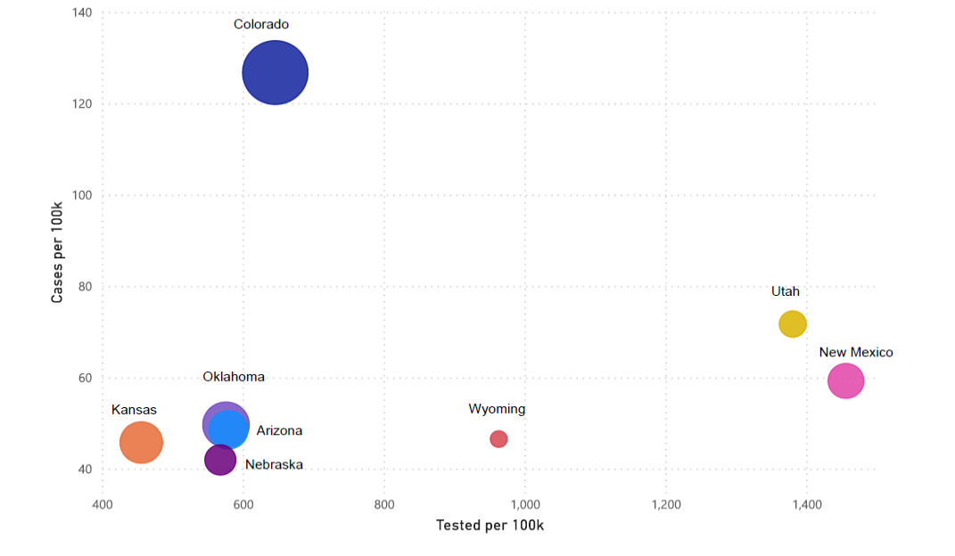
points sized by deaths/100k
Colorado and neighboring states: COVID-19 Cases/100,000 vs Tested/100,000 – 13-Apr-2020. Data from JHU-JSSE Interactive Map (13-April-2020), analyzed by El Paso County Public Health Data and Analytics Office.
Prevent • Promote • Protect
www.elpasocountyhealth.org

Slide 11
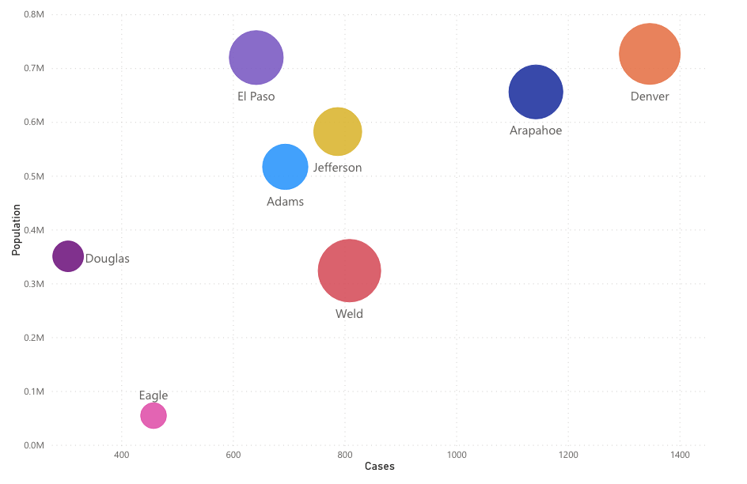
<will update with Monday COB #s>
points sized by total deaths
Top 8 Colorado Counties by COVID-19 Case Count – 13-Apr-2020. Data from CDPHE (12-Apr-2020), analyzed by El Paso County Public Health Data and Analytics Office.
Prevent • Promote • Protect
www.elpasocountyhealth.org

Slide 12
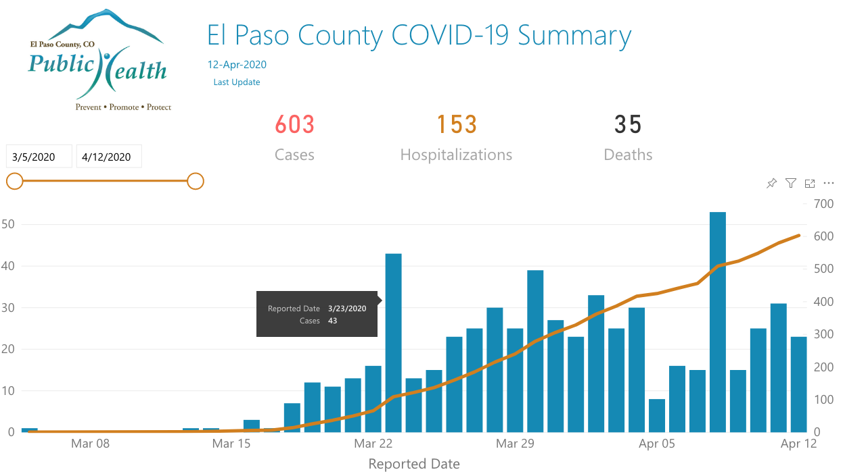
Screen Shots El Paso County Public Health COVID-19 Interactive Dashboard Prototype
Prevent • Promote • Protect
www.elpasocountyhealth.org

Slide 13
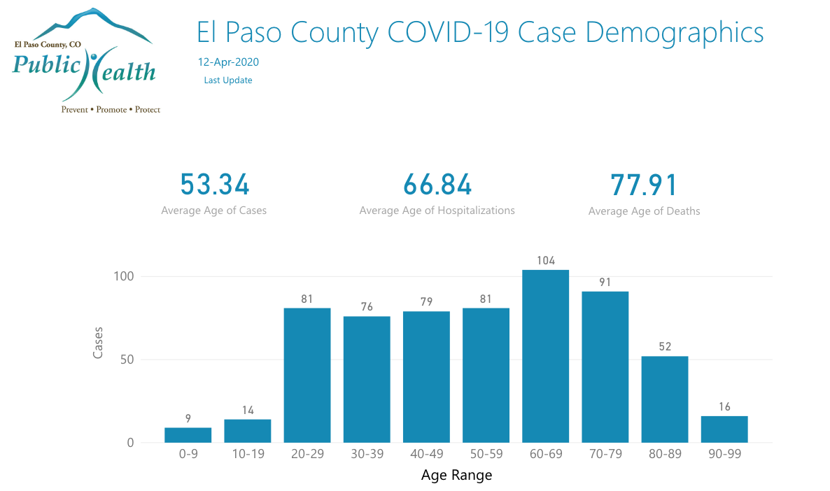
Screen Shots El Paso County Public Health COVID-19 Interactive Dashboard Prototype
Prevent • Promote • Protect
www.elpasocountyhealth.org

Slide 14
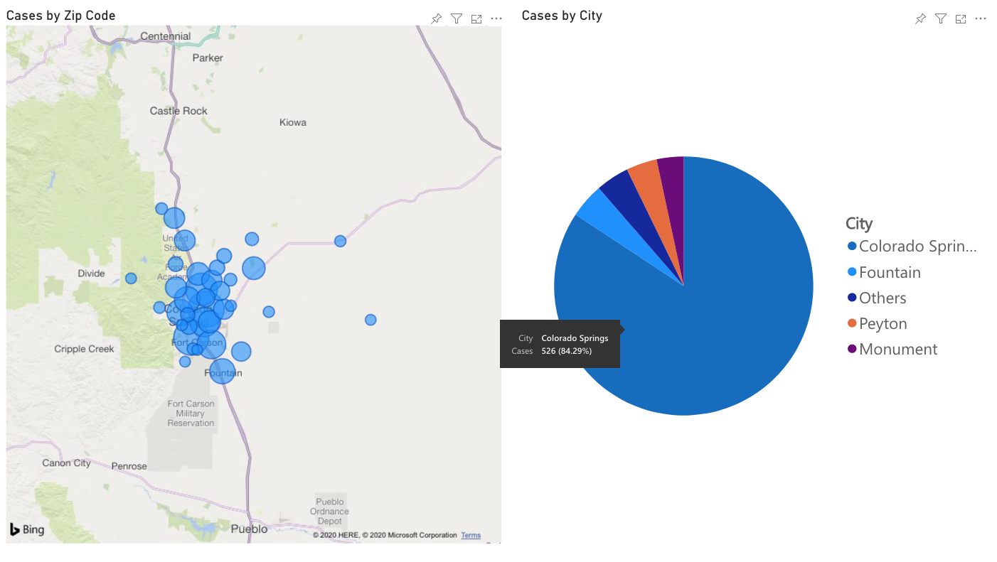
Screen Shots El Paso County Public Health COVID-19 Interactive Dashboard Prototype
Prevent • Promote • Protect
www.elpasocountyhealth.org

Slide 15
Recovered Cases
Non-confirmed Recovered Cases
  Not Hospitalized + 14 days elapsed since case reported
Confirmed Recovered Cases
  Qualitative information collected via case follow-up interviews - starting mid-April
Non-confirmed Recovered Cases as of April 13 171 out of 248
Prevent • Promote • Protect
www.elpasocountyhealth.org

Slide 16
EPC COVID-19 Hospitalizations. Data from CEDRS, (13-April-2020). El Paso County Public Health Data and Analytics Office.
Prevent • Promote • Protect
www.elpasocountyhealth.org

Slide 17
CO and EPC COVID-19 Cases and Hospitalizations. Data from CEDRS, CDPHE (13-April-2020). El Paso County Public Health Data and Analytics Office.
Prevent • Promote • Protect

Slide 18
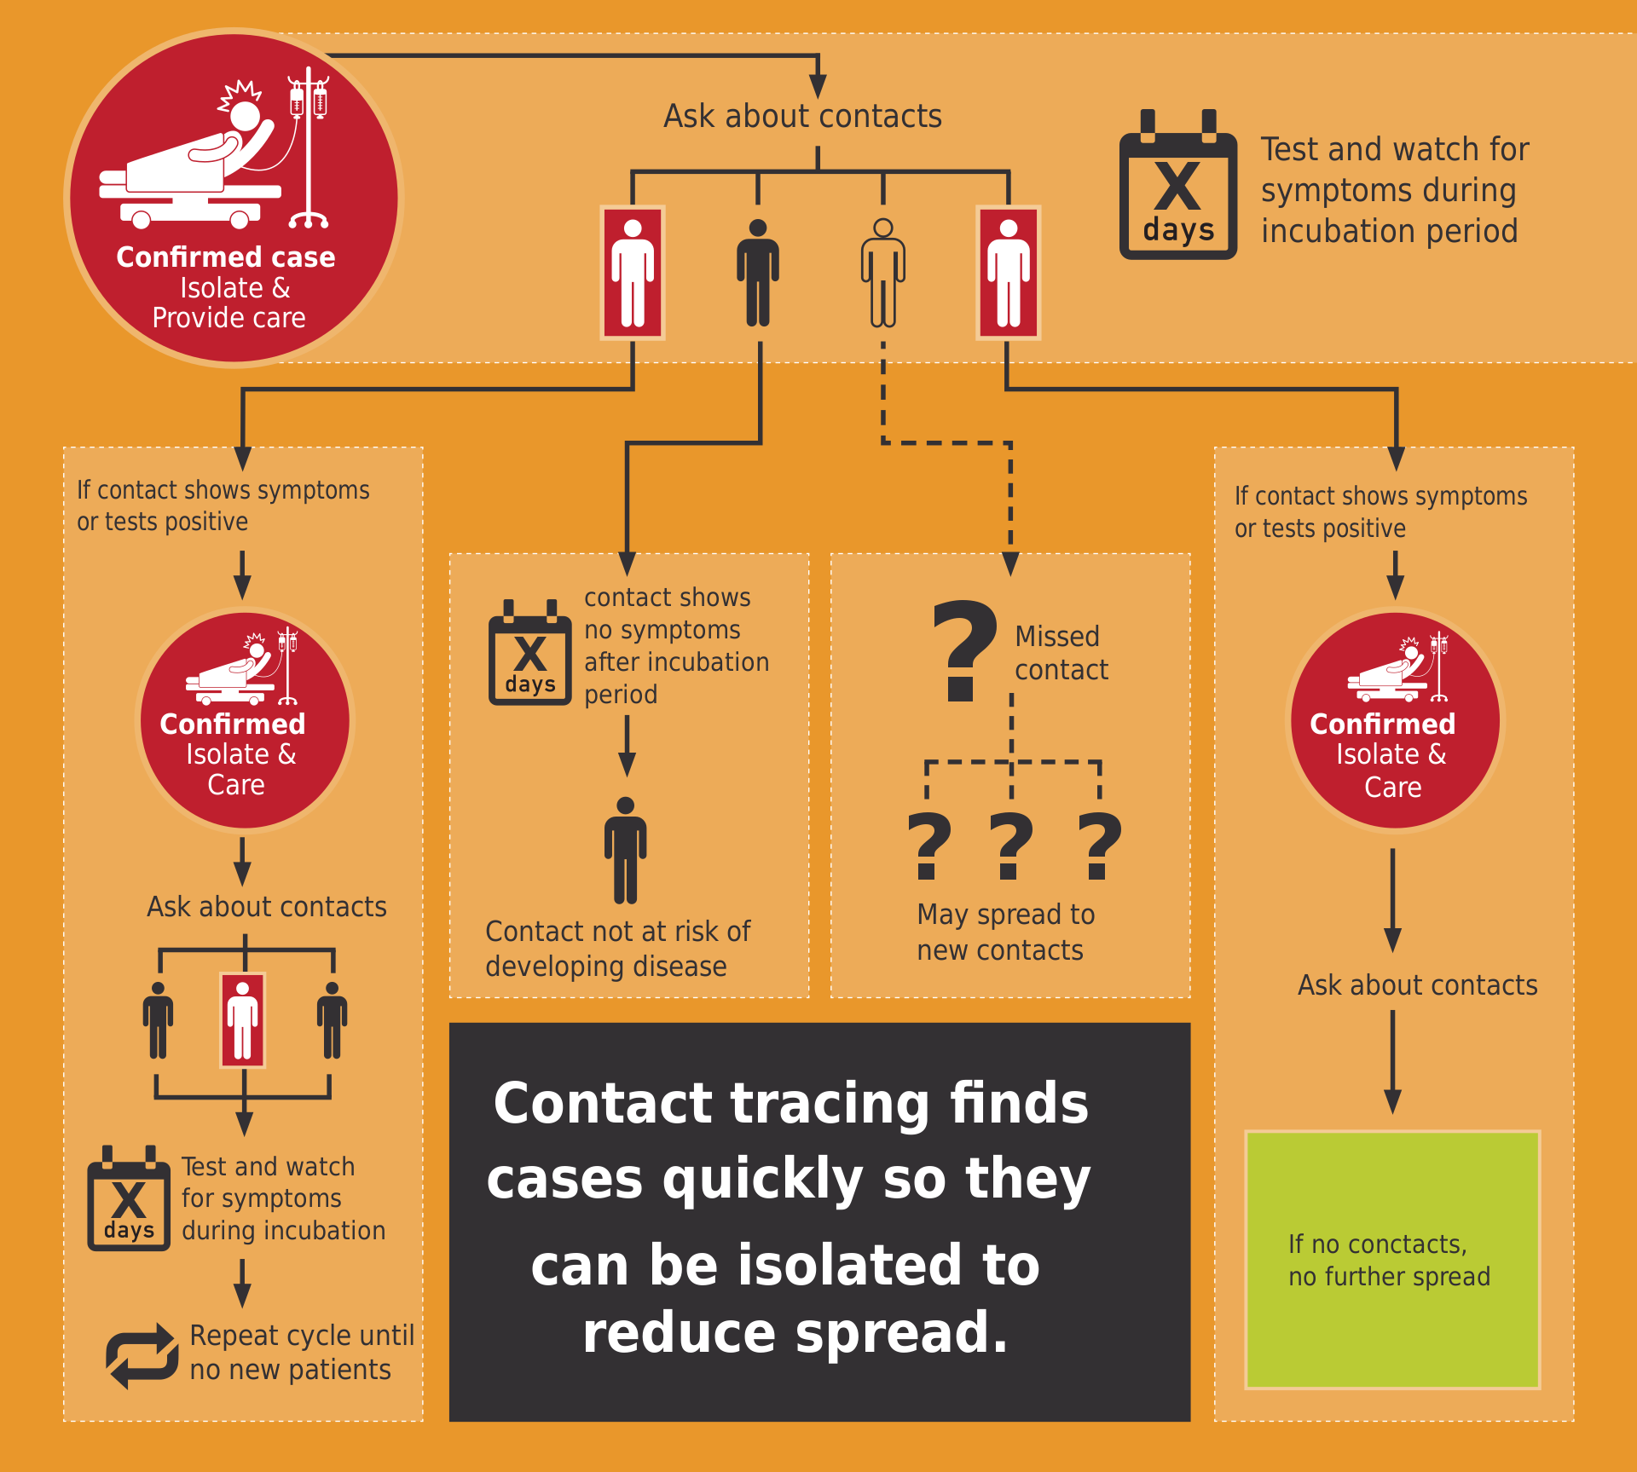
Contact Tracing
- Identify positive cases quickly
- Identify contacts
- Isolation and Quarantine
- Prioritize high-risk or clusters
- Building capacity for opening
Prevent • Promote • Protect

Slide 19
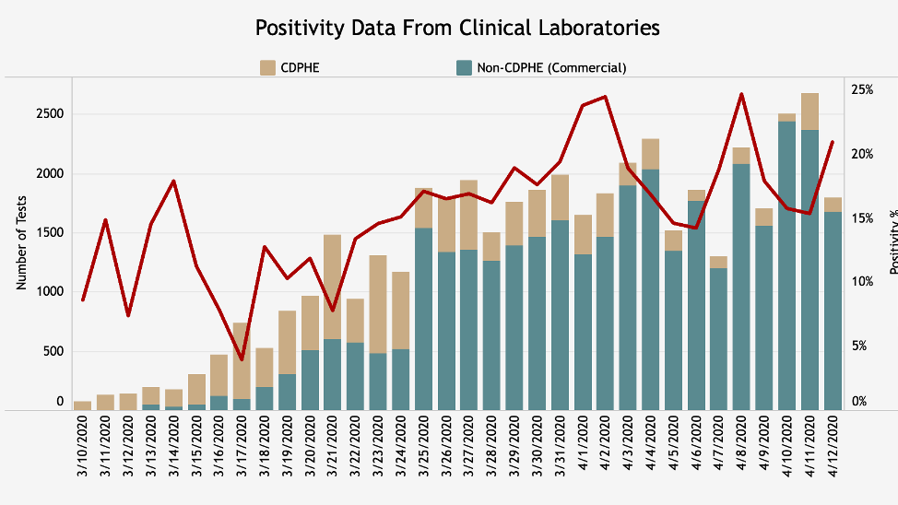
Prevent • Promote • Protect

Slide 20
A Phased Approach to Restart
Phase I – Slow the spread
Phase II – Reopen, state by state
Phase III – Establish protection then lift all restrictions
Phase IV – Rebuild our readiness for the next pandemic
Novel Coronavirus Response A Road Map to Reopening
American Enterprise Institute
29-March-2020
https://www.aei.org/research-products/report/national-coronavirus-response-a-road-map-to-reopening/
Prevent • Promote • Protect
www.elpasocountyhealth.org

Slide 21
Phase I
Slow the spread
Trigger
Actions
Techniques
Build capacities (e.g. testing, care, tracking)
Population-level controls
Community spread
Gain knowledge of COVID-19
Extensive social distancing
Save lives

Slide 22
Phase II
Reopen, deliberately and incrementally
Trigger
Actions
Techniques
Case-level controls - contact tracing and testing
Controlled spread - sustained reduction in new cases
Reduced social distancing - business and schools
Begin step-by-step return to normal for most activities – still no large crowds
High-risk populations remain sheltered

Slide 23
Phase III
Establish protection and lift all restrictions
Trigger
Actions
Techniques
Case-level controls continue
Effective therapeutics or vaccines
Phased deployment of medical interventions
Medical interventions and vaccines
Return to normal social gatherings

Slide 24
Phase IV
Prepare for the next pandemic
Trigger
Actions
Techniques
Now
Accelerated vaccine and therapeutic development technologies
National action priorities for infectious disease response
Improved surge capacity for health care systems
National forecasting systems for infectious diseases
National standards for preparedness and response

Slide 25
Questions
Prevent • Promote • Protect
www.elpasocountyhealth.org

