Slide 1
Near North End
Neighborhood Parking
Neighborhood Parking - Block Group 1
20 June 2019
Angie Martell, Associate Transportation Planner
Tim Roberts, Principal Transportation Planner

Slide 2
Overview
Why We Are Here
Outline of Process
Parking Program Examples
Citizen Discussion & Action Plan

Slide 3
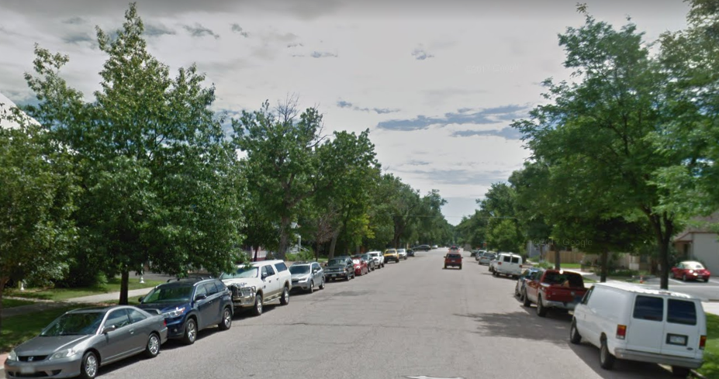

Slide 4
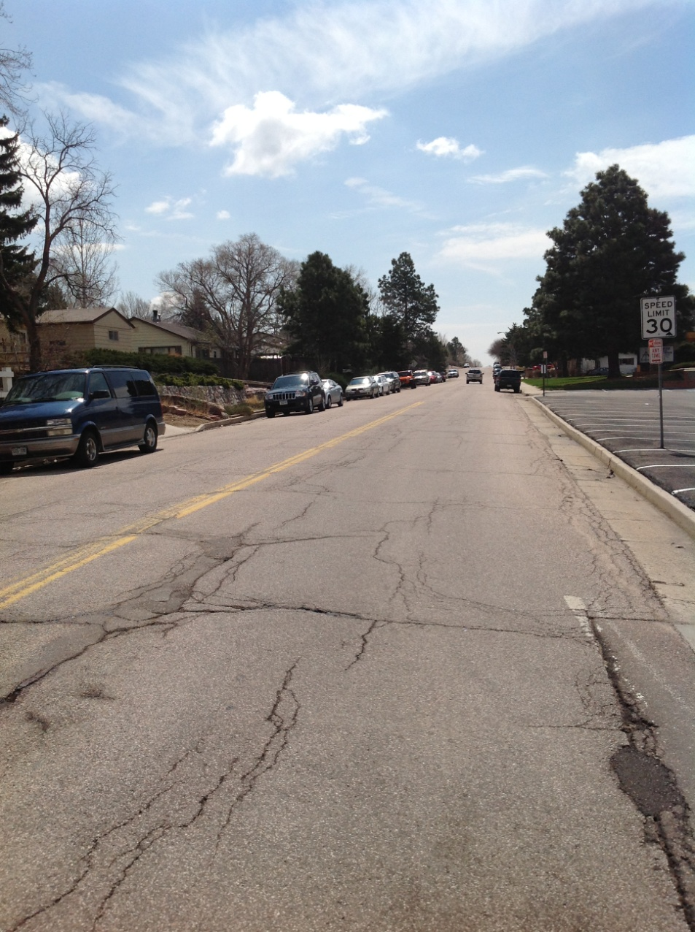
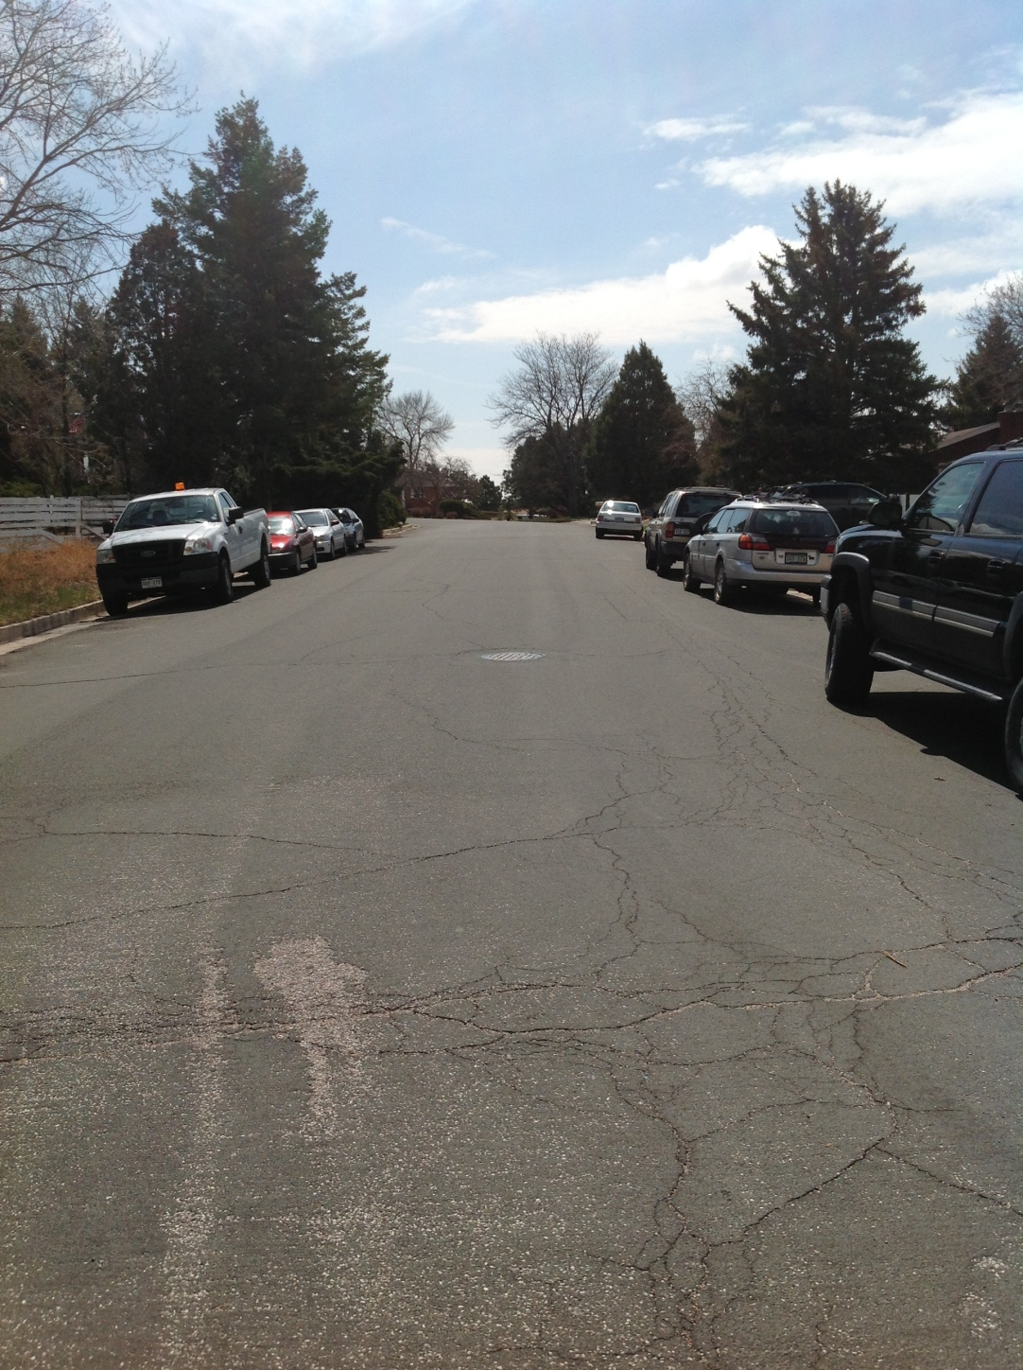
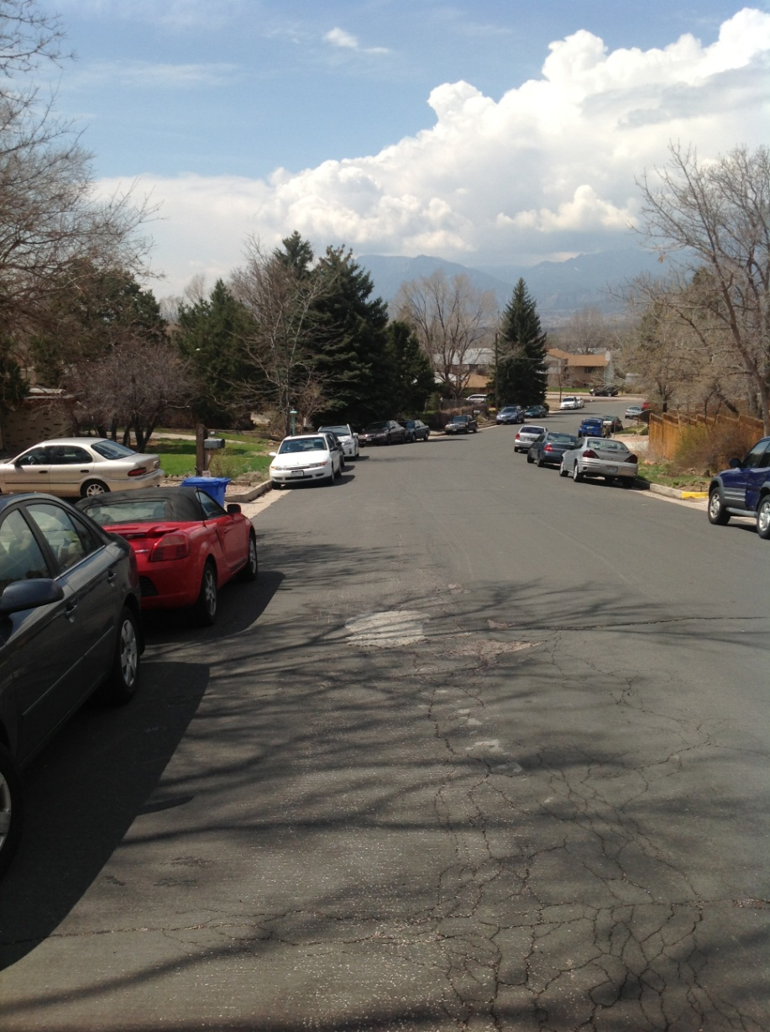
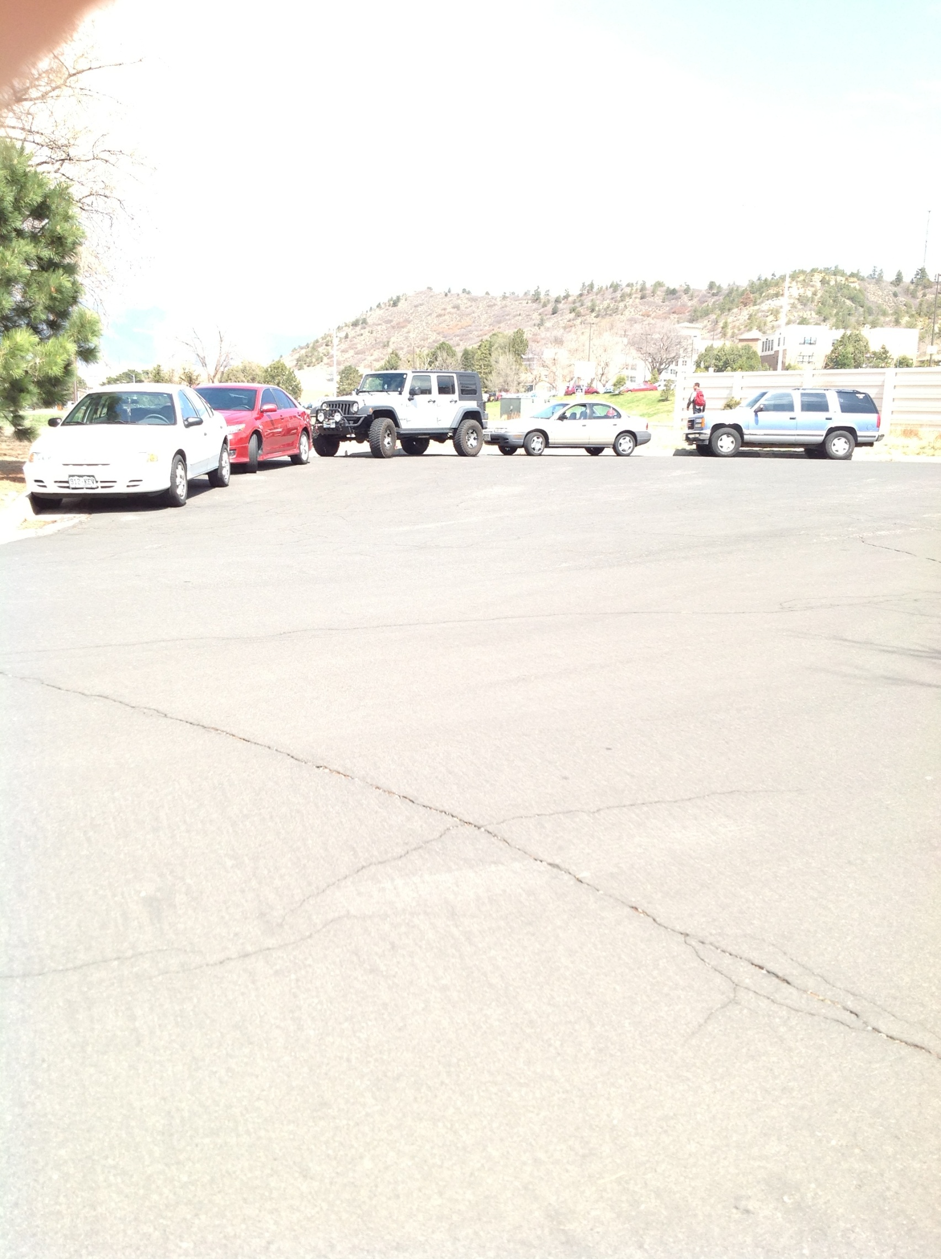
Cragmor Neighborhood Parking

Slide 5
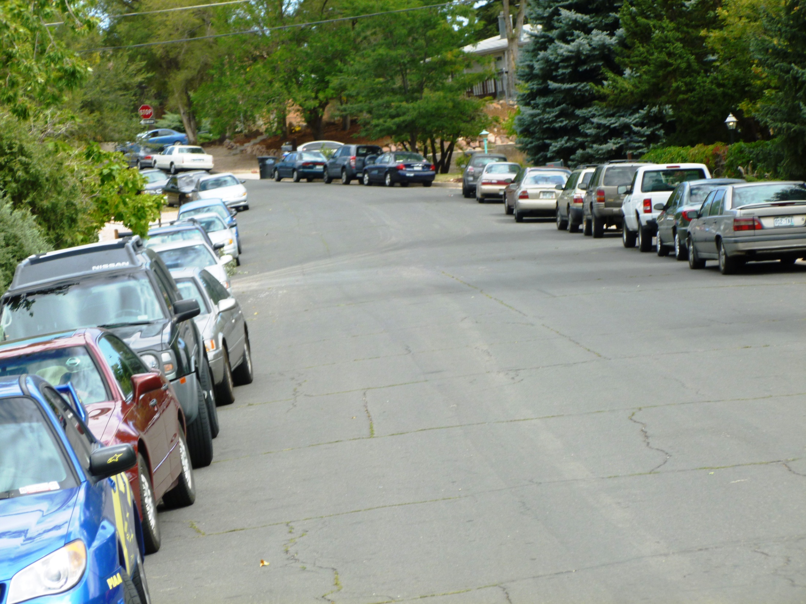
Notes:
This is the photo used in the Colorado Springs Gazette article about the issue. Clearly, there is a problem!

Slide 6
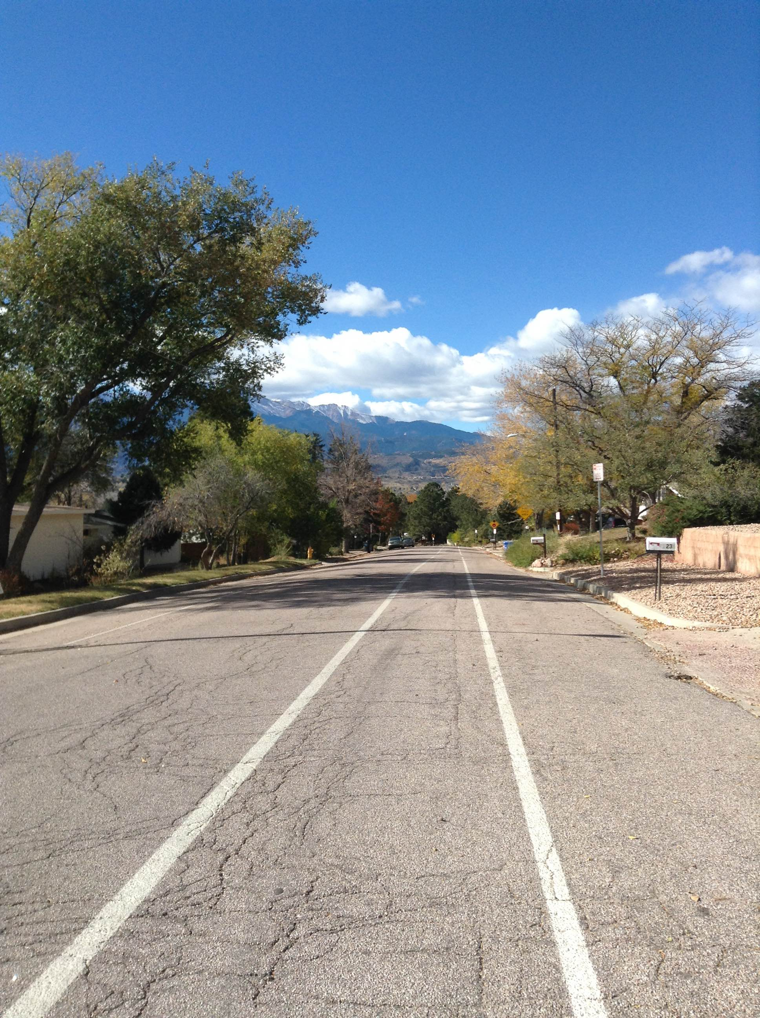
Notes:
Add new photo

Slide 7
Process
Kickoff meeting was June 11 for area south of Uintah Street
6 block group meetings planned
Develop action plan, if any, according to block group resident input

Slide 8
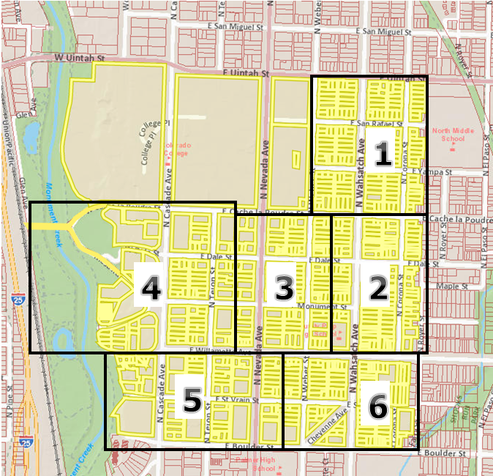
Process
South of Uintah Street Study area and Block Groups

Slide 9
Parking Program Examples
Time Managed
Permit Only
Metered Permits
Increase Supply
Combinations
Notes:
A few examples of parking programs
We are not proposing any of these as solutions, just examples to get you thinking of some possible options for solutions
One solution might not work the same for every block group, there may be a variety of solutions across the block groups in the study area

Slide 10
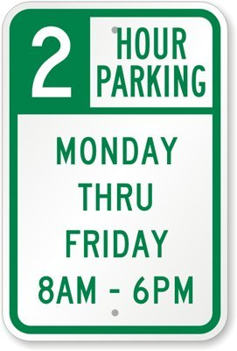
Parking Program Examples:
Time Managed
Notes:
A time managed system places a limit on the length of time that a car is allowed to be parked within a specific area.
Length of time can vary, days of week can vary, and holidays can be restricted. We can even specify no parking at all during certain times.
Signs will indicate when and for how long residents and non-residents will be allowed to park on the streets

Slide 11

Parking Program Examples:
Permit Only
Notes:
This is what we implemented near UCCS
Resident permits allow property holders to park a specified number of vehicles on the street in certain "No Parking" zones.
Residents can apply for a specific number of resident permits, as well as a specific number of visitor permits.
Property owners may encounter certain events that require a greater number of visitor passes to park on the street. For these situations, a greater number of temporary permits can be issued for specific dates
How many resident permits per property?
How many visitor permits per property?

Slide 12
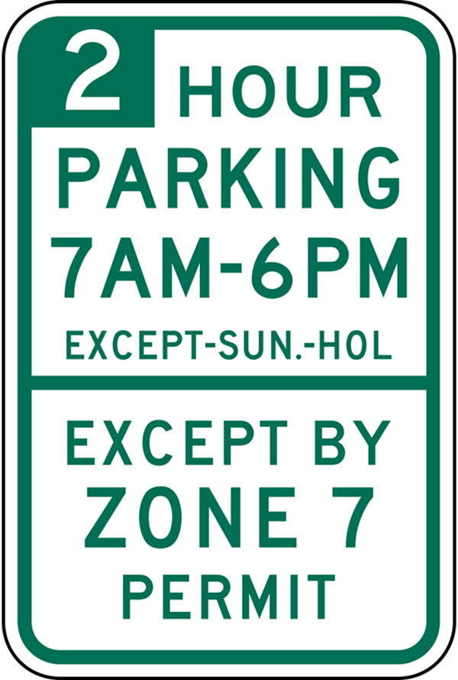
Parking Program Examples: Combinations
Notes:
Can also combine the above listed options, such as Time Restricted Parking with the option for resident permits.
This option would still allow non-residents to park on the street during specific time restrictions, while residents and their visitors holding permits are not subject to the time restrictions for on street parking
A Parking Permit (Residential or Area) exempts a resident's vehicle from the posted, on-street parking time limit restrictions ONLY for the area within which the permit is valid.
A Residential or Area Parking Permit does not allow parking in violation of any other parking regulation such as:
Parking during street sweeping restrictions
Parking in "No Parking" Zones
Parking without paying meters

Slide 13
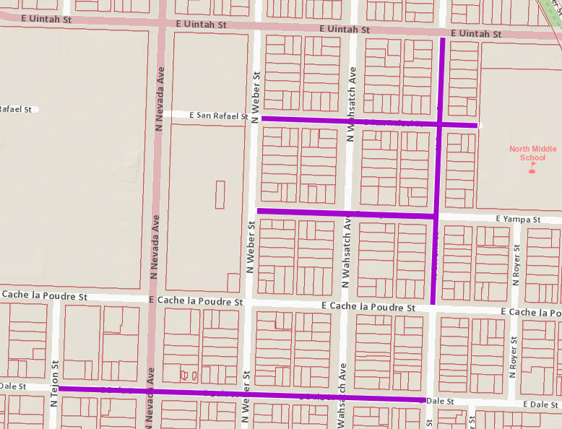
Parking Program Examples:
Increase
Supply
208 parallel spaces
to
467 diagonal spaces
Notes:
Based on roadway width and traffic operations, we looked at these streets within the study area
Dale Street from Tejon Street to Corona Street
Yampa St from Corona St to Weber St
San Rafael St from Weber St to North Middle School
Corona St from Cache La Poudre St to Uintah St
Would allow us to add 208 parallel spaces or 467 diagonal spaces
Additional parking on other streets in the study area would require more changes to traffic ops on those streets

Slide 14
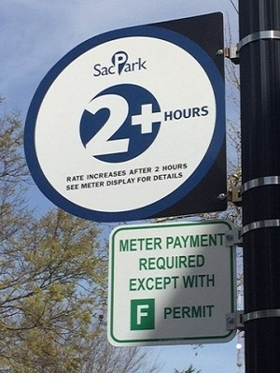
Parking Program Examples: Metered Permits
Notes:
Citizen suggested this example at the near north end HOA meeting
The metered permits parking model is another combination option
Method uses parking meters and permits to specify when, where, and who can take advantage of available on street parking.
Permit Holders (Residents and their visitors) will be able to park on street at the meters at no cost while displaying a permit, while those without permits will pay for metered parking in specific outlined parking spaces.
Permits can only be used at meters within specific zones, and not at any parking meter in the city.
Meters will have the effect of specifying exactly where a car can park and will also limit the amount of individuals searching for free parking in residential areas, while preserving space for residents and their guests to park.

Slide 15
Timeframe
Process: Summer 2019
Individual block group consensus by end of August
Plan of Action Meeting: September/October
Implementation: October/November

Slide 16
Discussion/ Action Plan
Notes:
These are just some ideas to get you thinking about some of the options out there. We will be meeting with various block groups to find out what works the best for everyone. So bring your ideas to those meetings.

Slide 17
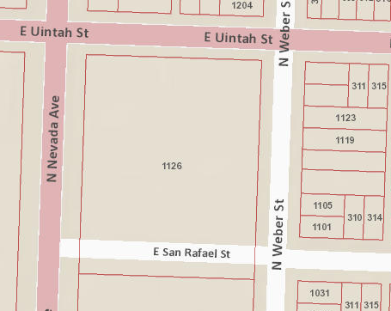
Notes:
These are just some ideas to get you thinking about some of the options out there. We will be meeting with various block groups to find out what works the best for everyone. So bring your ideas to those meetings.

Slide 18
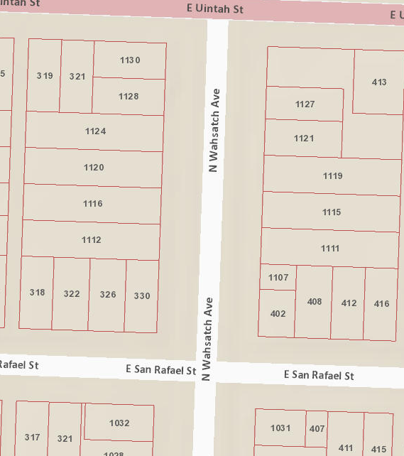
Notes:
These are just some ideas to get you thinking about some of the options out there. We will be meeting with various block groups to find out what works the best for everyone. So bring your ideas to those meetings.

Slide 19
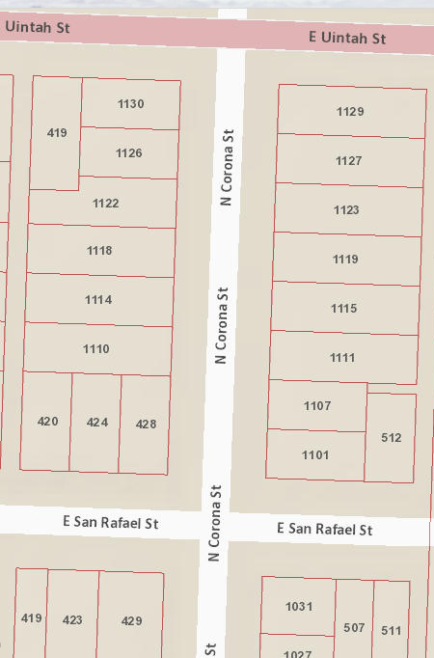
Notes:
These are just some ideas to get you thinking about some of the options out there. We will be meeting with various block groups to find out what works the best for everyone. So bring your ideas to those meetings.

Slide 20
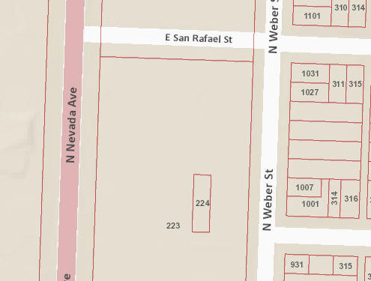
Notes:
These are just some ideas to get you thinking about some of the options out there. We will be meeting with various block groups to find out what works the best for everyone. So bring your ideas to those meetings.

Slide 21
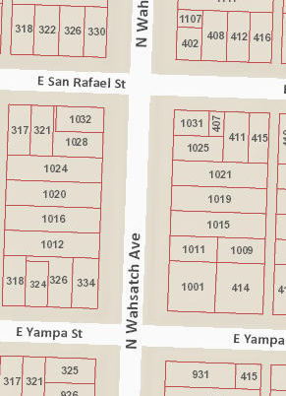
Notes:
These are just some ideas to get you thinking about some of the options out there. We will be meeting with various block groups to find out what works the best for everyone. So bring your ideas to those meetings.

Slide 22
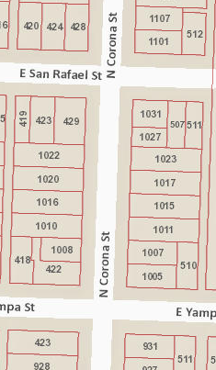
Notes:
These are just some ideas to get you thinking about some of the options out there. We will be meeting with various block groups to find out what works the best for everyone. So bring your ideas to those meetings.

Slide 23
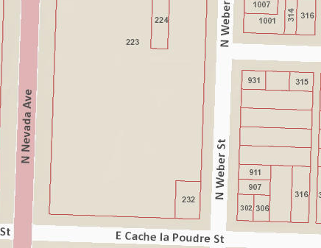
Notes:
These are just some ideas to get you thinking about some of the options out there. We will be meeting with various block groups to find out what works the best for everyone. So bring your ideas to those meetings.

Slide 24
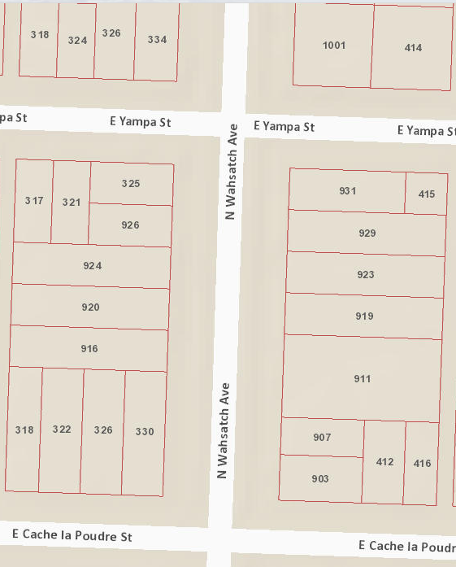
Notes:
These are just some ideas to get you thinking about some of the options out there. We will be meeting with various block groups to find out what works the best for everyone. So bring your ideas to those meetings.

Slide 25
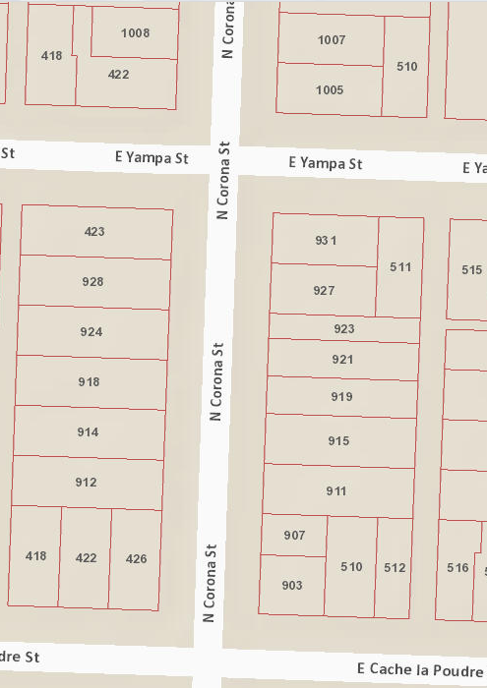
Notes:
These are just some ideas to get you thinking about some of the options out there. We will be meeting with various block groups to find out what works the best for everyone. So bring your ideas to those meetings.

