Slide 1
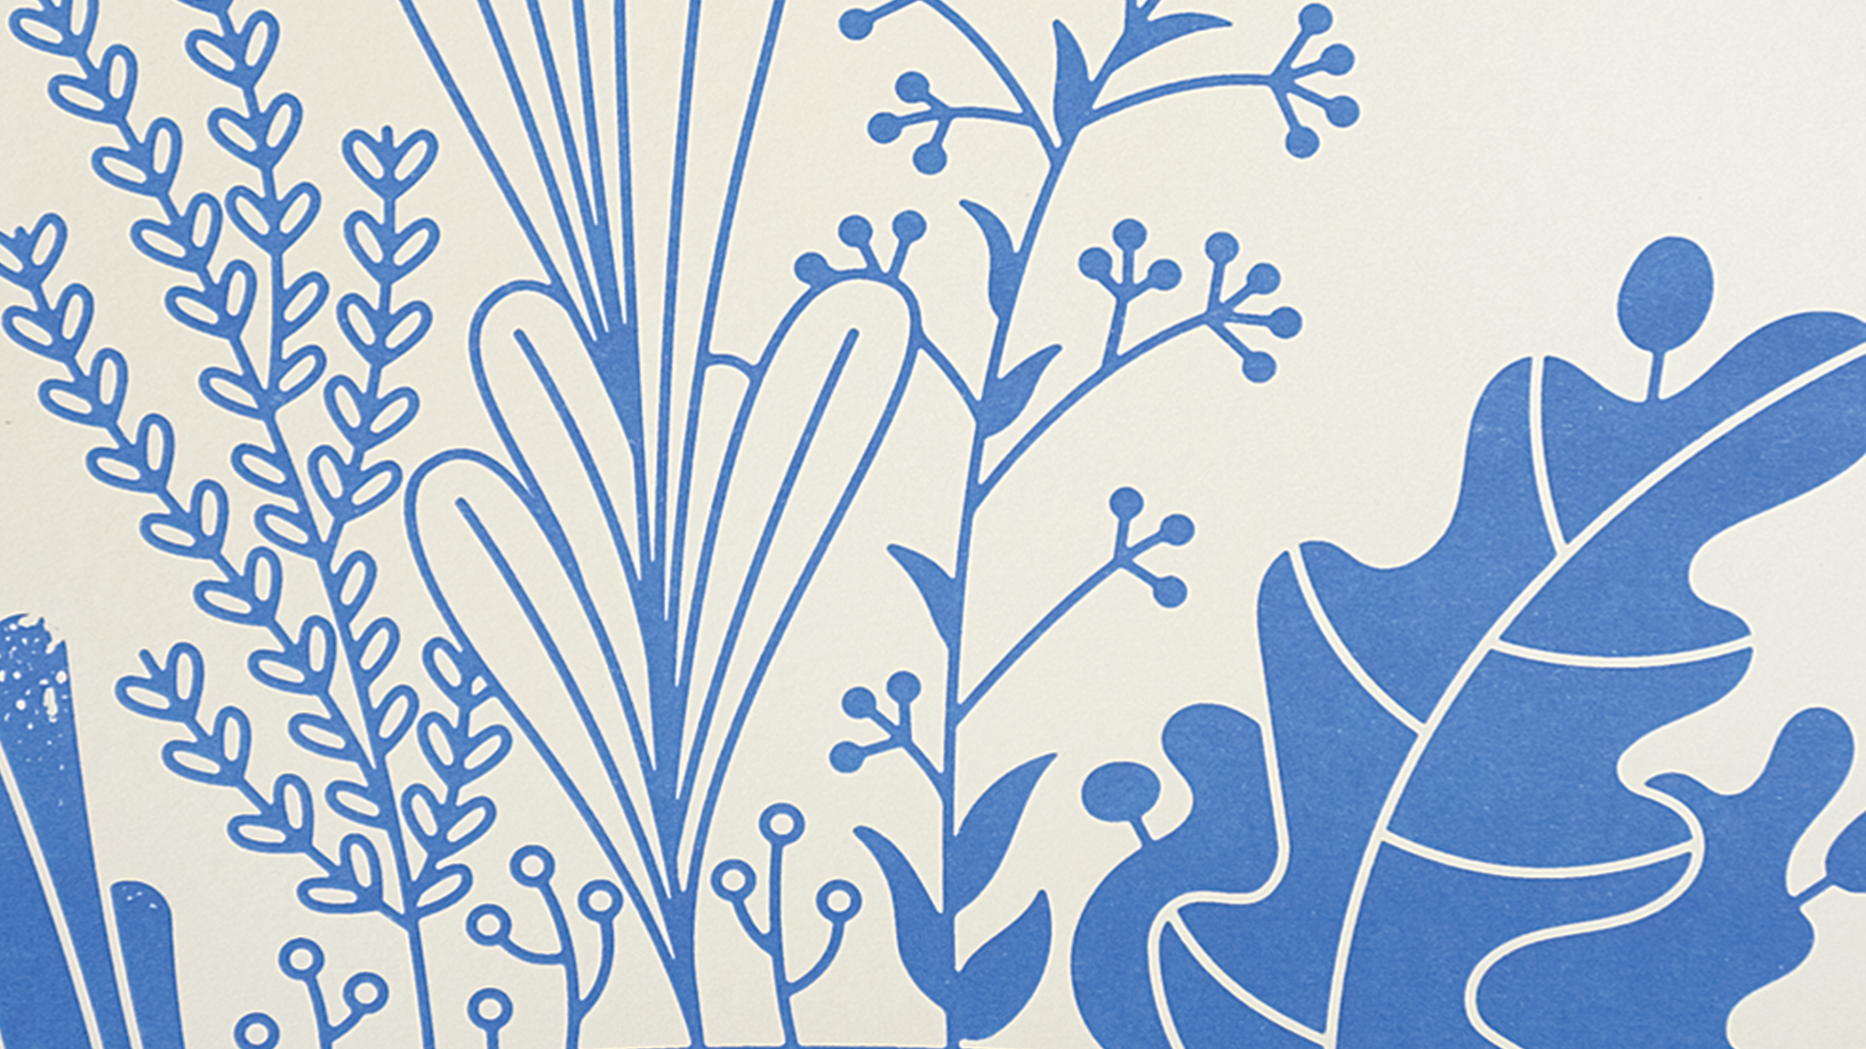
Public Art Master Plan Overview
August 18, 2020
Submitted by: Kendall Peterson, ThereSquared & Deana Miller, AMPA

Slide 2
Plan Goals
AMPA focused on the following objectives as outlined by master plan Steering Committee:
Review of the status of the City’s existing public art procedures, ordinances and activities.
Identify key action items for the near and long-term to get City programs better aligned with best practices.
Identify community and/or neighborhood projects that might serve as near term priorities for new public art.
Develop a tool kit that neighborhoods could utilize to help spread more public art around the community.
Define an “Aspirational Vision” for public art in Colorado Springs.

Slide 3
Timeline
Spring/Summer 2019: Research and community engagement
Through interviews, focus groups, an online questionnaire and hosting playful, unique outdoor activities, the team gathered information that helped to uncover the community’s perceived needs and interests and we gained insight into the community’s attitudes and behaviors toward public art.
Highlights:
Interviews/Focus Groups with over 30 City Council members, Developers, Neighbors and Organizations (CONO) representatives, Art/Culture leadership/board members, Planning and Parks staff members.
The 18-question survey posted to the City’s Public Art Plan website received 929 responses over the summer.
Small community-engagement events throughout the summer.
Fall/Winter 2019:
Analysis of research and crafting of vision, goals and strategies of the Public Art Plan
Winter/Spring 2020:
Internal review of plan by Mayor Suthers, Steering Committee, Planning Department.

Slide 4
Summary of Key Findings
A sustained, permanent public art program is desired by the community. This can only happen with the city’s participation.
Public art is unequally distributed around the city.
The Colorado Springs community would benefit from having a “public art expert” on city staff.
PlanCOS and other guiding documents recommend that we “integrate arts, culture and education as part of the planning process.”

Slide 5
Summary of Key Findings, cont.
Developers have a positive view of public art and want a smooth, enticing process to include more of it in their projects.
Public art needs stronger support at a policy level. This will require more education, political support and advocacy. The Colorado Springs community would benefit from having a “public art expert” on city staff.
The time is right to jump-start a public art program.
Public art commission has a passive role that doesn’t allow for effectiveness.
A regional cultural plan is on the horizon.

Slide 6
Mission and Vision Statements
VISION
The City of Colorado Springs public art program reinforces Colorado Springs’ reputation as a special cultural destination and state leader in the creative economy. The City’s public art collection is a legacy that will remain in place for future generations to enjoy and celebrate. The public process and resulting artwork will be a valuable catalyst to build community by enriching more neighborhoods and public spaces throughout the city, creating a sense of place and celebrating our collective history. Public art will be integrated into all City initiatives, developments and planning projects as standard practice.
MISSION
To build a robust, impactful and more widely accessible public art program funded and staffed by the City of Colorado Springs while leveraging private-public partnerships, collaborating with City departments and engaging local talent.

Slide 7
Recommended Goals and Strategies
GOAL 1:
Begin boldly and sustain momentum
Strategy 1: Commission a special sesquicentennial project

Slide 8
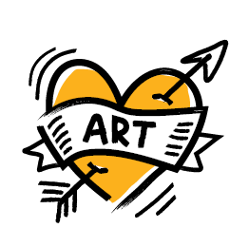
Recommended Goals and Strategies
GOAL 2:
Demonstrate dedication to public art
Strategy 1: Designate a public art expert
Strategy 2: Evaluate and redefine the role of the public art commission
Strategy 3: Structure the public art program
Strategy 4: Lead and collaborate with organizations creating public art
Strategy 5: Collaborate with city departments
Strategy 6: Advocate for sustainable funding for public art

Slide 9
Recommended Goals and Strategies
GOAL 3:
Goal 3: Encourage and incentivize placemaking
by developers
Strategy 1: Provide incentives
Strategy 2: Create incentives for public art in established and developing arts districts
Strategy 3: Make it easier to include art in new developments
Strategy 4: Advocate for a public art process in new urban renewal developments

Slide 10
Recommended Goals and Strategies
GOAL 4:
Place art throughout the city
Strategy 1: Focus on opportunity areas
Strategy 2: Develop a neighborhood grant program

Slide 11
Recommended Goals and Strategies
GOAL 5:
Goal 5: Promote and foster local creative economy through public art
Strategy 1: Support the local workforce by making it easy to hire local artists
Strategy 2: Market and promote artists and the collection

Slide 12
Recommended Goals and Strategies
GOAL 6:
GOAL 6: Create a unified, Olympic-level public art collection
Strategy 1: Develop a gold medal public art collection
Strategy 2: Emphasize process over product

Slide 13
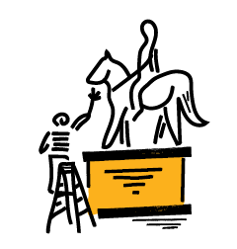
Recommended Goals and Strategies
GOAL 7:
Goal 7: Maintain, preserve and cherish the public art collection
Strategy 1: Conduct regular public art collection assessments
Strategy 2: Maintain existing assets
Strategy 3: Evaluate the funding for maintenance and adjust accordingly

Slide 14
QUESTIONS / DISCUSSION

