Slide 1
30th Street Corridor
(Mesa to Fontanero)
Robin Allen, P.E.
City Engineering
October 09, 2019

Slide 2

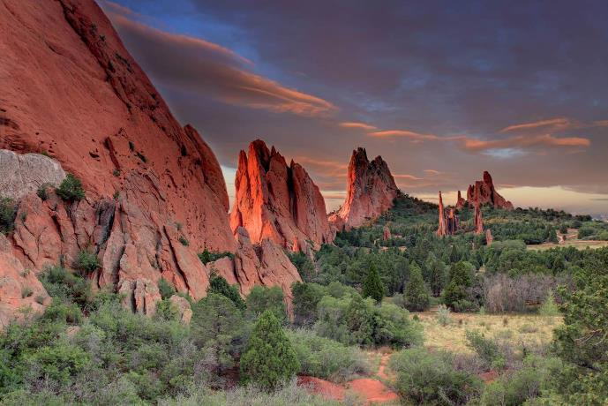
Project Team
Robin Allen, P.E. City of COS
Tim Roberts, Traffic, City of COS
FHU Engineering
Bachman PR
Yeh and Associates
TRS
Ascent Geomatics

Slide 3

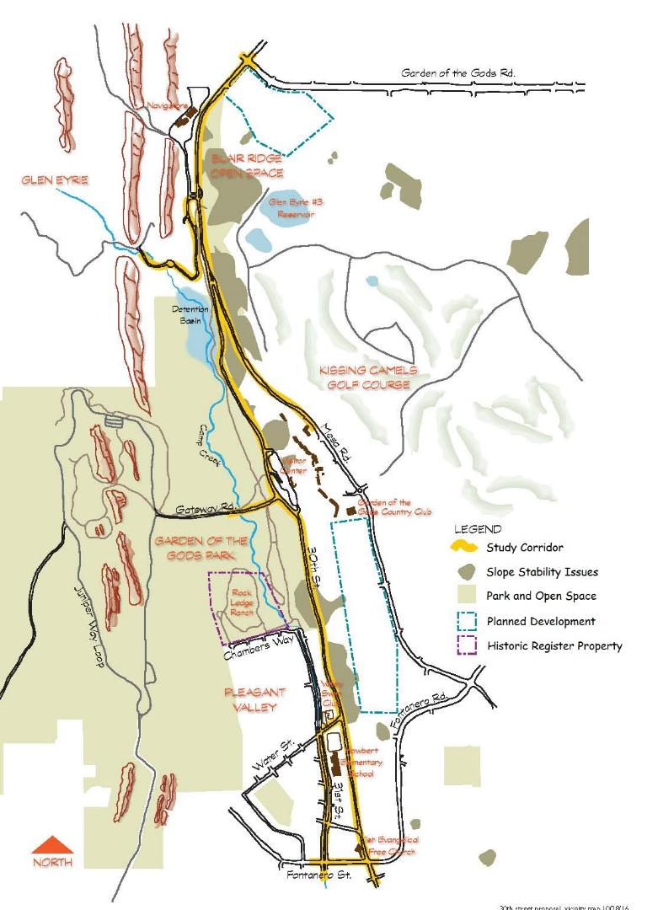
Project Purpose
Increase Safety
Improve Emergency Evacuation & Response
Issues
Pavement Degradation
Traffic Congestion
Intersection Operations
Slope Stability
Stormwater/Water Quality
Aesthetics

Slide 4
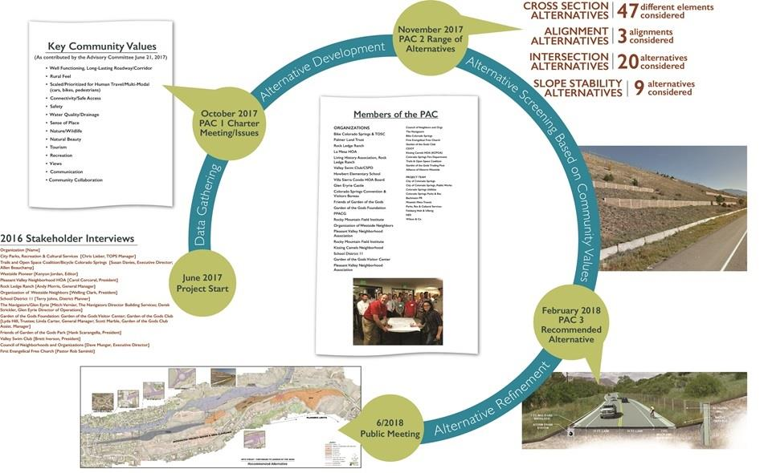

Slide 5
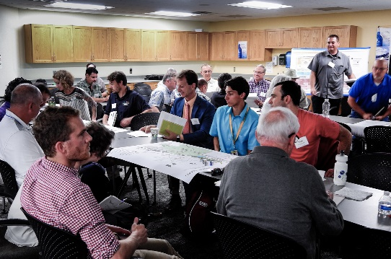
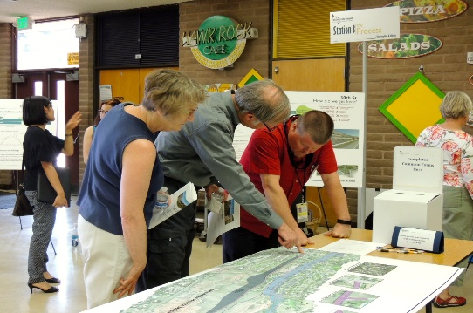
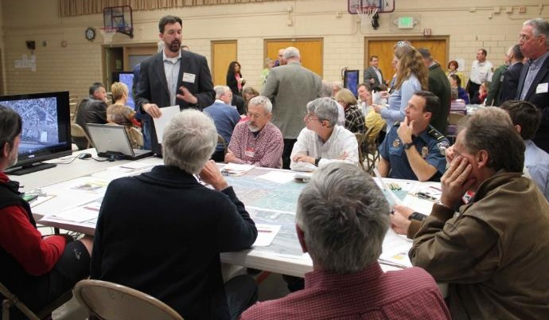
Public Involvement & Communications
Stakeholder interviews: Oct/Nov 2016
Project Team Charter / Advisory Committee Meetings:
  Nov 15, 2017
  June 21, 2017
  Feb 27, 2018
Numerous small group / one-on-one / HOA meetings (2016 – 2019)
  Pleasant Valley neighborhood
  Sierra Villa Townhomes
  Organization of Westside Neighbors
  Garden of the Gods Visitor & Nature Center / Foundation / FOGG
  Rock Ledge Ranch
  Navigators / Glen Eyrie
  Valley Swim Club
  Hobart Elementary / D11
  Ute Tribes
  Trails and Open Space Coalition

Slide 6
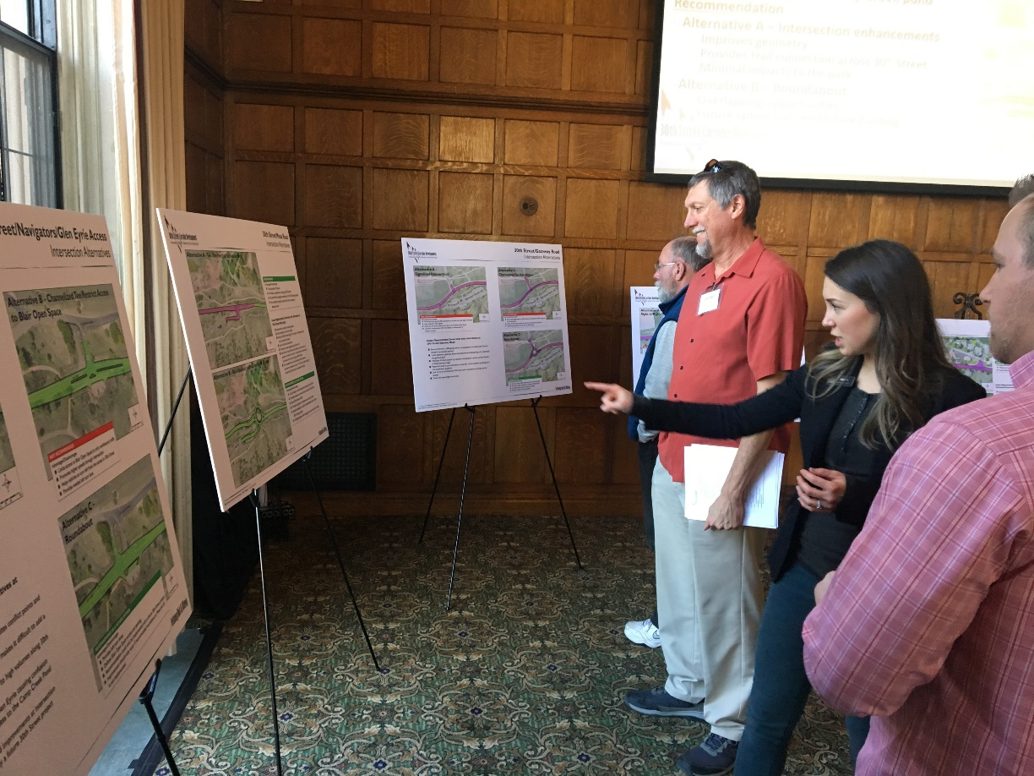
Public/Neighborhood Meetings
Public Meetings:
  June 14, 2018
  October 9, 2019
4(f) notifications July 27, 2019
September 10, 2019 (Pleasant Valley)
September 19, 2019 (CSU and 2C)
Agency coordination - ongoing
Communications tools
e-newsletters, E-mail notifications
News releases / Social Media (Facebook, Twitter, NextDoor.com
Signs for 4(f) posted in the Park
Postings to TOSC, CONO, TOPs e-newsletters
Project website:
https://coloradosprings.gov/public-works/page/30th-street-corridor-development

Slide 7
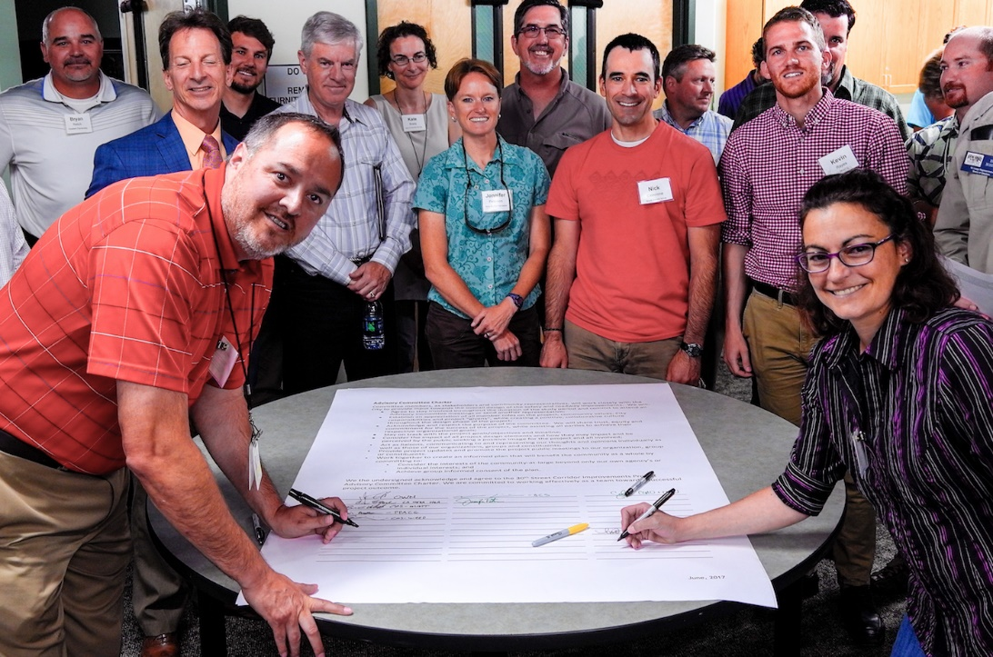
Key Community Values
(Advisory Committee June 21, 2017)
Rural Feel
Sense of Place
Nature/Wildlife
Natural Beauty
Views
Connectivity, Safe Access
Safety
Water Quality/Drainage
Tourism
Recreation
Well Functioning, Long-Lasting
Multi-Modal
Communication
Community Collaboration

Slide 8
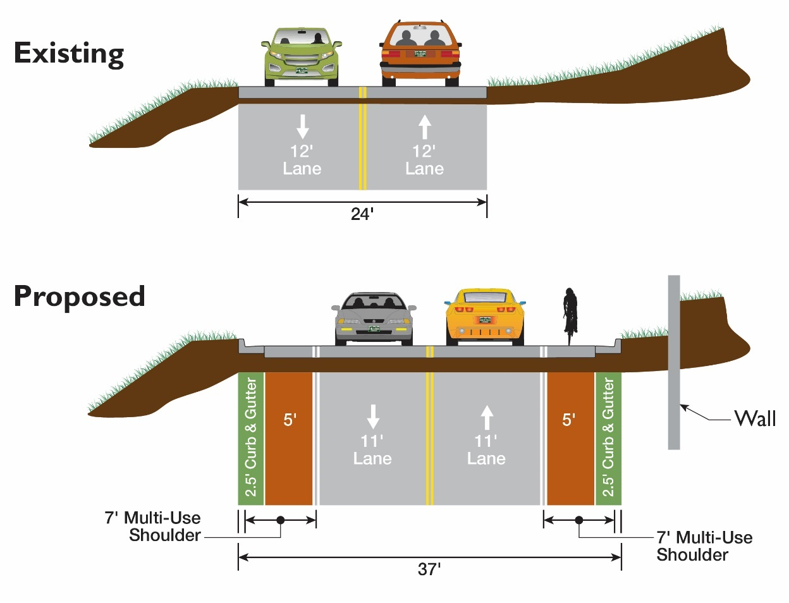
Recommended Typical Section
Widen to the East
11-foot lanes
7-foot multiuse shoulders
Soldier pile wall (retaining wall)
Storm Sewer/Water Quality

Slide 9
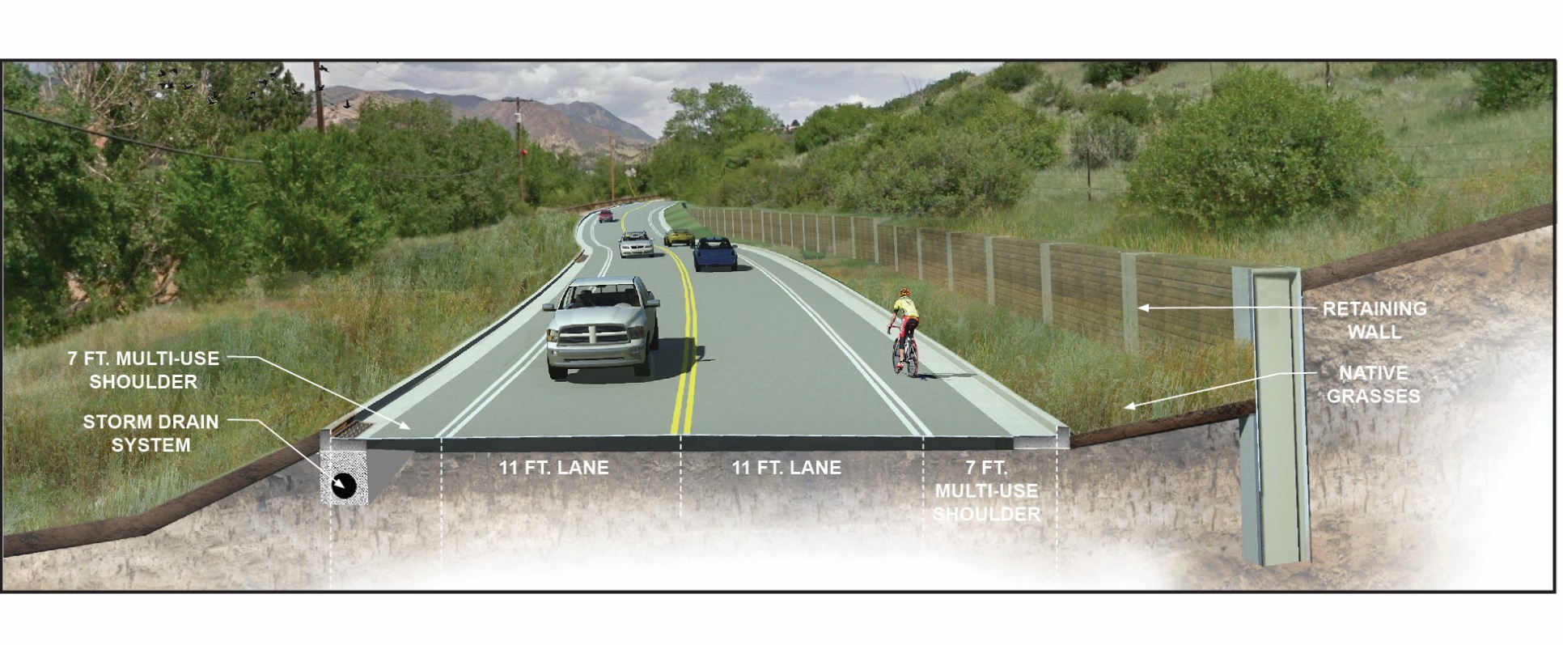
Recommended Typical Section

Slide 10
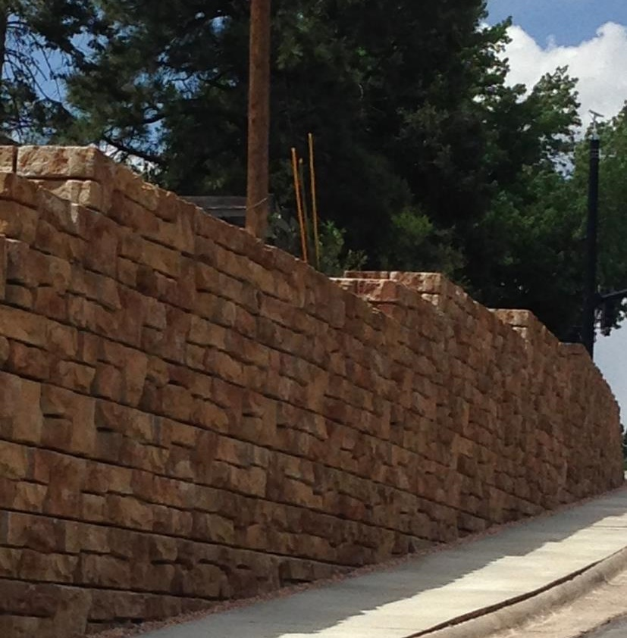
Soldier Pile Walls
- Minimal foot print
- Versatile for both cut and fill
- Highly Customizable
- Proven performance history

Slide 11
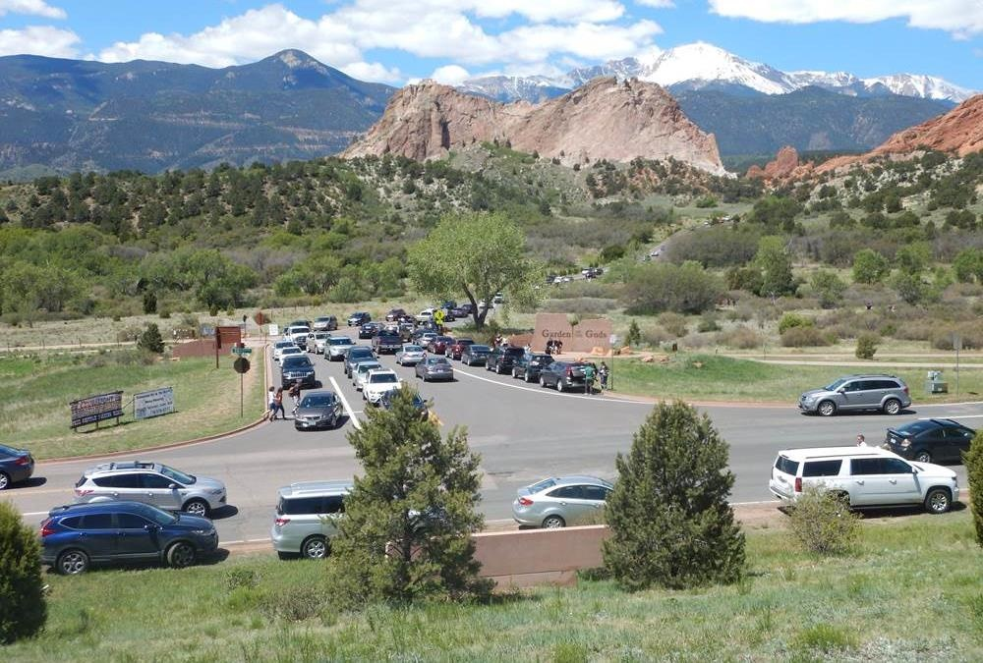
Traffic Safety and Congestion
Issues
- Operations / congestion
- Sense of arrival

Slide 12
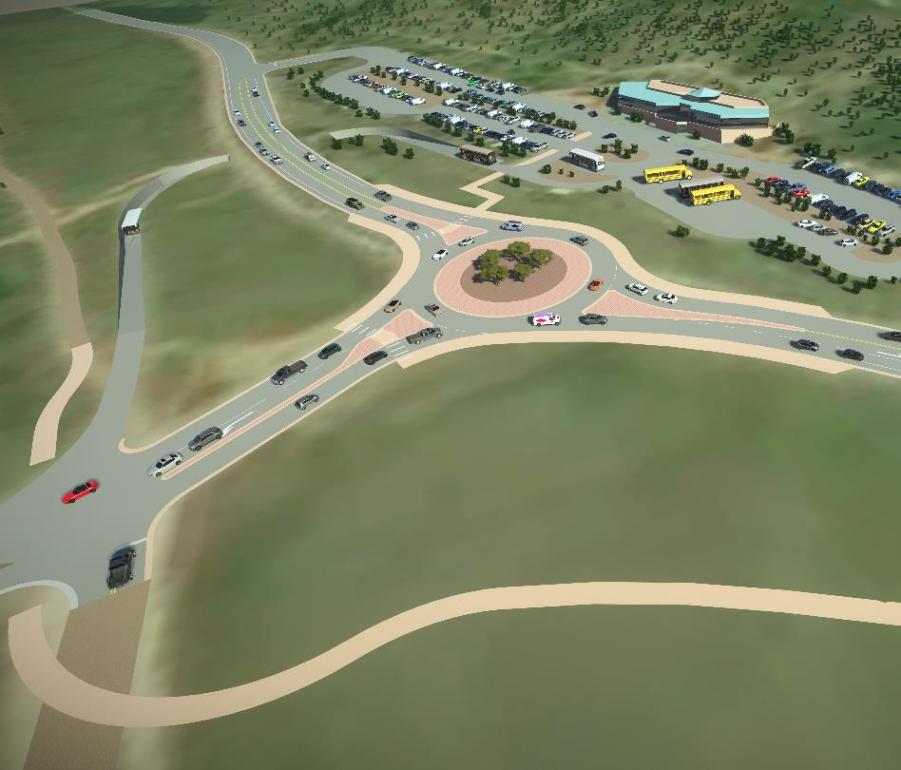
Preliminary Roundabout Design at Gateway Road
Provides opportunity for gateway feature
Reduce pollution and fuel use due to fewer stops and hard accelerations
No signal equipment to power or maintain

Slide 13
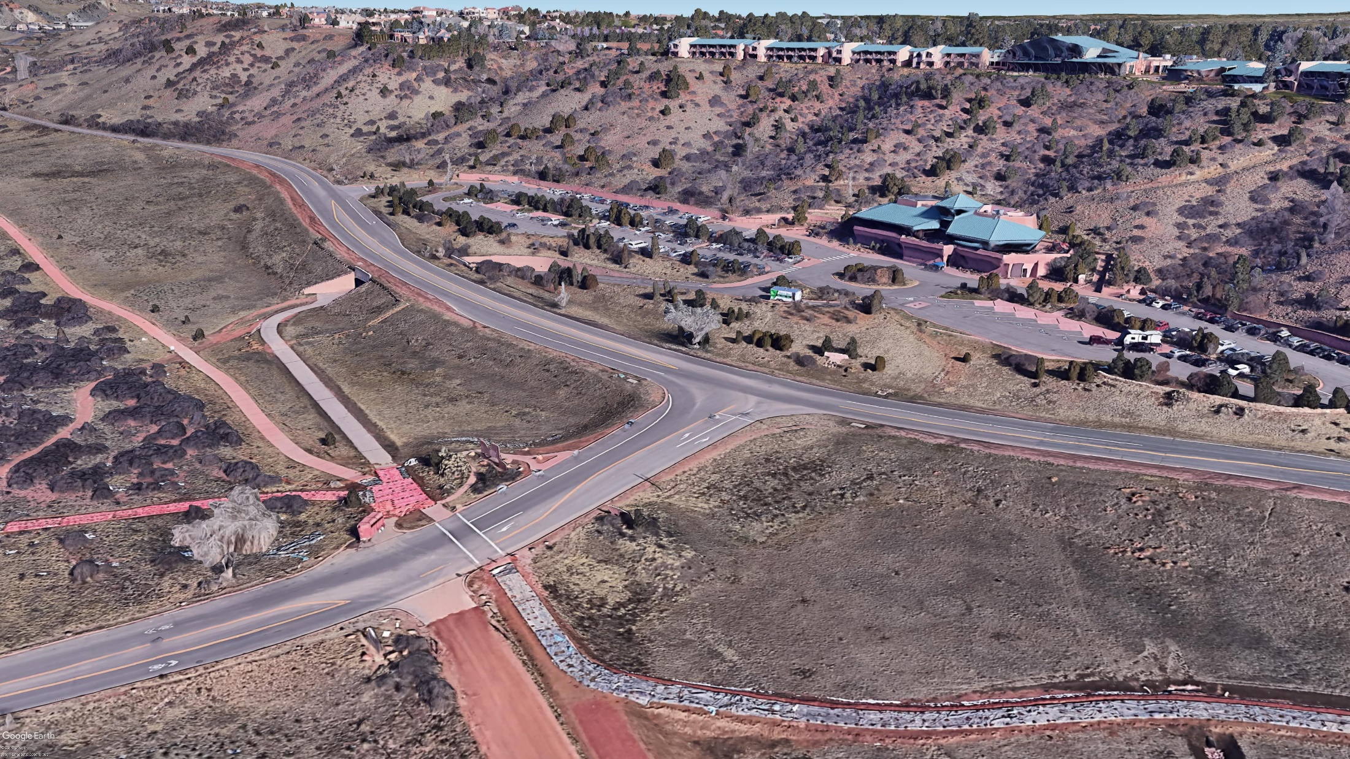
Existing Gateway Road Intersection

Slide 14
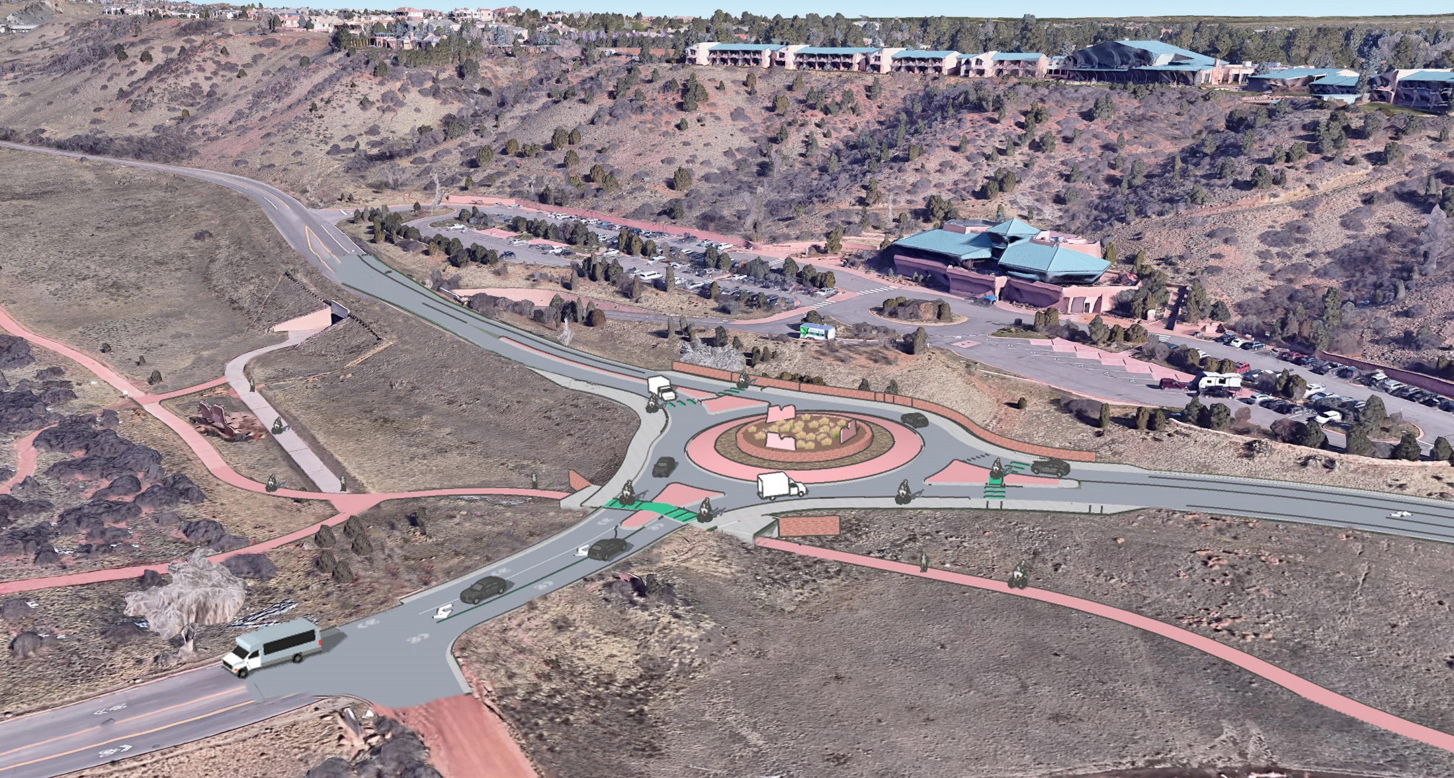
Gateway Road Roundabout & Trail underpass

Slide 15
Roundabout Benefits
Provides opportunity for gateway feature
Reduce air pollution and fuel use due to fewer stops and hard accelerations
No signal equipment to power or maintain
90% reduction in fatal crashes
76% reduction in injury crashes
35% reduction in all crashes
Slower speeds are safer for all users (cars, peds., bicycles)

Slide 16
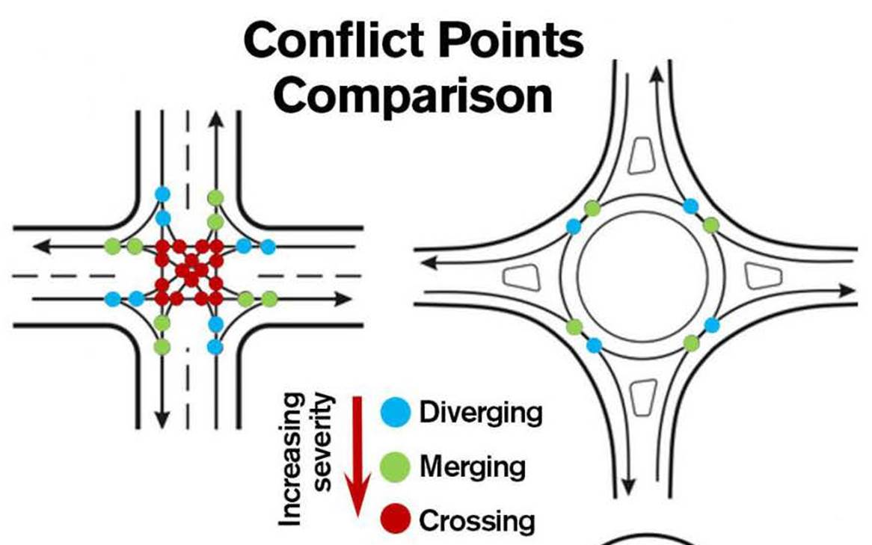
Issues
- Operations / congestion
- Sense of arrival
Recommendation – Roundabout
- Provides good operations
- Provides opportunity for gateway feature
- Natural Aesthetic preferred
32- conflict points
8 - conflict points

Slide 17
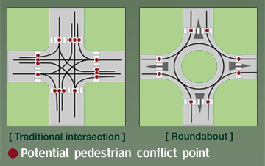
Issues
Pedestrian Safety
Long distance pedestrian crossings
Risk of high-speed pedestrian vehicle collision
8- conflict points
4- conflict points
Recommendation – Roundabout
Reduces conflict points by half from 8 to 4
Simplifies pedestrian crossing decisions to 4 short single lane one-way crossings
Reduces speed considerably at the pedestrian crossings

Slide 18
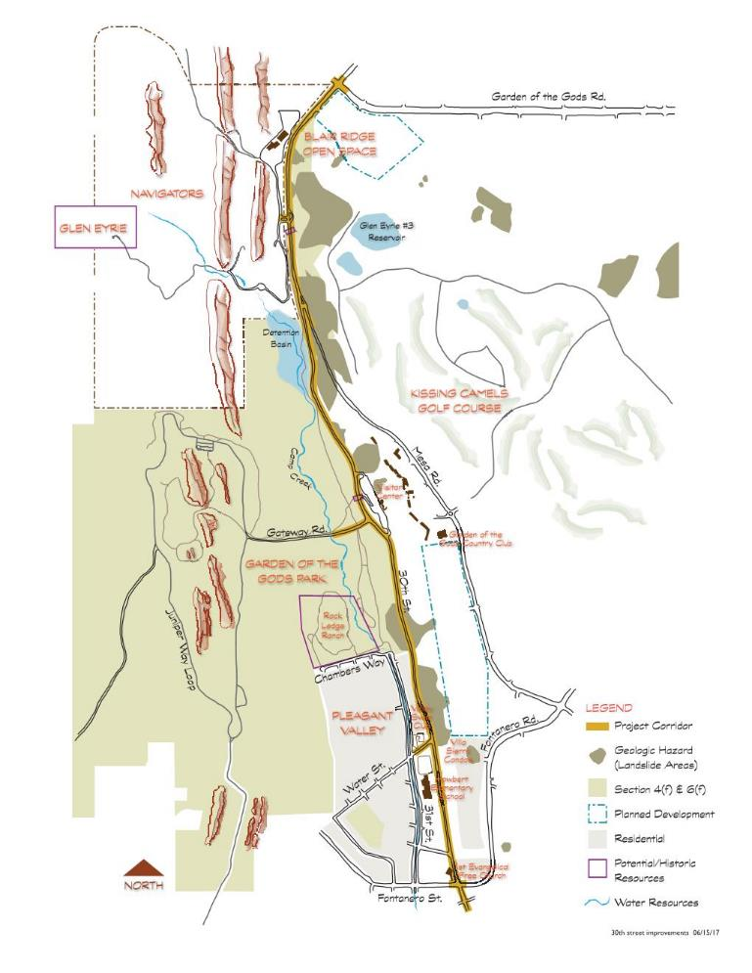
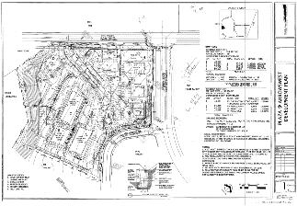
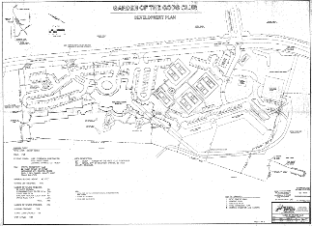
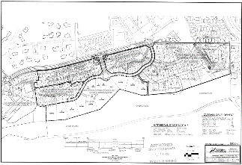

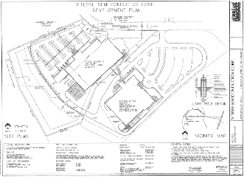
Stormwater –
3 Water Quality locations were chosen
  1 Chambers Way
  2 Water Street
  3 Fontanero Street
CFS = Cubic Feet per Second
Camp Creek within 31st Street carries 1,200 CFS
145 cfs
1
60 cfs
2
30 cfs
3

Slide 19
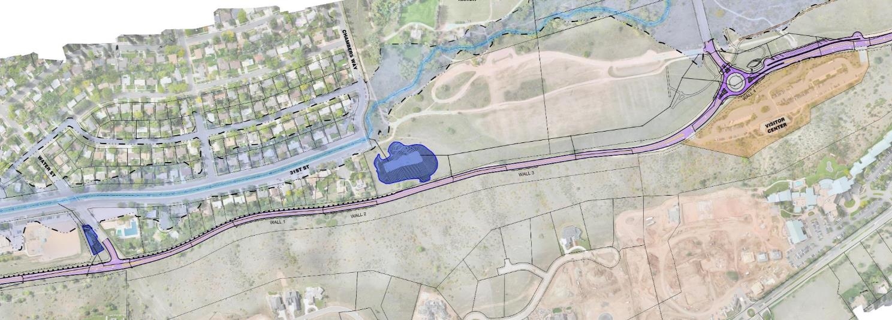
Required water quality ponds near GOTG Park at:
1- Chambers & 2- Water Street
1
2

Slide 20
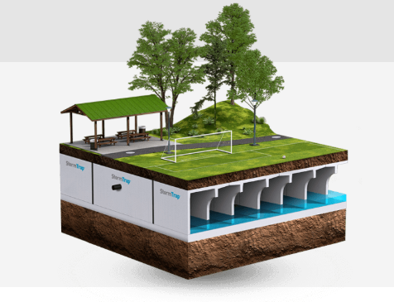
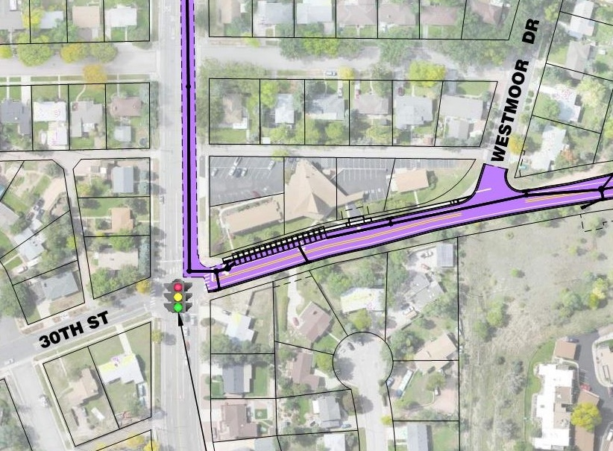
Required underground water quality stormtrap
3- Fontanero
3

Slide 21
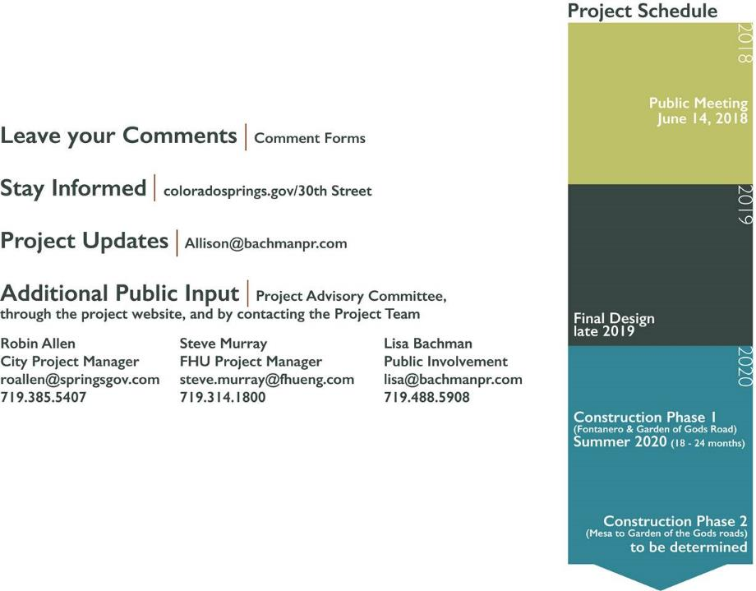
Project Input
Project Advisory Committee
Project Website https://coloradosprings.gov/30thStreet
https://coloradosprings.gov/public-works/page/30th-street-corridor-development
Project Team
Robin Allen | 719-385-5407 | roallen@springsgov.com
Steve Murray | 719-314-1800 | steve.murray@fhueng.com
Lisa Bachman | 719-488-5908 | lisa@bachmanpr.com

