Slide 1
Stormwater Advisory
Committee
February 21st, 2019

Slide 2
2018 YTD Financial Overview (preliminary)

Slide 3
2018 YTD Financial Overview (preliminary)
Stormwater Capital Improvements
2018 ORIG. BUDGET |  | $ 12,472,700
PY Rollover/Supplemental |  | $ 12,494,534
TOTAL BUDGET |  | $ 24,967,234
EXPENSED |  | $ 9,587,853
CONTRACTED |  | $ 3,634,615
REMAINING |  | $ 11,744,766
% CIP Design Complete | 75 | % CIP Design Remaining | 25
% CIP Construction Complete | 25 | % CIP Construction Remaining | 75
*includes $6M TABOR Funding and $346K Tutt Bridge Supplemental Appropriation
Note: CIP design and construction can be funded over multiple years

Slide 5
Billing and Revenue Update
Stormwater Fees | Parcels Billed | Billed | Collected
Residential Fees | 19,394 | $ 3,607,971 | $ 3,133,183
Non-Residential Fees | 127,708 | $ 3,823,700 | $ 2,916,646
Total |  | $ 7,431,671 | $ 6,049,828
* Dec. payments due in Jan.
Est. Residential billed thru Utilities approx. 98% collections rate
Est. Non-residential approx. 82% collection rate
4,727 Non-Residential accounts prepaid $284,832
2,657 Non-Residential accounts over 90 days past due $128,960

Slide 6
Revenue Collection Strategies and Billing Efficiencies
Completed or In Process
  Coordinated with property management companies, HOAs, and title companies to act as agents for the property owners
  Mailed letters to over 40 local title companies and offered presentations
  Notified non-residential customers of added payment options
    Drop box has been added at local CLA Office - reception area is in process
    Advance payments are accepted
    Added E-check option $1 to reduce payment fees
    Automatic withdrawal ACH option in process
    Cart Option for making multiple payments in process
    Combined Billings – test run with City billing
  Returned Mail
    Billing Co. is handling all returned mail with forwarding notifications
    City hired 2 temp. staff to work 2-3 weeks to handle approx. 2200 pieces of returned mail and identify better mailing addresses on unpaid accounts, so far identified 787 residential properties are unpaid
  On going discussions with Colorado Springs Utilities

Slide 7
Revenue Collection Strategies and Billing Efficiencies
Next Steps
  Working to develop an automated GIS billing system
  6 mo. review of newly developed properties
  Stormwater fee determination of commercial condo plats
  Collection of accounts over 90 days past due utilizing tax liens
  Utilize collection company for tax exempt
  Research options for payment assistance on non-residential

Slide 8
2018 Customer Service Statistics
94% of the non-residential calls are now being handled by the billing company.

Slide 9
2018 Customer Service Statistics
City Stormwater– 66% are now billing questions
 | Aug-18 | Sep-18 | Oct-18 | Nov-18 | Dec-18 | Total | YTD%
SWENT Billing | 430 | 166 | 169 | 57 | 43 | 865 | 66%
SWENT Fee | 182 | 55 | 32 | 12 | 10 | 291 | 22%
Landlord/Tenant | 8 | 4 | 1 | 2 | 0 | 15 | 1%
SWENT Program | 22 | 14 | 9 | 5 | 2 | 52 | 4%
Other | 25 | 19 | 13 | 6 | 15 | 78 | 6%
Total | 667 | 258 | 224 | 82 | 70 | 1,301 | 100%
Billing Company Common Questions
Payment Options (Prepay, Automatic Transfer Options - ACH)
Verification of payment received
Statement requests by property management companies
What the bill is for
Ownership changes

Slide 10
SWENT Social Media Report
JANUARY 2019

Slide 11
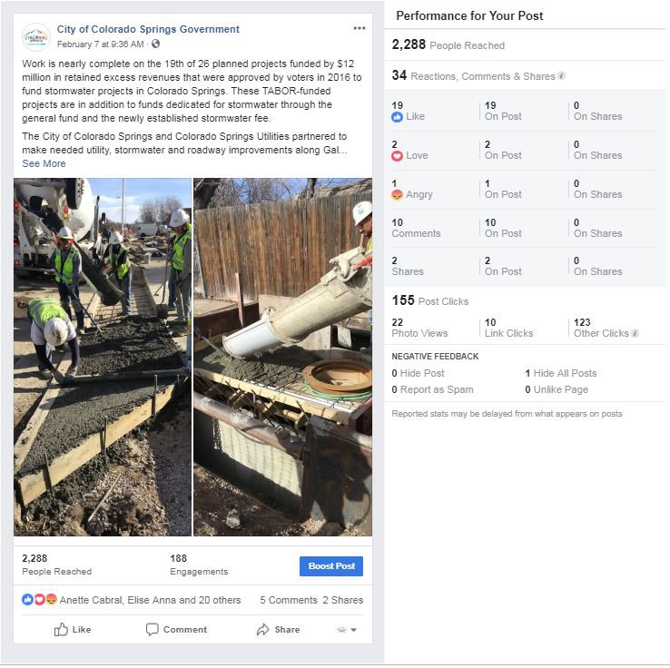
Facebook
(January 1, 2019-Feb15, 2019)
Most Popular Post
Overview
◆ 7 Messages
◆ 34,119 Impressions
◆ 25,308 Users Reached
◆ 311 Reactions to posts
◆ 87 Comments
◆ 70 Shares
◆ 33 Clicks
◆ Topics: Illicit Discharge, Scoop the Poop, project updates

Slide 12
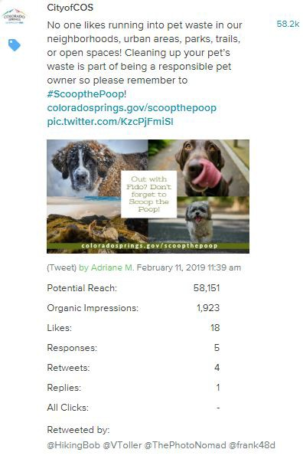
Twitter
(January 1, 2019-Feb15, 2019)
Most Popular Tweet
Overview
◆ 9 Messages
◆ 13,129 Impressions
◆ 64 Likes
◆ 16 Retweets
◆ 16 Clicks
◆ Topics: Illicit Discharge, Scoop the Poop, project updates

Slide 13
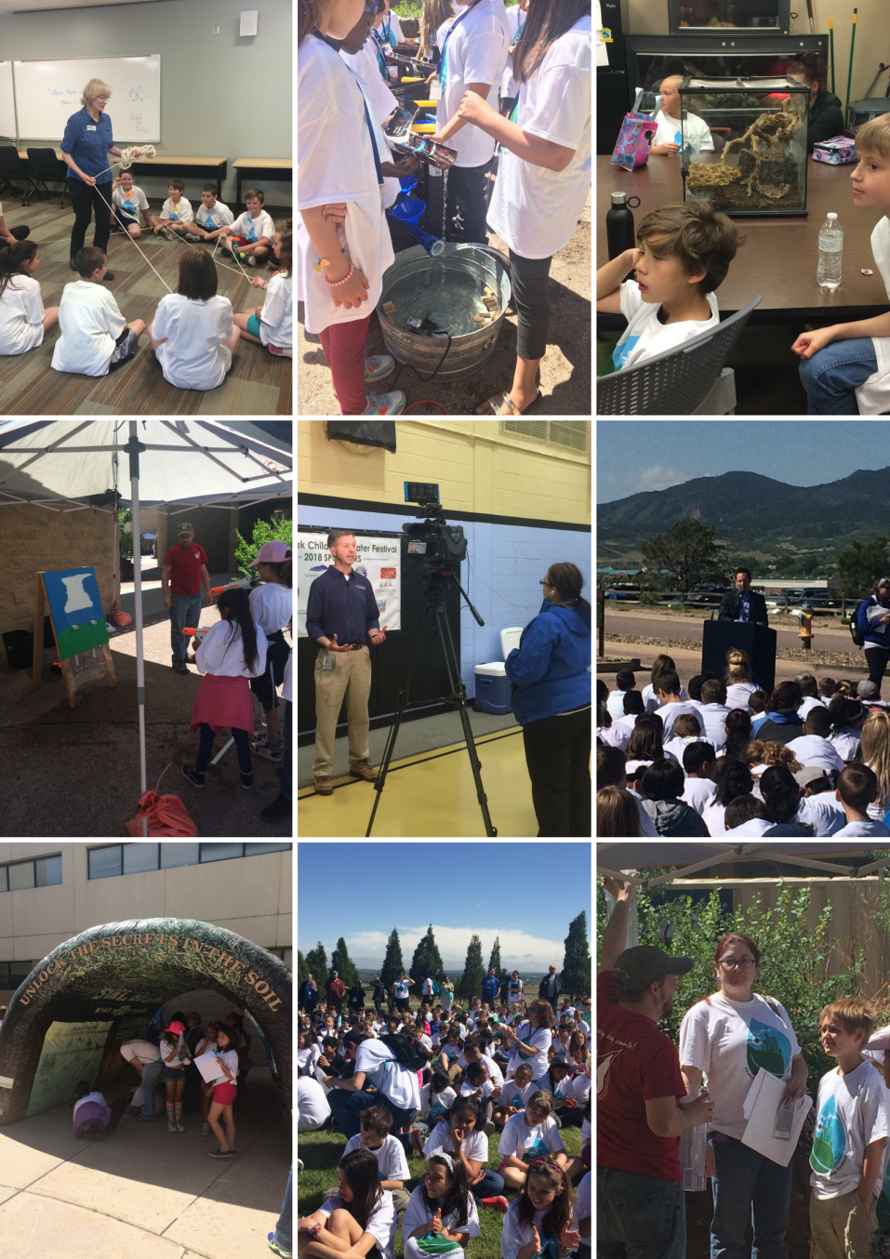
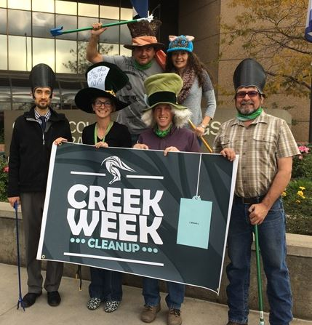
Educational Outreach
2018 Overview
◆ Runoff and Flood Messaging
◆ 4,244 Children Reached
◆ 35 Schools
◆ Other Events – Children’s Water Festival

Slide 14
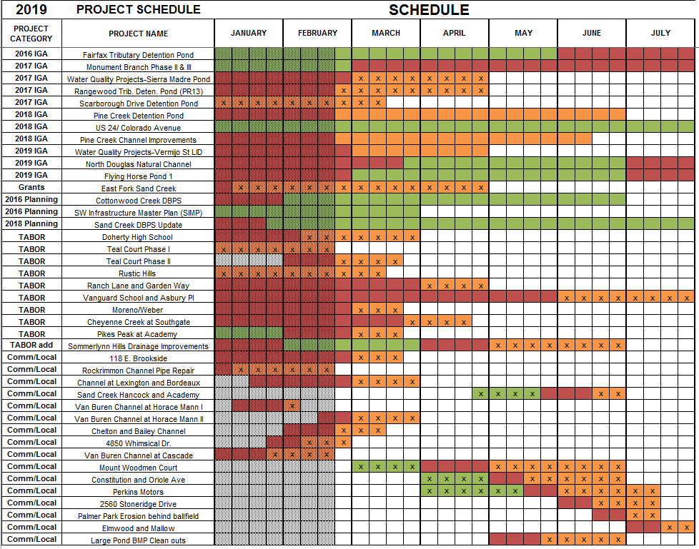

Slide 15
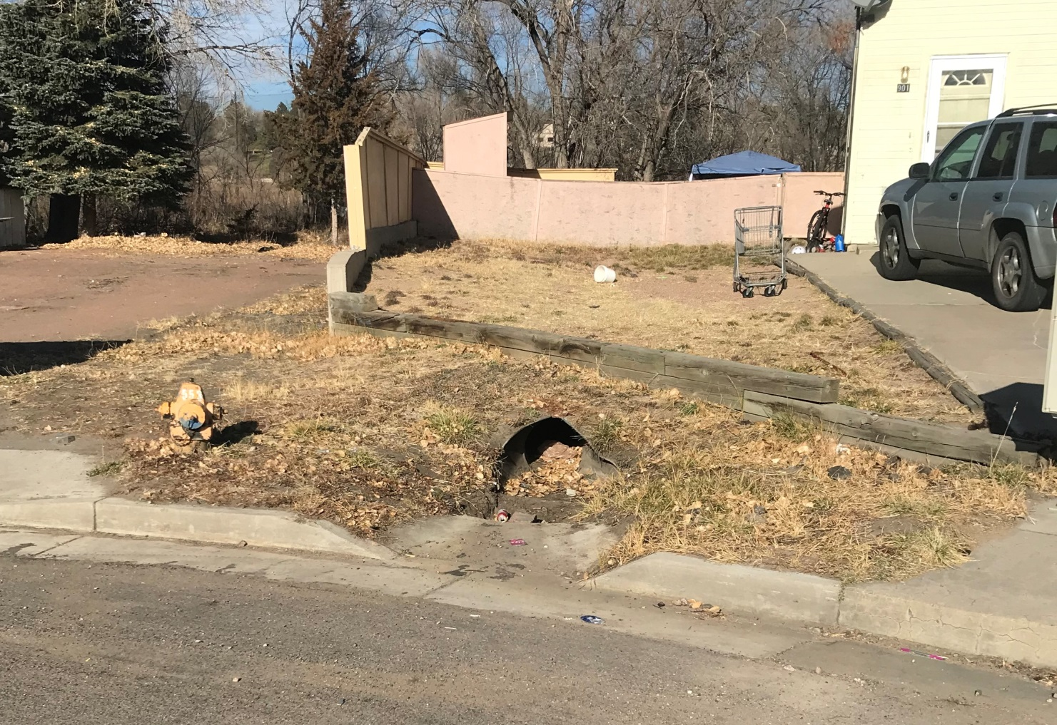

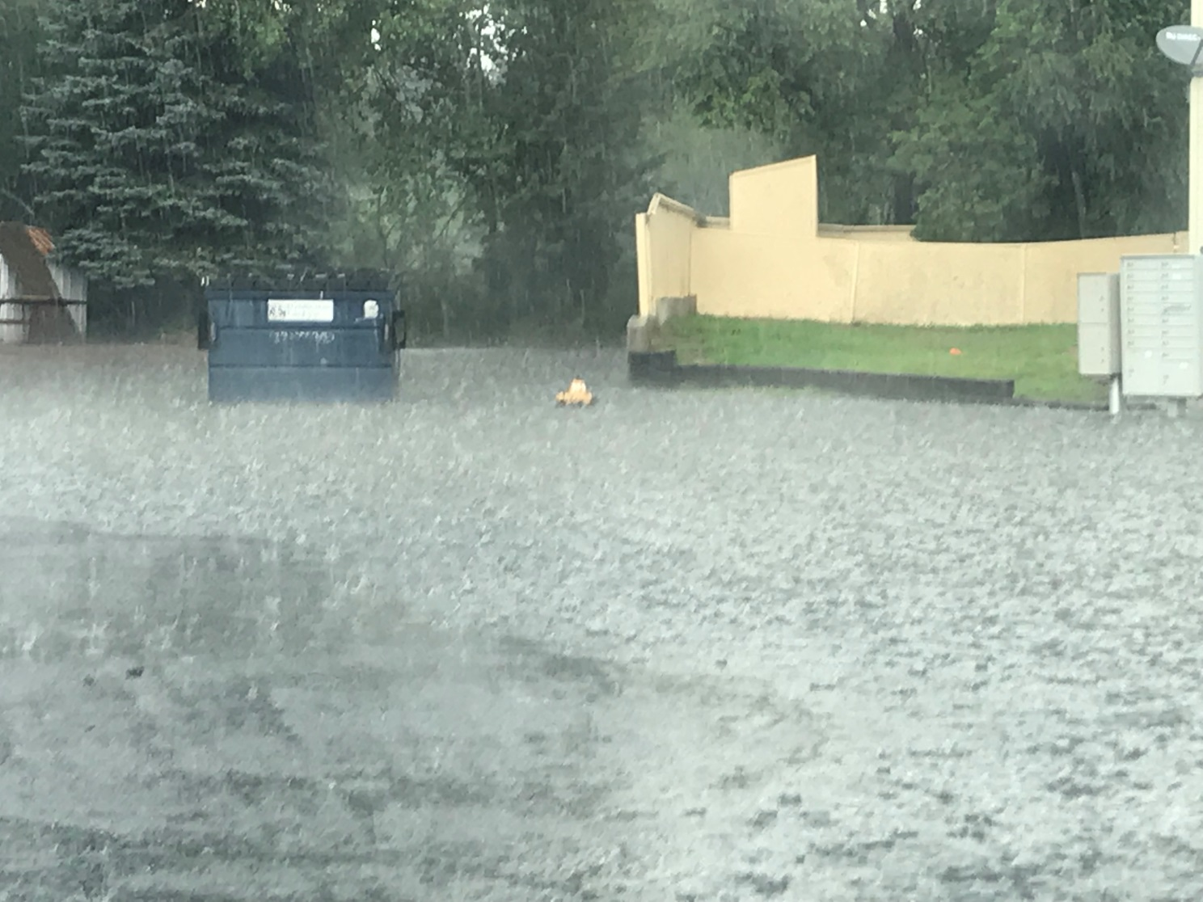
TABOR Project Example - Teal Court

Slide 16
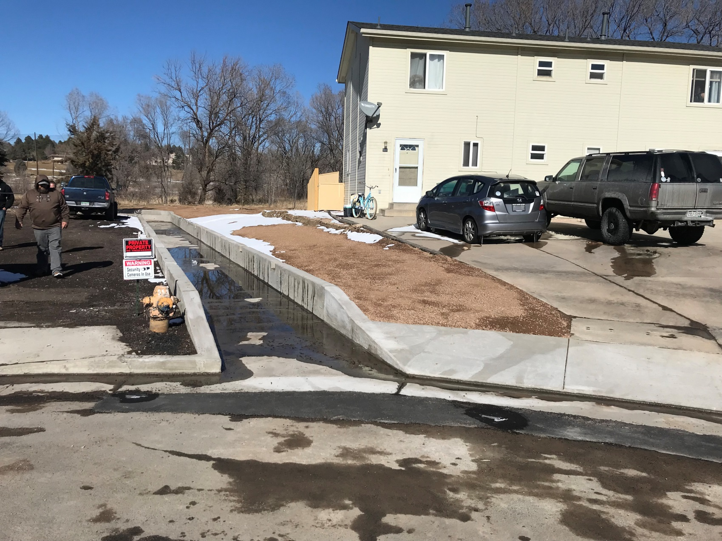
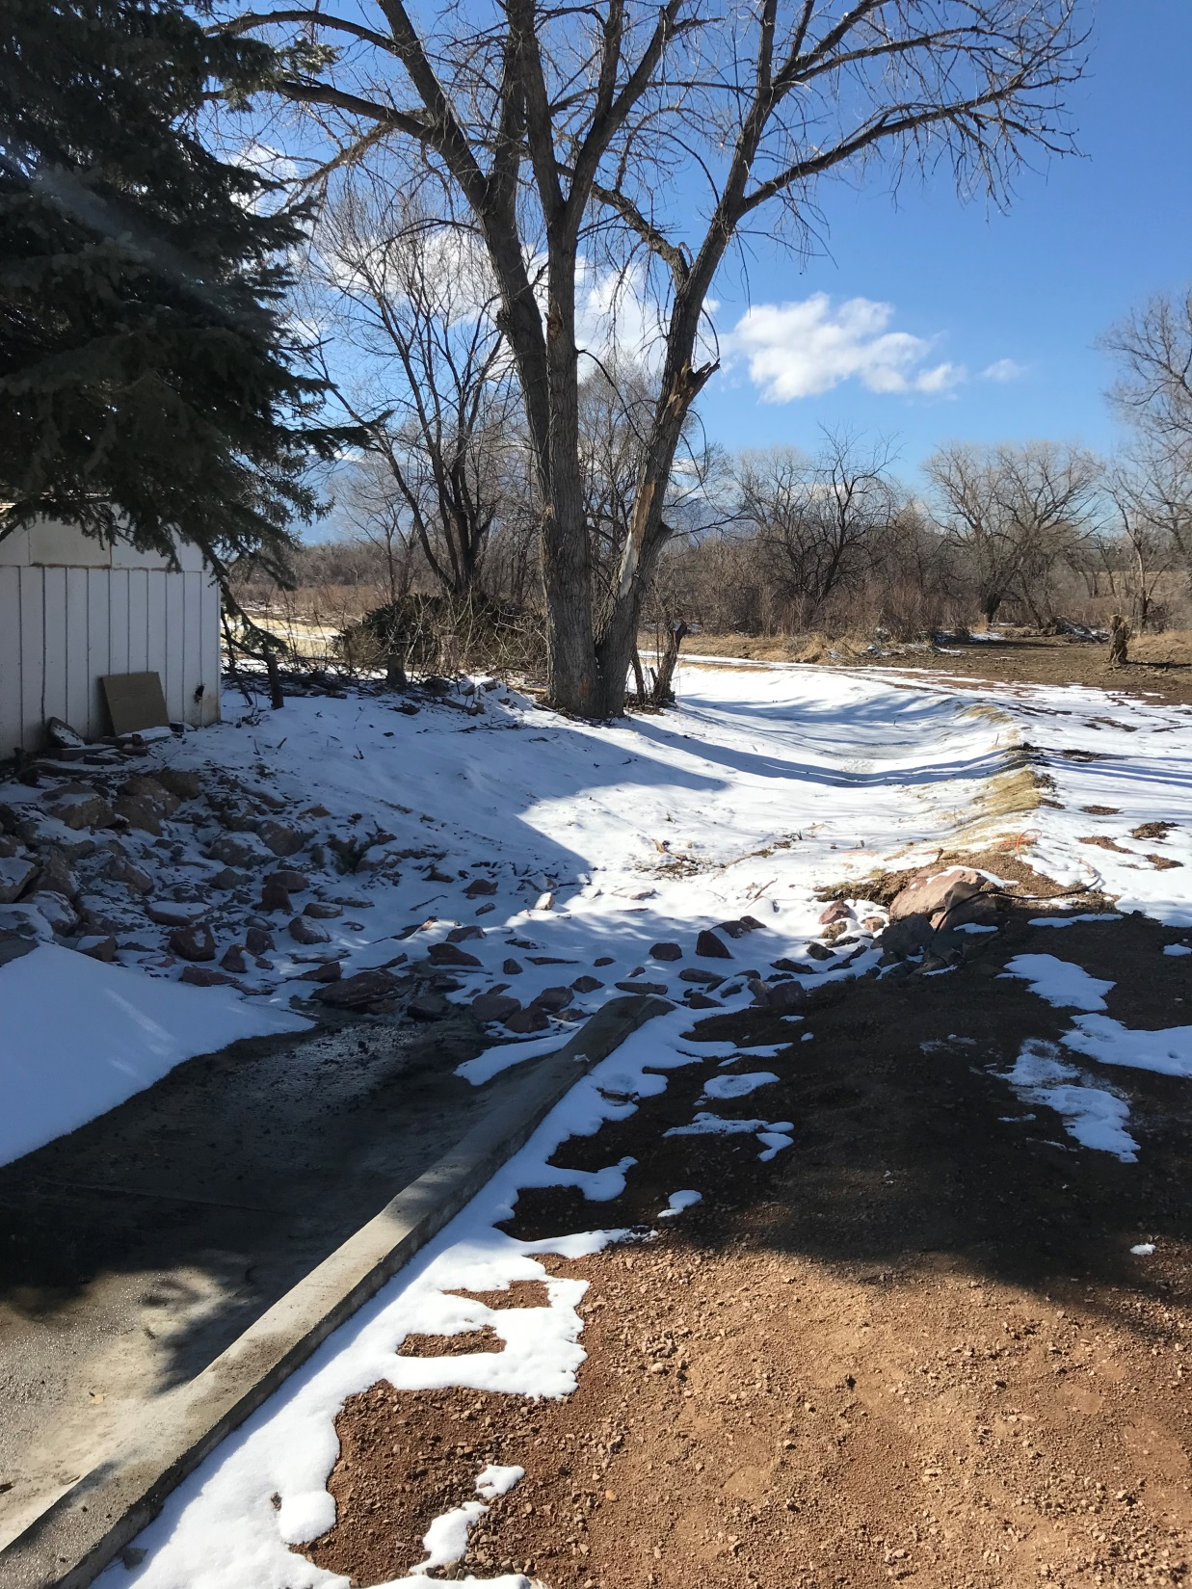
In House Design
On-Call Contractors List - Low Bid Selection
Total Cost: $138,359

Slide 17
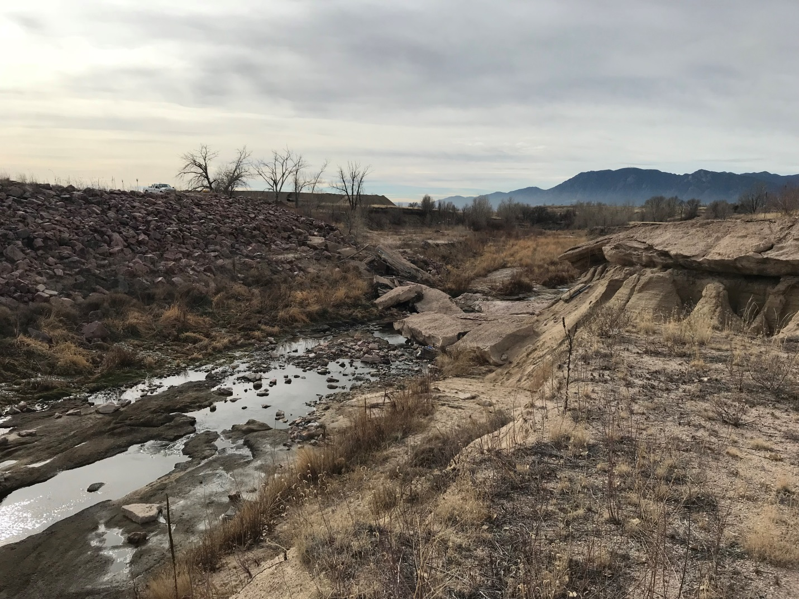
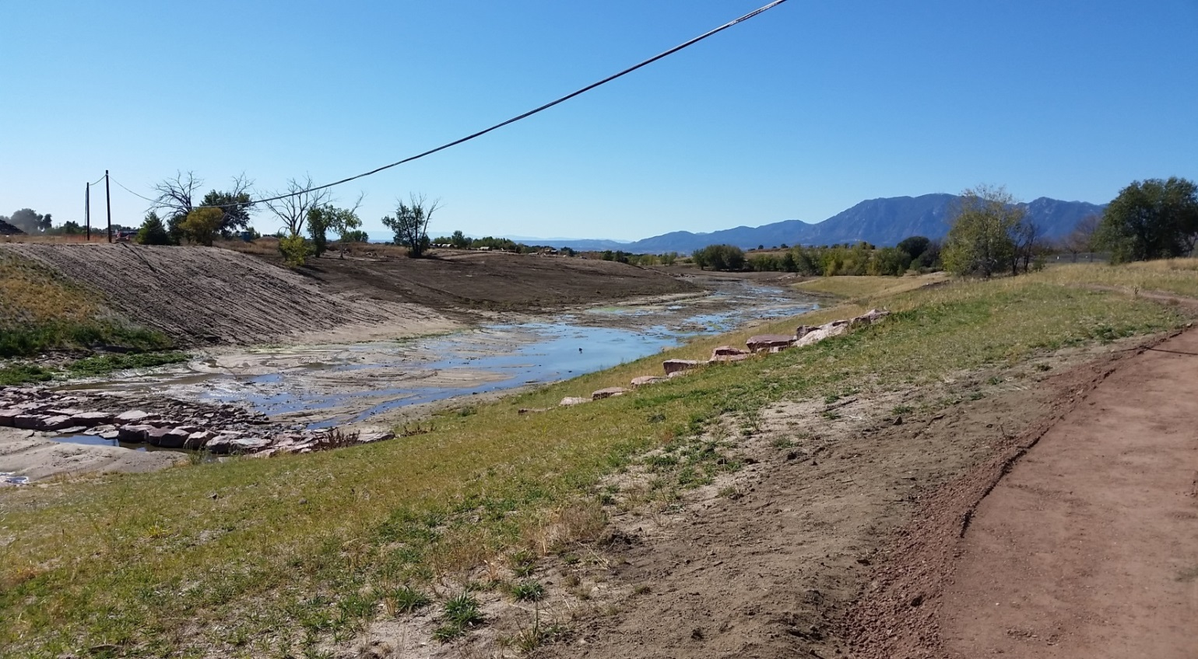
IGA Project Example - Sand Creek South of Platte
FEMA Grant Funded
Open Solicitation Design and Construction
Total Cost: $5.7M

Slide 18
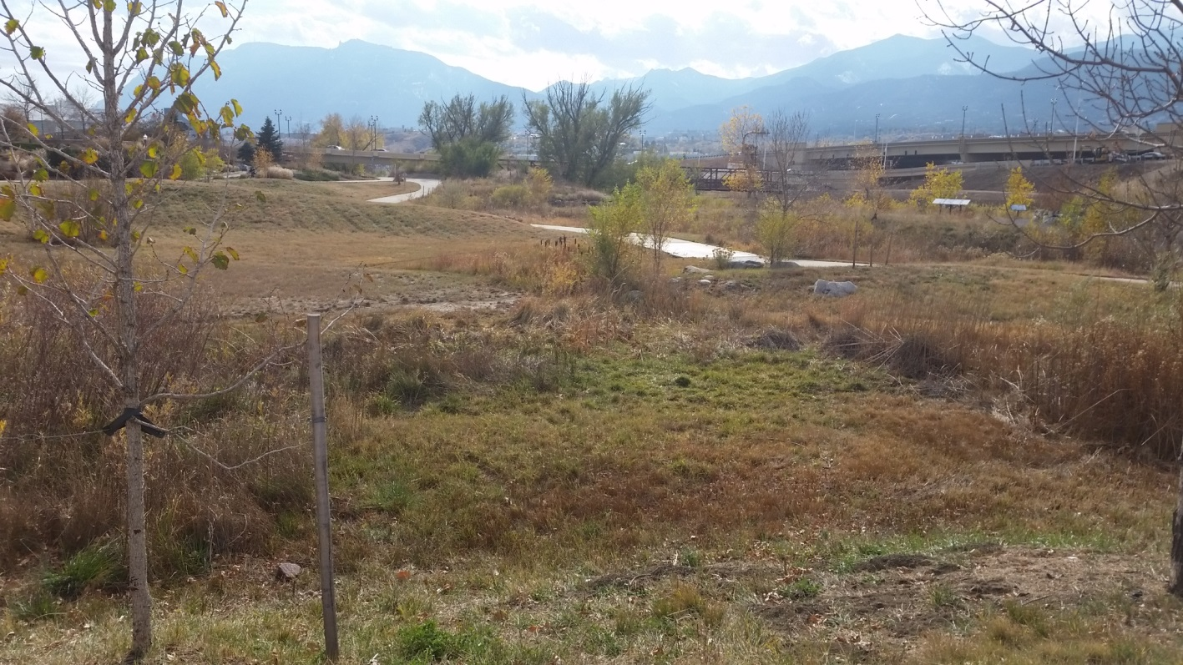
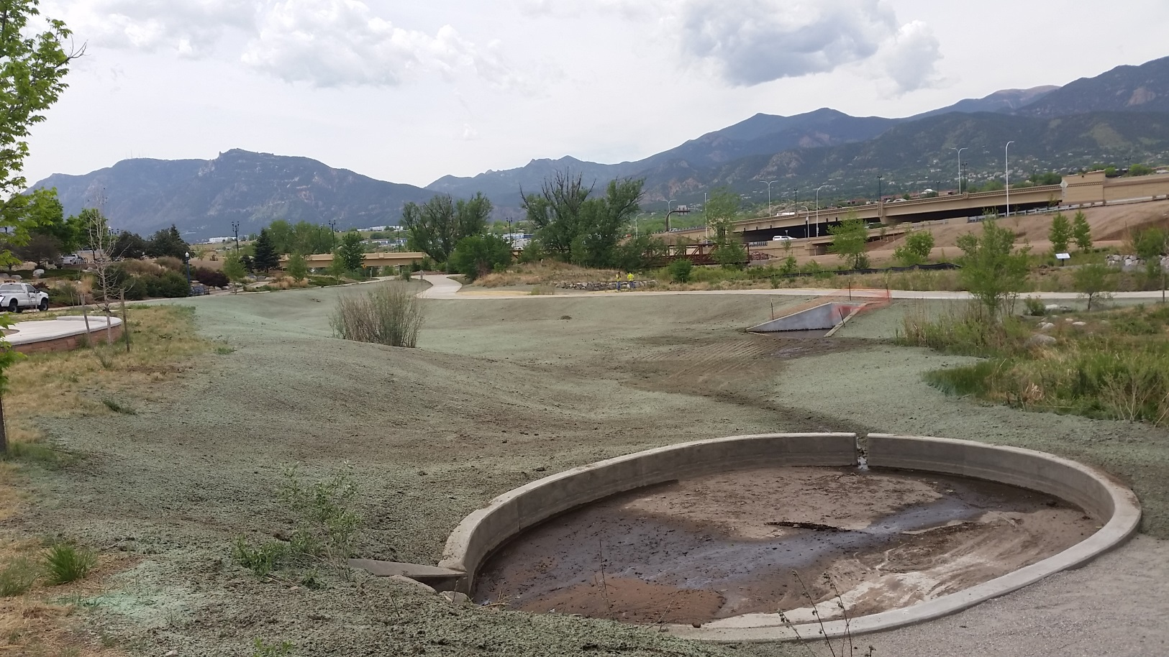
IGA Project Example – ATB Park Detention Pond
On-Call Design
On-Call Contractors List - Low Bid Selection
Total Cost: $464,484

Slide 19
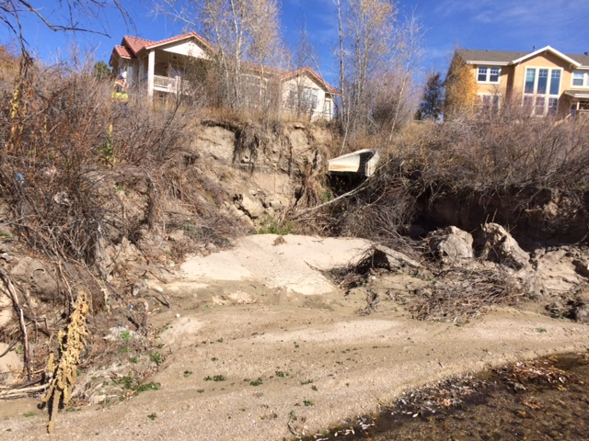
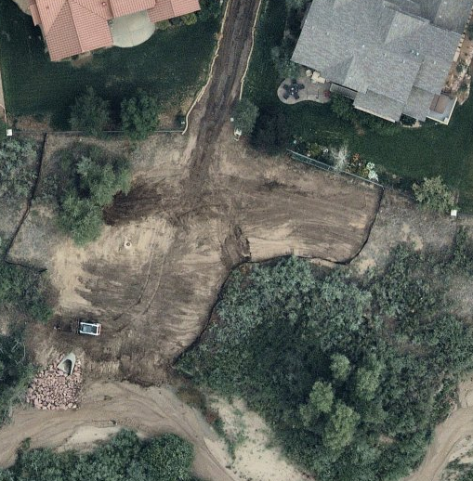
Emergency Project Example – Willowglen Outfall into Pine Creek
In House Design
On-Call Contractors List - Low Bid Selection
Total Cost: $57,230

Slide 20
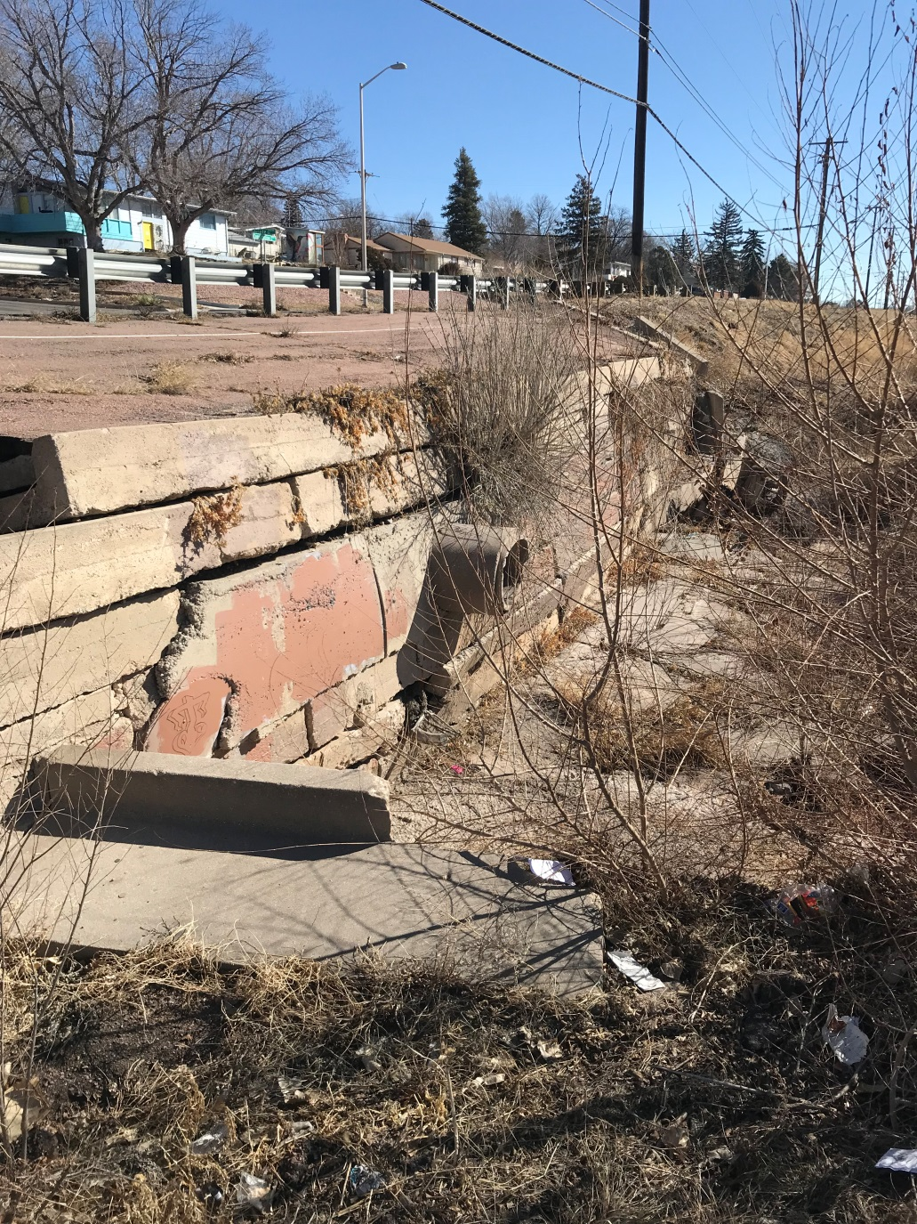
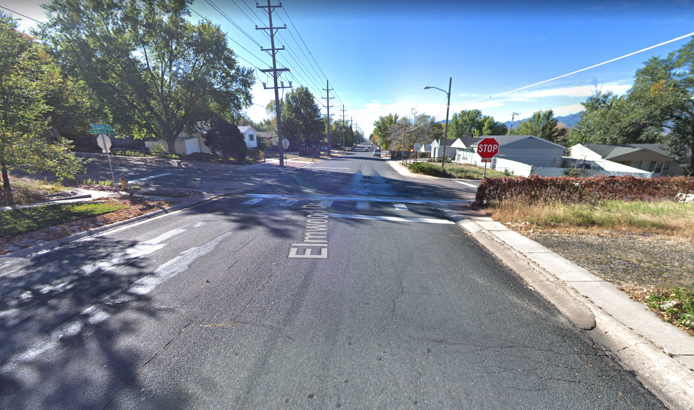
Emergency Project Prioritization - $200K
VS.

Slide 21
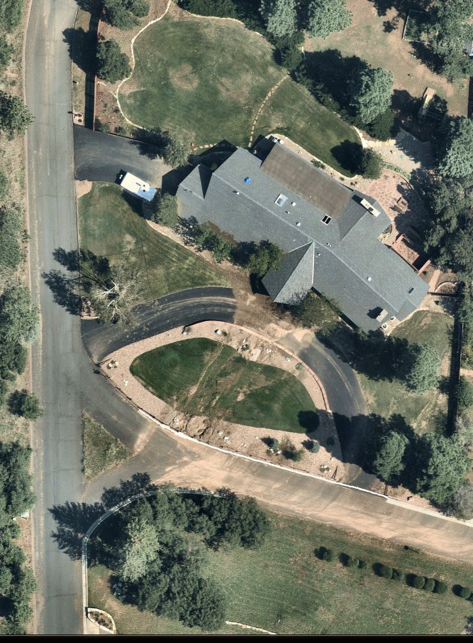
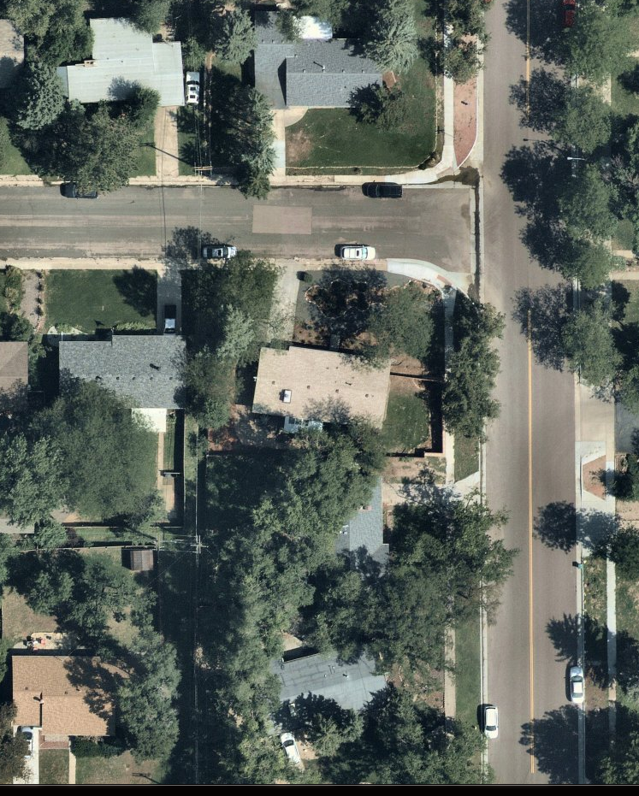
Emergency Project Prioritization - $100K
VS.

Slide 22
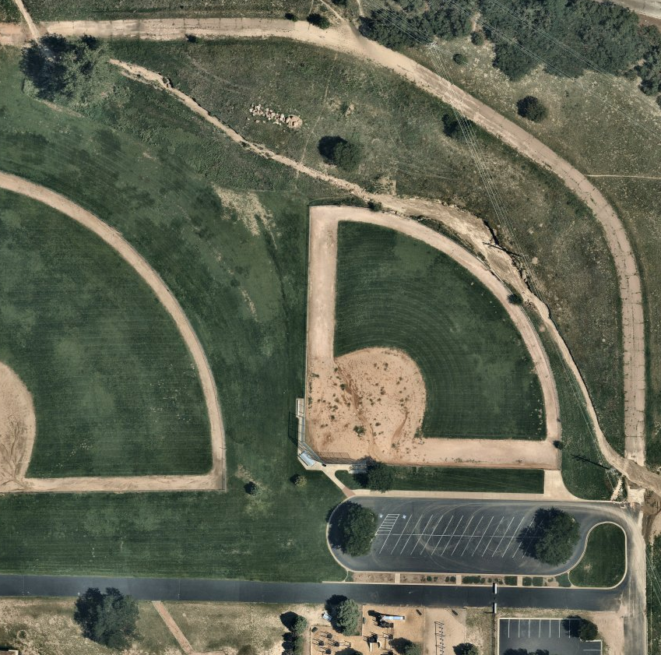
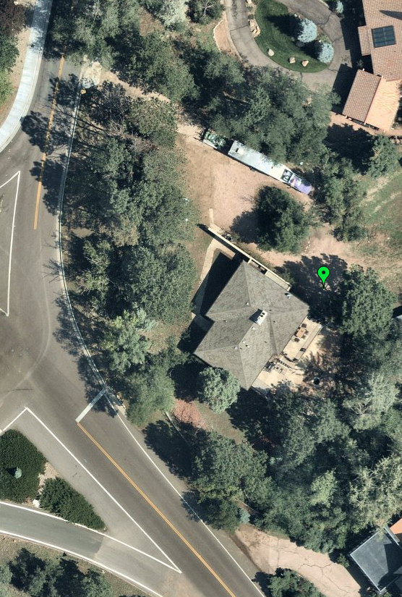
Emergency Project Prioritization - $20K
VS.

