Slide 1
Near North End
Neighborhood Parking
Action Plan
October 16, 2019
Tim Roberts,
Principal Transportation Planner
Stacey Salvatore,
Associate Transportation Planner

Slide 2
Overview
Why We Are Here
Summary of Process
Feedback from Meetings
Action Plan Details
Citizen Questions

Slide 3
Why We Are Here
Citizen requests for action regarding existing parking issues
Old and Near North End Neighborhoods Transportation Study Recommendation
Present the proposed Action Plan

Slide 4
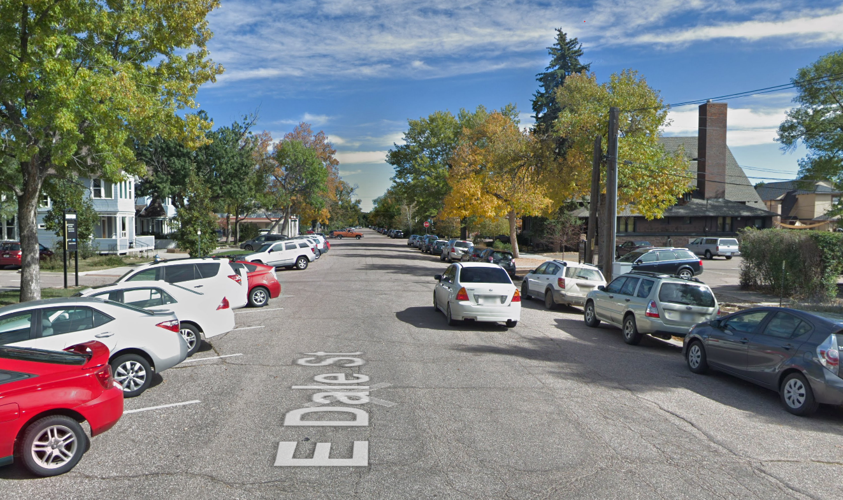

Slide 5
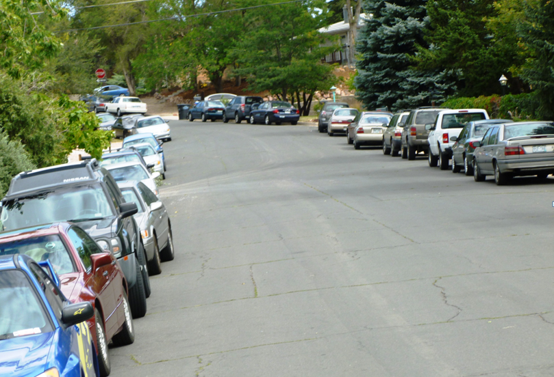

Slide 6
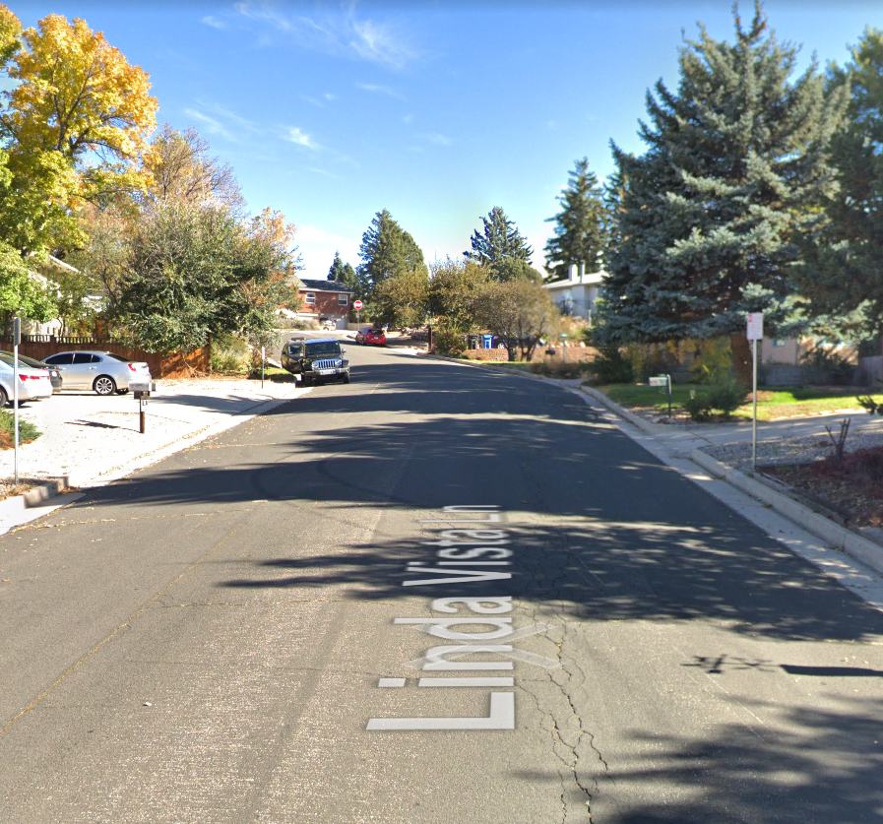

Slide 7
Summary of Process
Identified Study Area
Segmented into smaller Block Groups
Conducted Individual Block Group Meetings
Identified Options for Action Plan
Followed Up with Enforcement, Parking Enterprise, Signs & Markings, Traffic Technicians

Slide 8
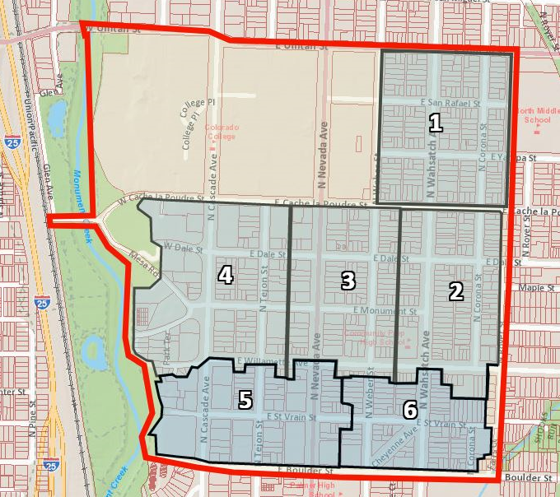
Process
South of Uintah Street Study area and Block Groups

Slide 9
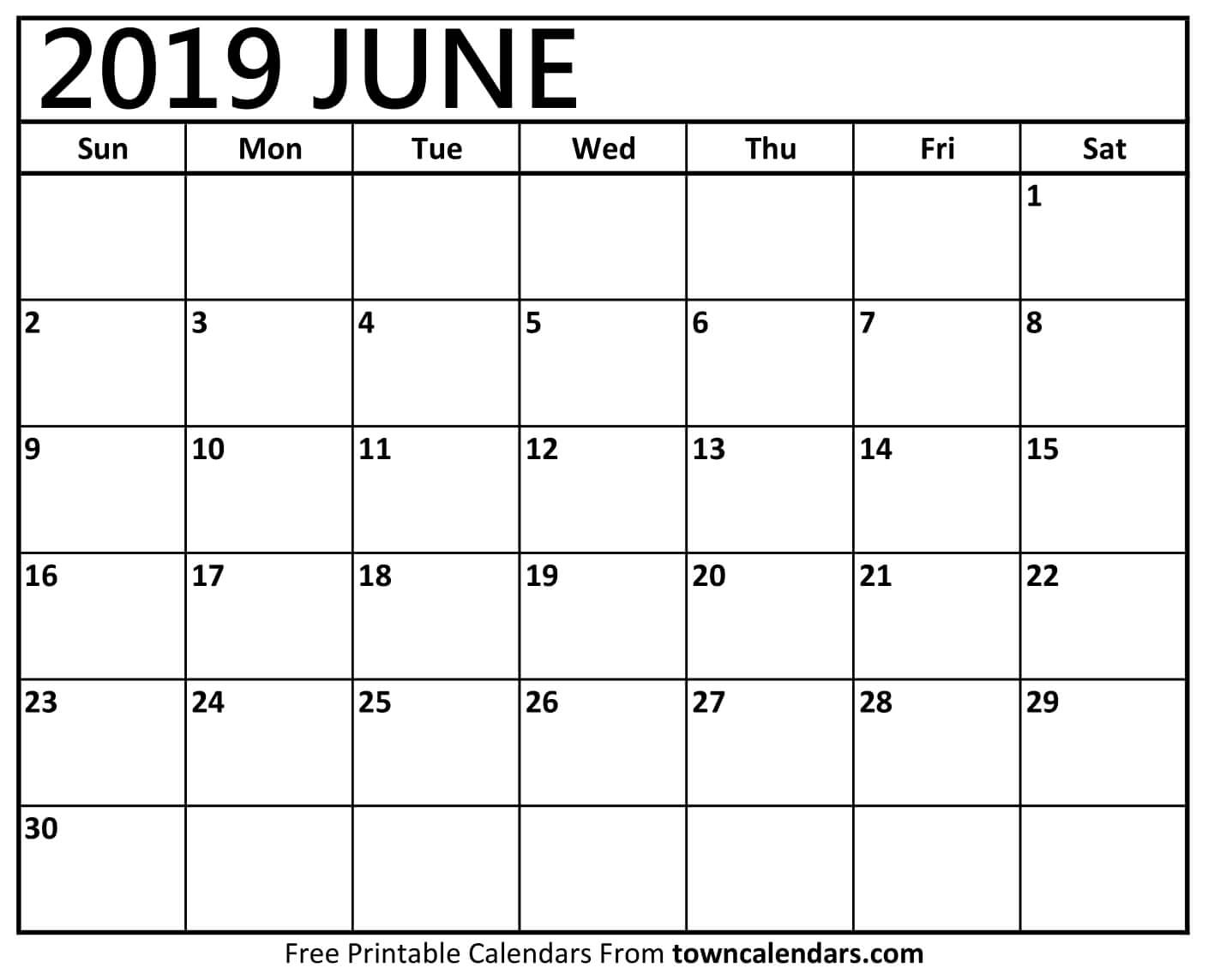
Kick Off
Block Group 1
Block Group 2

Slide 10
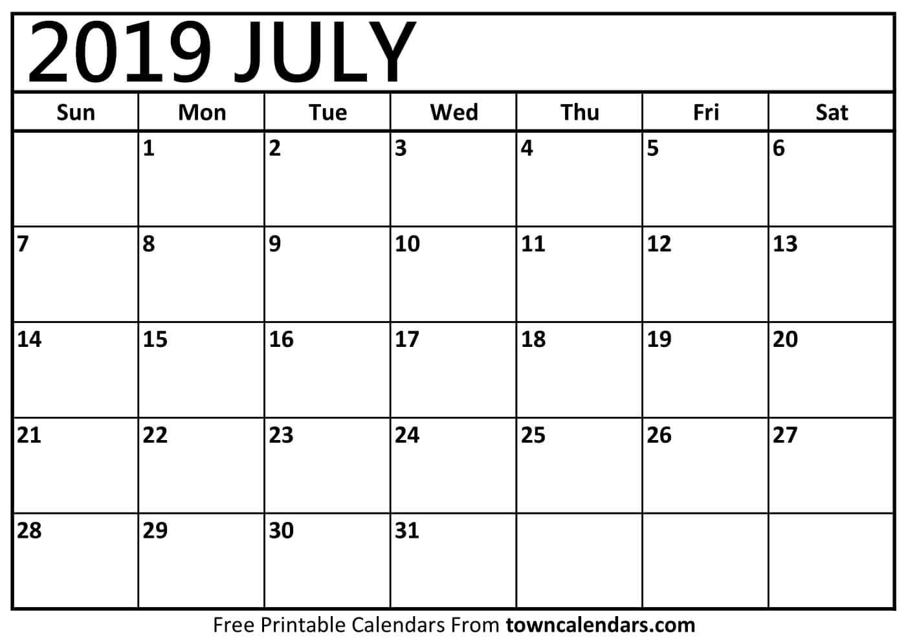
Block Group 3
Block Group 4
Block Group
5 & 6

Slide 11
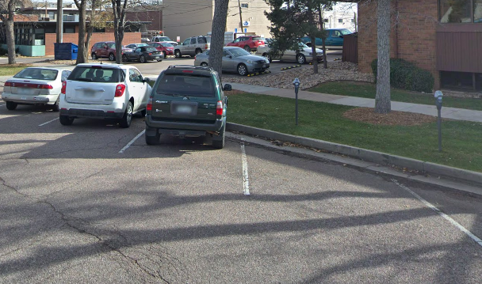
Meeting Feedback
Add & Relocate Metered Parking
Add Diagonal Stalls near Monument Park
Paint Parking Stalls
Implement Permit Parking
Enforcement

Slide 12
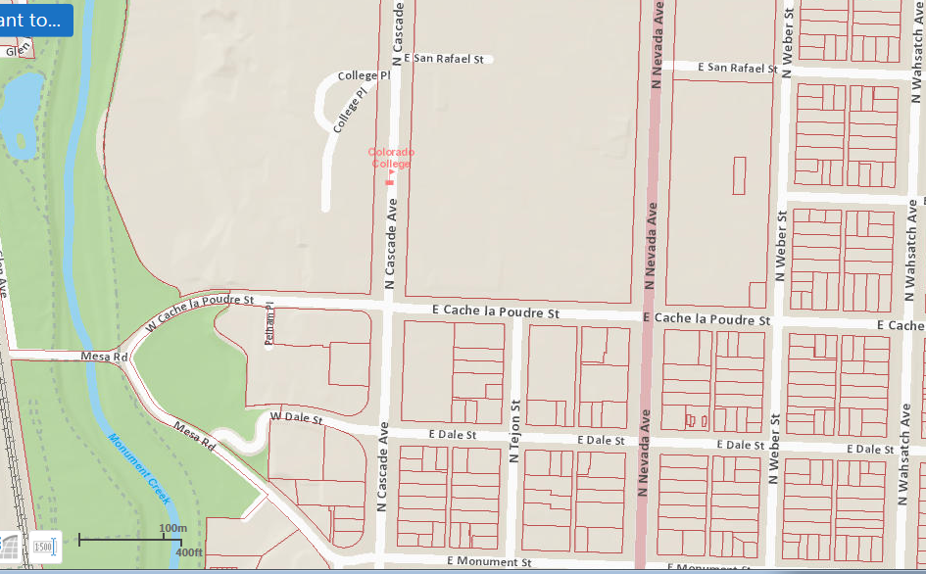
Proposed Permit Locations
Insert Maps
Notes:
A few examples of parking programs
we are not proposing any of these as solutions, just examples to get you thinking of some possible options for solutions

Slide 13
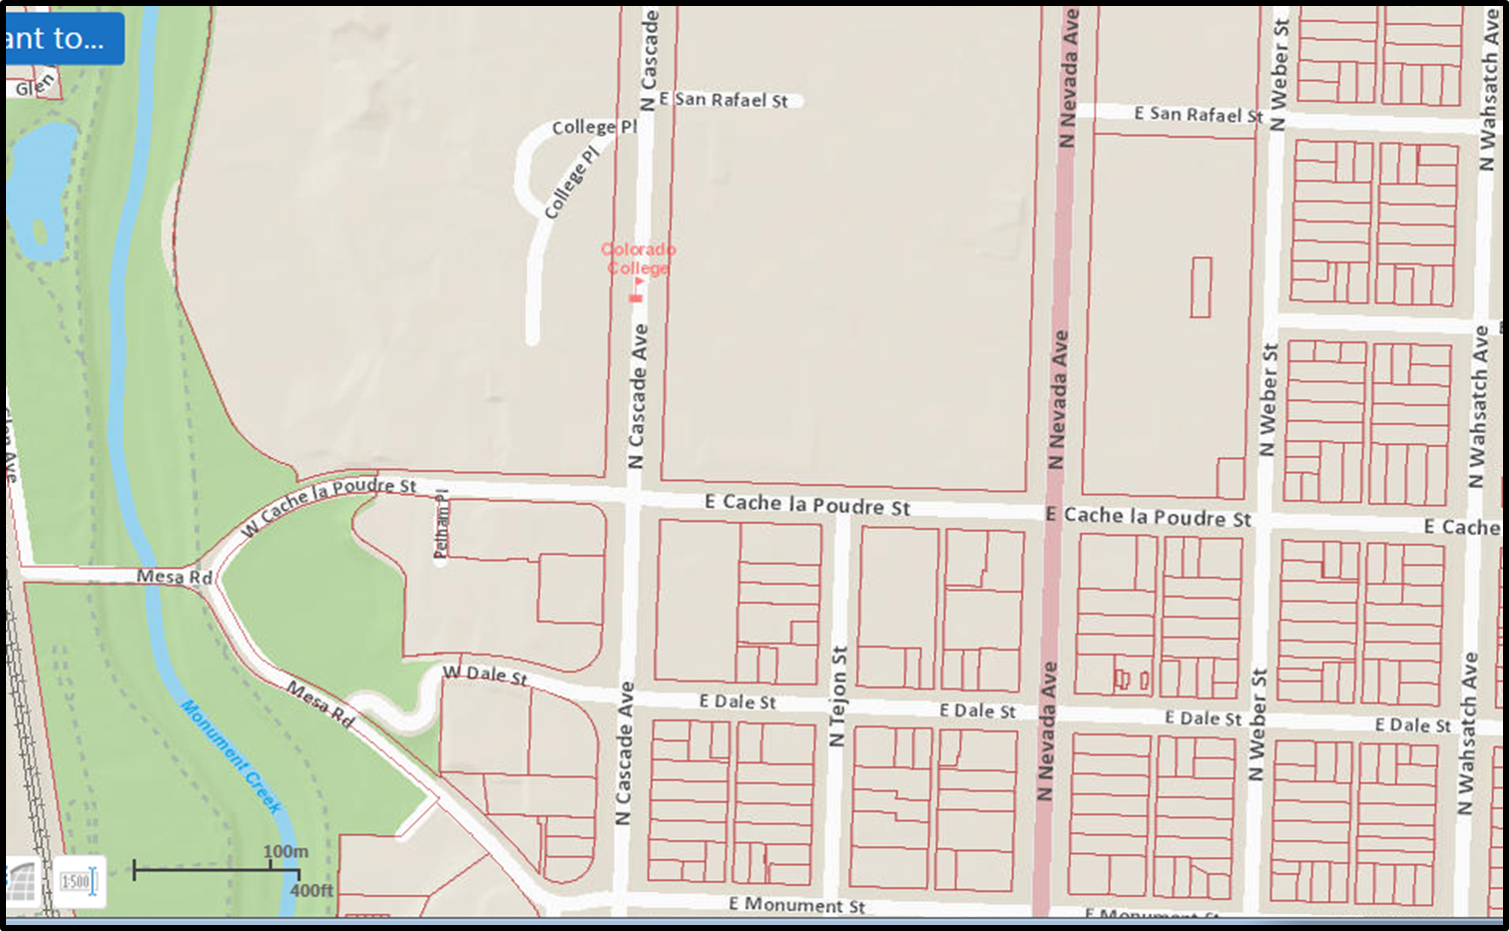
Future Meters

Slide 14

Future Striping Plan

Slide 15
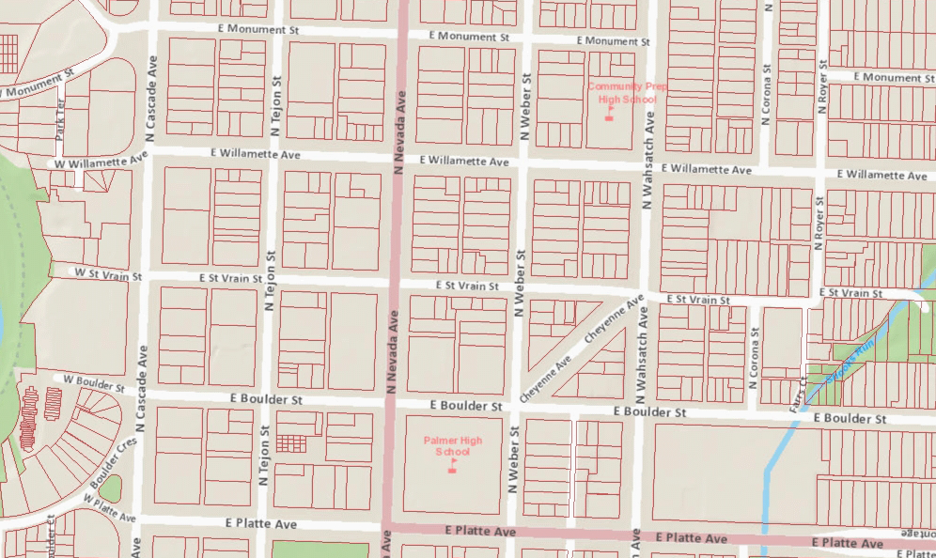
Future Striping Plan

Slide 16
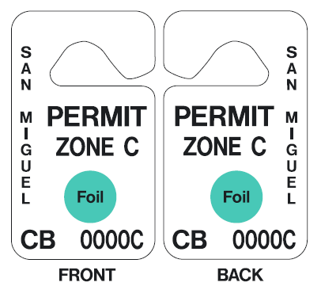
Permit Parking
Address Specific
Initial Permit is Free
$150 Replacement Fee
Guest Passes Available
Parking Fine $60.00
Notes:
These are just some ideas to get you thinking about some of the options out there. We will be meeting with various block groups to find out what works the best for everyone. So bring your ideas to those meetings.

Slide 17
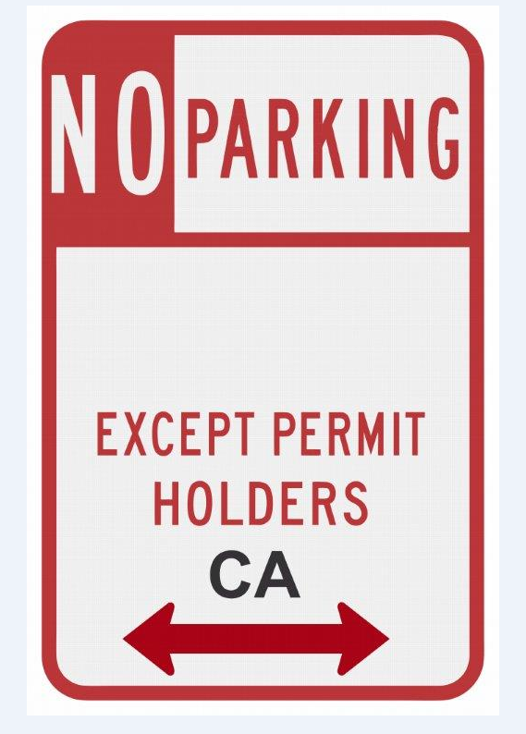
Implementation
Winter Break
Permits Distributed by Certified Mail to Property Owners
Signs Installed
Parking Striping Now
Monument Park
Other Roads

Slide 18
Questions?
Notes:
These are just some ideas to get you thinking about some of the options out there. We will be meeting with various block groups to find out what works the best for everyone. So bring your ideas to those meetings.

