Slide 1
Near and Old North End
Neighborhood Transportation Plan
December 7th, 2017
Kathleen Krager

Slide 2
What did we learn?
Speed
Sensors
Noise From
I-25
Move Buses
To Wahsatch
Make Fontanero More
Bike/Ped Friendly
Maintain Historic
District Facilities
CC Tunnel or
Overpass Crossing
Murals Painted
At Intersections
More
Bumpouts
Neighborhood Watch
Empowerment for
Speeding Traffic
Reduce
Dips on Nevada
Protected Left Turns
Lanes on Fontanero
Bad Ped Flashers
At Colorado College
Sych Cascade Signals
With Other N/S Signals
No SB Left Turn
At Wood
Vagrancy and
Panhandling
Cut Through
Traffic
Tree Trimming
Around Signs
Protected Left Turns
Lanes on Fontanero
No Stops Between
Uintah and Fontanero
On Weber
Steele Elementary
Nevada Crossing
Add Median and
Ped Ramps on Weber
NO TRUCKS
ON NEVADA
Improve Intersection
At Uintah/Cascade
Physical Barrier at
Wood/Uintah
No Right Turn
SB Wahsatch/Fontanero
Traffic Diversion
Into Alleyways
Roundabout at
Cascade/Cache La Poudre
Lower Speed Limit
On Fontanero
Tejon and Weber
One Way
Protected Left Turns
On Uintah Corridor
Lanes Too Wide
On Cascade
Left Turn Arrow
Fontanero/Nevada
No Right Turn Lane
Fontanero/El Paso
Weight Signal Progression
For NB Wahsatch
Ped Flashers at
Colorado College and
Preschool
Better Street
Lighting
Raised Ped Crossings
On Uintah
More Crosswalks
On Weber
Colorado College
Parking (Tejon)
Make I-24 More
Attractive/Accessible
Extend Constitution
To I-25
Extend Constitution
To I-25
Move Parked Cars
From Crosswalks
No Turns Lanes
At Signals
Marking and Paving
On Tejon
Enforce Side-Lawn
Maintenance
Espanola/Nevada
Ped Crossing
Improvements
No Right Turn on
Red at Intersections
Curbs, Gutters and
Sidewalks
Ped Crossing at
Tejon/Uintah
Slower Speeds on
Wahsatch
1 Bus/1 Thru Lane
On Wahsatch
ADA Ramps
Improve Uintah Signals
At Palmer park and Union
Weber Bike
Commuting Corridor
Signal Triggers
For Bicycles
Capacity Concerns
On Uintah
Ensure Other Changes
Don’t Affect Nevada
More Left Turn Lanes
Cascade Ave.
Traffic
Cameras
Extend Uintah Bike Lanes
West of Cascade
Cascade Ends at
Fountain St.
Shook’s Run
Crossing
Empty Buses
Frequent Stops
More Stop Signs
Reduce Cut-Through
Bike Lanes on
Weber Over Wahsatch
Closure at Paseo and
Constitution Extension
Road Diet
Fontenero
Keep Nevada Median
And Old Trees
Rubberized Asphalt
To Reduce Noise
Uniform Speed Limit
On Nevada
Road Diet for
Side Street Visibility
Cascade Ped Crossing
Improvements
No Turns Lanes
At Signals
Painted Curbs
Traffic Congestion
On Weber
Side Street Parking
Obstructs Vision
More Parking
On Nevada
Buses to
Bon Shopping Center
Move Buses from
Nevada to Cascade
Enforce Noise
Ordinance
Roundabouts
Better Lighting
No Big Poles
Bottleneck at
Cascade /Jackson
Better Progression
On Fontanero
Penrose Hospital
Parking
Community Education
Of Laws
Enforce 4-Way Stop
Wood/Columbia
Colorado College
Parking
Jackson/Cascade Right
Lane Right Turn Only
Additional Speeding Fines
In Neighborhoods
Lower Speed Limit
On Fontanero
Extend Cascade South
Of Fountain
Potholes on
Tejon
Colorado College Ped
And Vehicle Traffic
Penrose Hospital
Parking
Align Cascade
Median Openings
Speeding

Slide 3
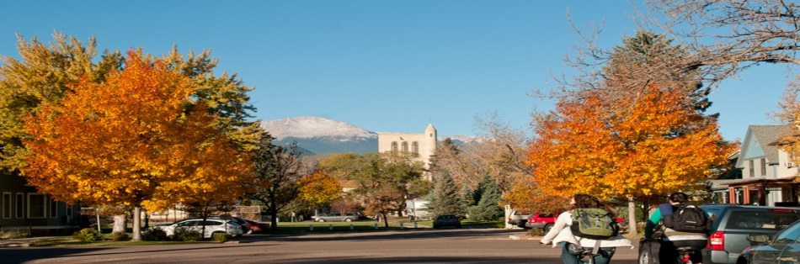
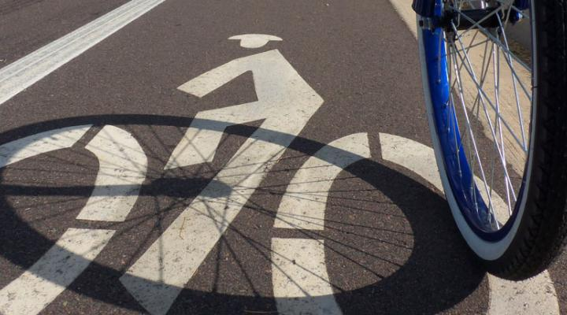
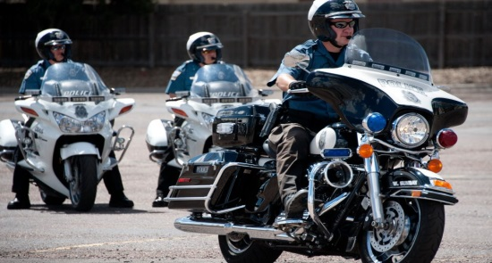
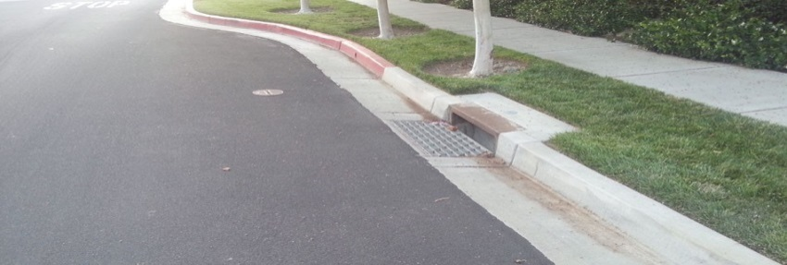
Wood Avenue
Parking Issues
  Colorado College
  Penrose Hospital
Speed Issues
  Increase Enforcement
  More Curb Bump Outs
  No Southbound Left Turn onto Uintah St.
Bike Improvements
  Penrose Hospital to Downtown
  Signal Triggers for Bicycles
Infrastructure
  Curbs, Gutters and Sidewalks
  Drainage Issues

Slide 4
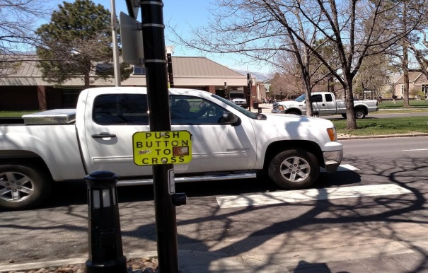
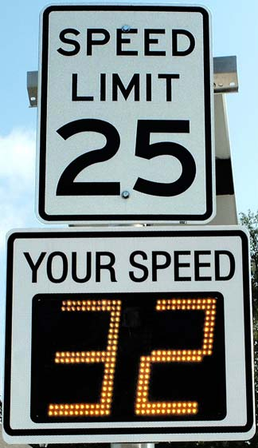
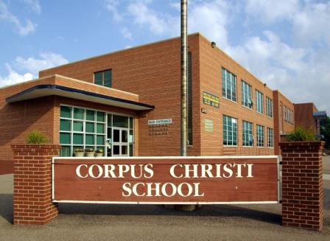
Cascade Avenue
Pedestrian Issues
  Improvements at Colorado College
  Too Many Wide Lanes
  More Pedestrian Infrastructure
Traffic Operations
  Uintah St.
  Cache La Poudre St.
  Jackson St.
  Synchronized Signal Timing
  Access to I-25
  More Left Turn Lanes
  Aligned Median Openings
Speed /Noise
Bicycle Infrastructure

Slide 5
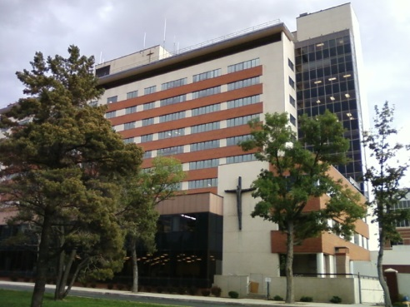
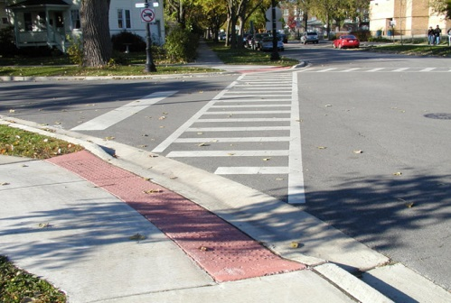
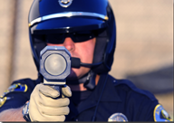
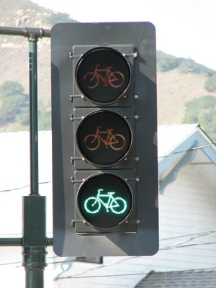

Tejon Street
Infrastructure Improvements
  Signage
  Curbs and Gutters
  Markings
  ADA Ramps
Parking Issues
  Colorado College
  Penrose Hospital
Speed Issues
  Reduce Cut-Through Traffic
Bicycle Infrastructure
  Crossing At Uintah St.
  Signal Triggers for Bicycles

Slide 6

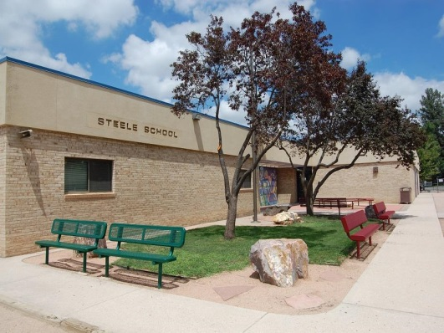
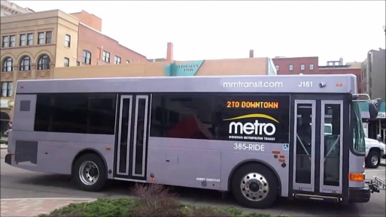
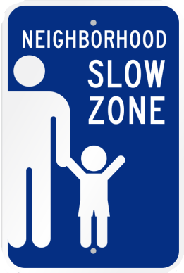
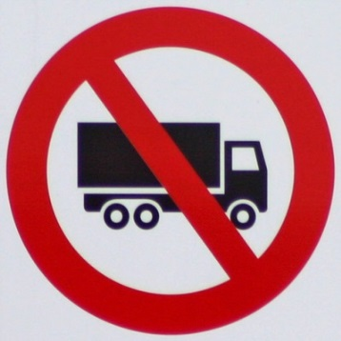
Nevada Avenue
Pedestrian Improvements
  Crosswalks for Colorado College and Daycare
  Curb Bump-Outs
  Visibility of Crosswalks
  Steele Elementary
  Espanola St.
Buses
  Empty Buses
  Frequent Stops
Speed /Noise Issues
  Rubberized Asphalt
  Uniform Speed Limit
  Speed Sensors
Truck Traffic
  NO TRUCKS!
Bicycle Infrastructure

Slide 7
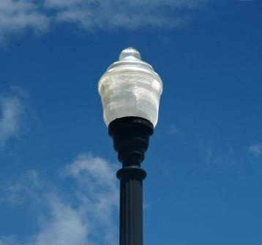
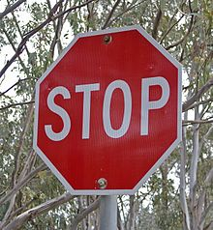
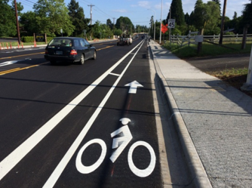
Weber Street
Pedestrian Improvements
  More Crosswalks
  Finish/Maintain Shook’s Run
Speed /Noise Issues
  More Stops
  Add Median and Roundabouts
  Road Diet
Bicycle Infrastructure
  Add Bike Lanes
Infrastructure
  Sight Distance
  Left Turn Lanes
  Painted Curbs
  Better Street Lighting
Buses
  Move Buses to Wahsatch Ave.

Slide 8
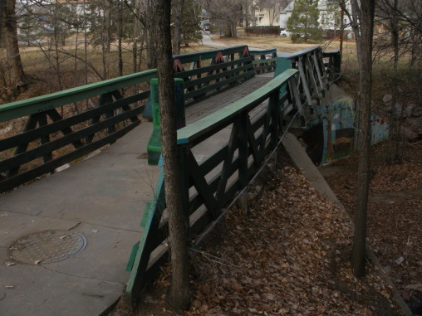
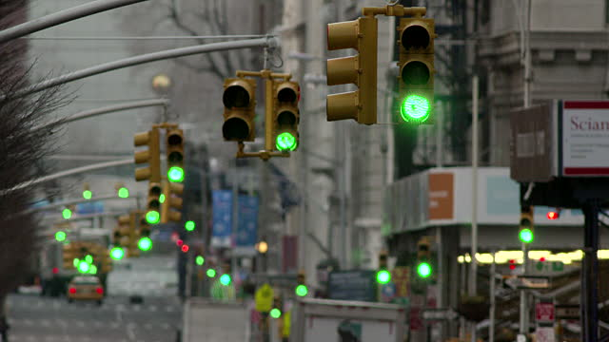
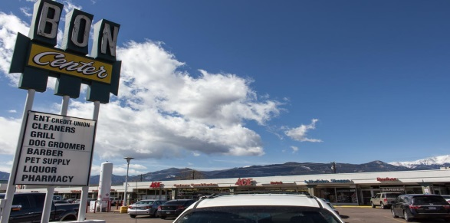
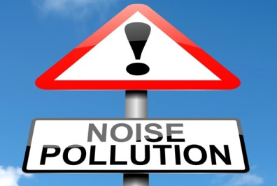
Wahsatch Avenue
Traffic Operations/Infrastructure
  Left Turn Arrow at Uintah St.
  Improve Signal Timing
  Better Street Lighting
Bicycle Infrastructure
  Road Diet
  Connect Shook’s Run Trail to Crossing
  Bike Lanes Preferred on Weber
Buses
  Move Buses to Bon Shopping Center
Speed/Noise

Slide 9
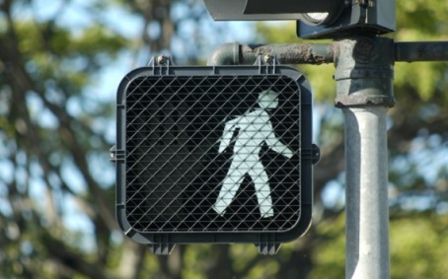

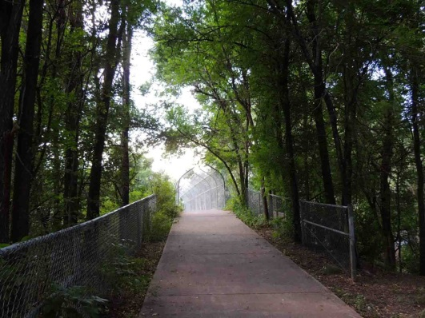
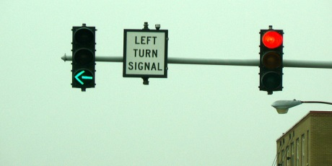
Uintah Street
Pedestrian Improvements
  Crossing at Tejon St.
  Shook’s Run
Traffic Operations
  Left Turn Lanes/Arrows Along Corridor
  No Right Turn on Red at Signals
  No Left Turn at Wood Ave.
  Improve Cascade Ave./Uintah St. Intersection

Slide 10
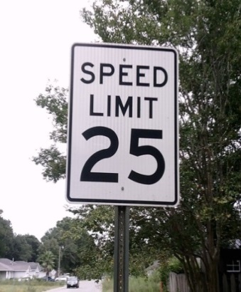
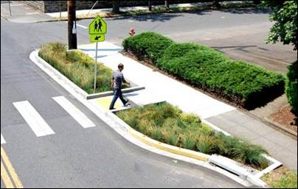
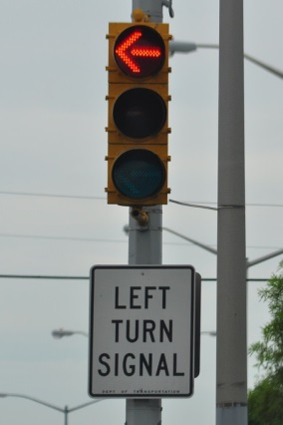
Fontanero Street
Bicycle Improvements
  More Bike Friendly
  Signal Triggers for Bicycles
Speed /Noise Issues
  Lower Speed Limit
Traffic Operations
  Right Turn Lane at El Paso St.
  Left Turn Arrow at Nevada Ave.
  Sight Obstructions
  Road Diet
  Curb Bump-Outs
  Signal Progression
  Protected Left Turn Lanes
Pedestrian Improvements
  Shook’s Run Crossing

Slide 11
MAJOR
STRATEGIES

Slide 12
Speed and Noise Issues
Special Speed Limits in the Area
  Arterial Streets – 30 mph
  Local Streets – 25 mph
Design to Promote Posted Speed Limit
Noise Ordinance Difficult to Enforce

Slide 13
Pedestrian and Bike Issues
Pedestrian Safety Criteria
  4 Lanes – Controlled Crossings
  2 Lanes – Uncontrolled Crossings
Bicycle Infrastructure Criteria
  Continuous Routes
  Controlled Crossings
  Bike Detection at Signals
Analysis/Decisions to be Made
  Pedestrian Safety for Colorado College and Surrounding Areas
  Location of Bike Routes
  Specific Projects

Slide 14
Traffic Operations/Infrastructure
Staff Study/Concept Design
  Uintah St. – Wahsatch Ave. to Nevada Ave. Left Turn Lanes
  Cascade Ave./Uintah St. Intersection Improvement
Median Design Criteria
  Medians on Cascade Ave., Nevada Ave., and Wahsatch Ave. are historic.
  Requires Parks Board Approval
  Establish a criteria for considering changes to medians.

Slide 15
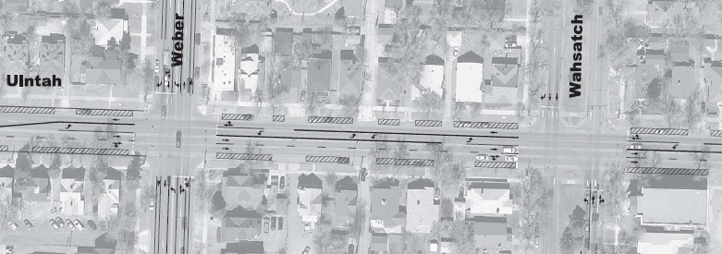
Alternative Proposal
Uintah Street

Slide 16
Parking Improvements
Specific to Certain Areas
  Penrose Hospital
  Colorado College
Consider Alternatives Within Those Areas
  Working with Institutions
  Restrict Parking Times
  Parking Permit Program

Slide 17
Bus Improvements
City Traffic will work with Mountain Metro Transit to determine appropriate bus routes
Any changes will go through Mountain Metro Transit public involvement process.

Slide 18
Commercial Truck Traffic
Remove Restricted Truck Route on Nevada Ave.
Trucks will need an origin/destination within the neighborhood.
Closures on I-25 – Trucks will be rerouted to Circle Dr., Fillmore St. or Academy Blvd.

Slide 19
Immediate Actions
Traffic Improvements on Uintah St.
Changes to truck routes
Changes to Speed Limits

Slide 20
Follow-Up
Pedestrian Safety
  January 2018
Neighborhood Parking Meetings
  Tim Roberts
Bike Route Locations
  January 2018
Median Change Criteria
  TBD
Bus Route Analysis
  Mountain Metro/Traffic Engineering Staff

Slide 21
QUESTIONS?
COMMENTS?

