Slide 1



Colorado Springs “Special Districts 101.5”
Session No. 7
City Council Work Session August 24, 2020
Peter Wysocki, Planning and Community Development Director
Carl Schueler, Planning Manager- Comprehensive Planning

Slide 2

Session 7 Topics
Reminder of Prior Sessions
Follow-up from Session #6
3) District Accountability and Reporting
4) Transition of District Governance
District Dissolution
Next Steps
  Jeff Greene, Peter Wysocki

Slide 3
Prior Sessions
Session 1- (September 23, 2019)
−General district overview
−State and County-wide district context
−2006 Special District Policy
−BIDs
Session 2- (October 21, 2019)
−Metropolitan Districts
Session 3- (November 7, 2019)
−Metropolitan district follow-up- statutory findings
−Special district submittal, review and approval processes
−GIDs

Slide 4
Prior Sessions
Session 4- (November 25, 2019)
-Metropolitan district service adequacy finding
-LIDs and SIDs
-Mill levies and Gallagher adjustments
Session 5- (December 9, 2019)
-SIMDs
-Special district financial obligations, debt authorizations and debt issuances
Session 6- (January 13, 2020)
-District powers and functions in addition to debt issuance
-District boards and elections
Most materials will be available Planning Website

Slide 5
Session 6 Follow-up
Updated district mill levy summary is now available and attached
    Numerous small updated Gallagher adjustments
    Some addition levies for new or activated districts
  Taxable status of District versus HOA-owned properties

Slide 6
Follow-up
-Mill Levy Summary Table
Attached
2019 taxes payable in 2020
Additional districts have certified levies
Several limited upward Gallagher adjustments

Slide 7
Follow-up
-Taxable Status of District versus HOA-owned Properties
Neither are typically assessed for taxes
District property usually tax exempt
HOA property non- taxable
  -value of common property allocated to individual taxable properties

Slide 8
HOA/ Metropolitan District Comparison
Advantages of a combined structure:
  Communication
  Avoidance of duplicate administrative costs
  Efficiency of tax and fee collection
  Powers and protections district
  Similar opportunities for representation, recourse, accountability

Slide 9
Accountability and Reporting
As governmental entities, all districts subject to Colorado Open Records and Meetings law
Various district- specific legislation
BID annual actions
Metropolitan District (Exhibit E) disclosures and annual reports
Contacts available via Assessor
Colorado Department of Local Affairs (DOLA) Site
IRS (Internal Revenue Service) accountability for tax-exemption and certification of costs, etc.

Slide 10

Contacts, Annual Reports and Disclosure
Contacts Approach and Philosophy
  Rely on Districts
  Colorado Department of Local Affairs (DOLA) Local Government web site
  Official City Files in Clerk’s Office, or Budget and Finance

Slide 11
District Contacts
Budget and Finance is the first point of contact for GIDs (general improvement districts)
Parks Department is first point of contact for SIMDs
Districts themselves are first contact for metropolitan districts and BIDs
  City maintains a contact list
  Most districts have a management contact

Slide 12
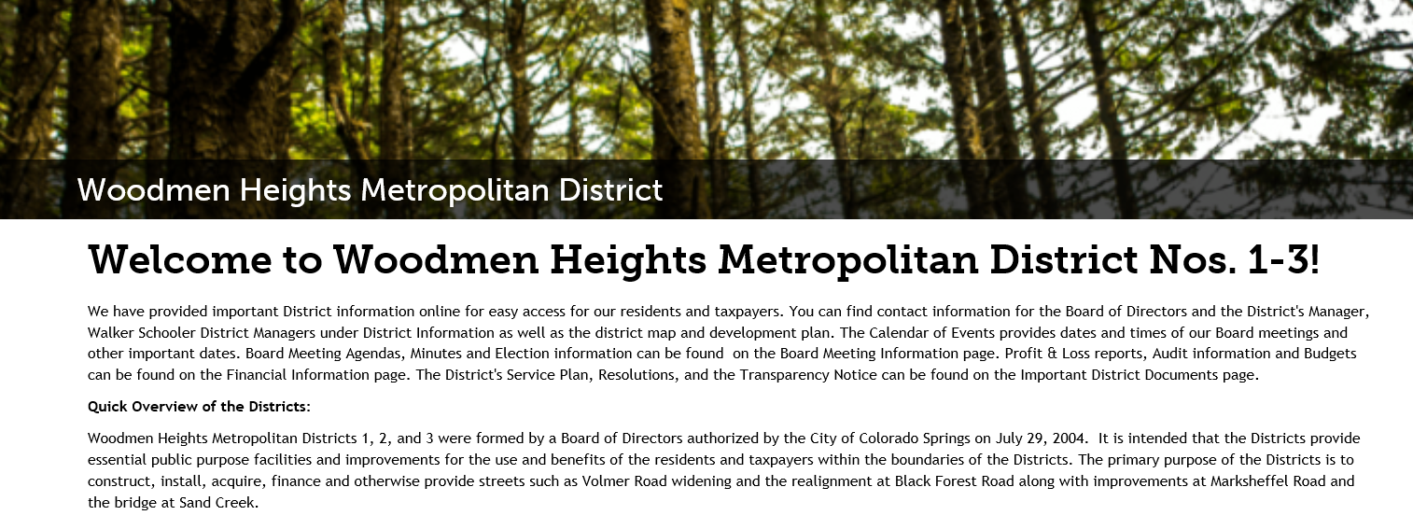
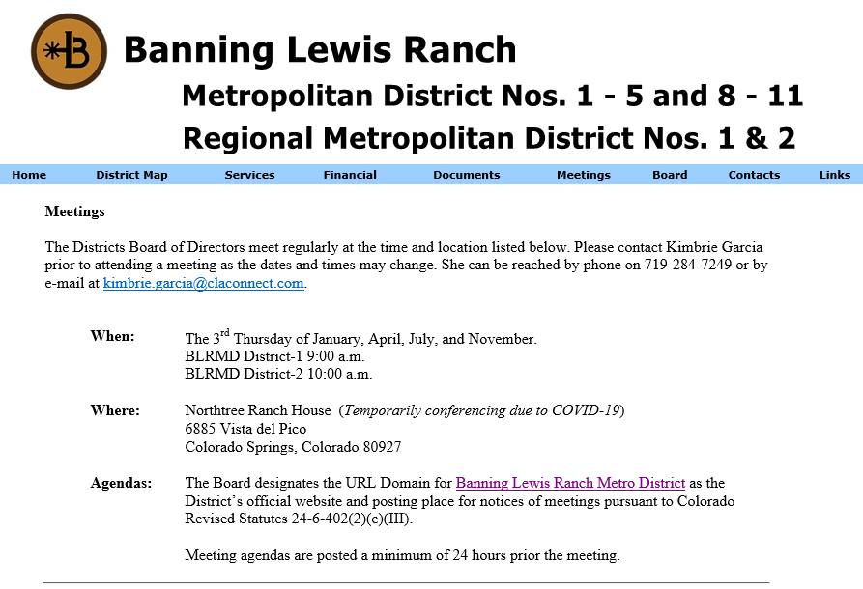
District Web Sites
Many Districts have robust web sites

Slide 13
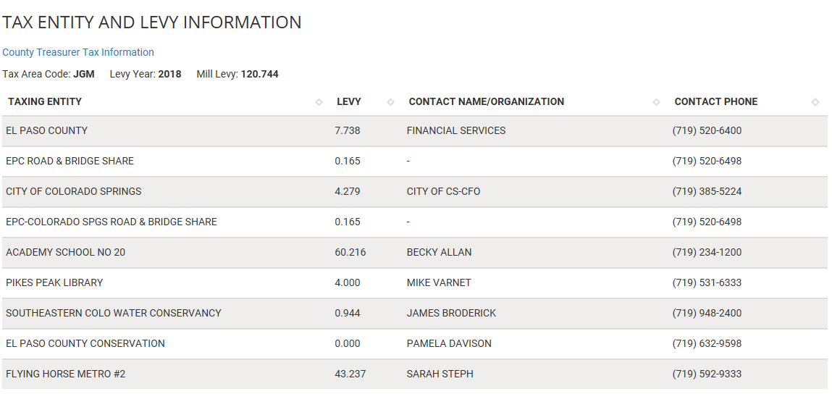
Sample from EPC Assessor’s Web Site

Slide 14
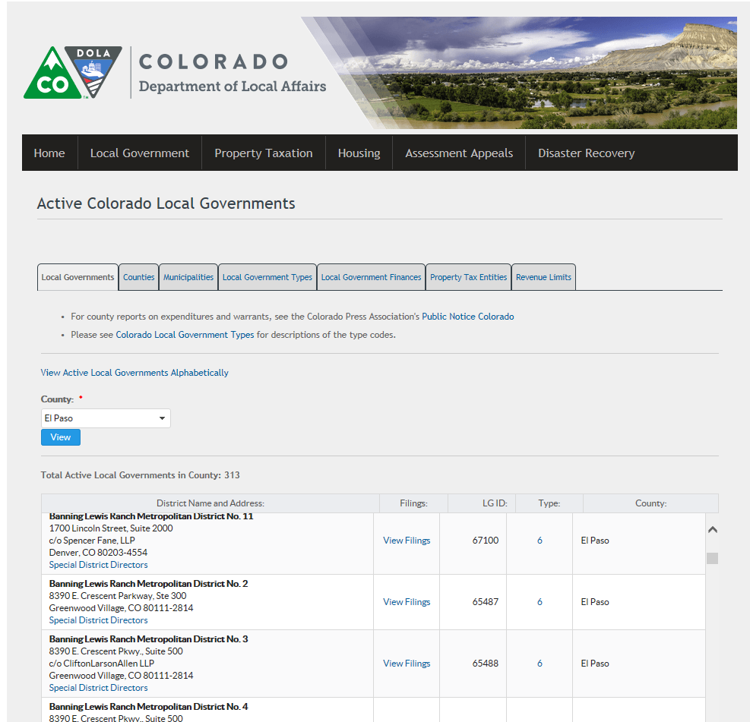
DOLA Local Government Web Site
State has some reporting requirements
Systematic format

Slide 15
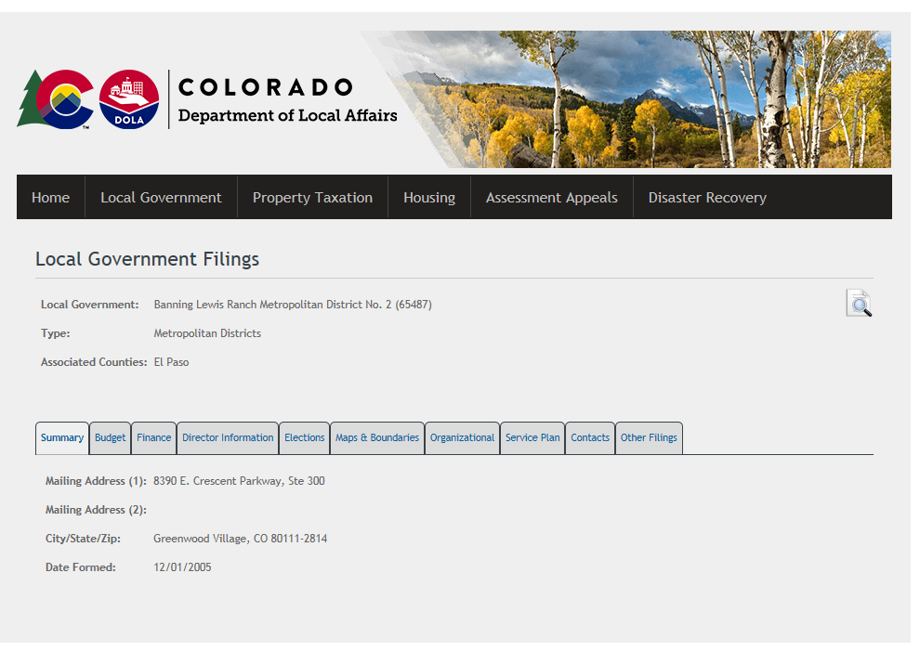
Standardized DOLA Filings

Slide 16
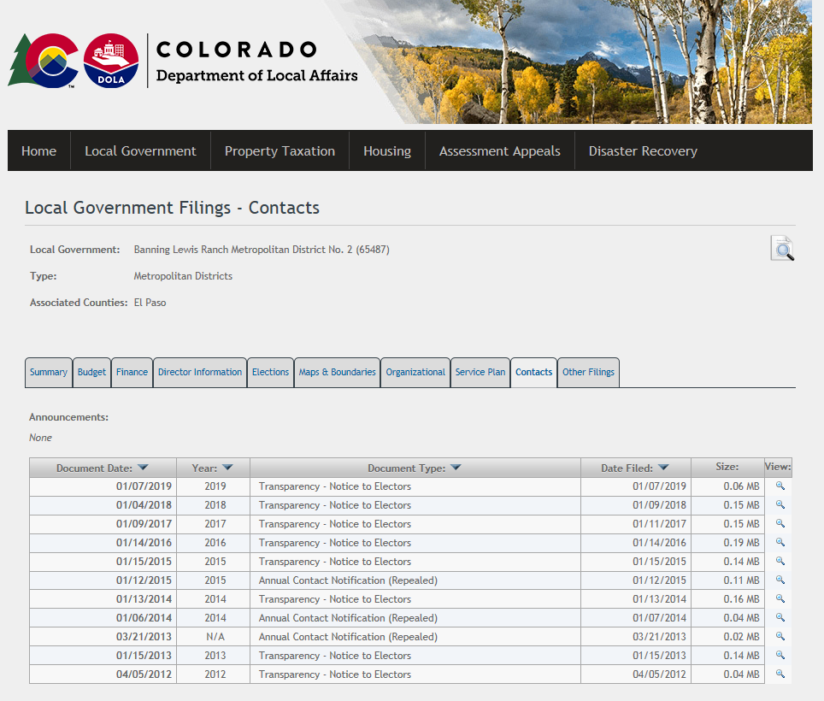
Location of Transparency Notice

Slide 17
District Dissolution
District- specific statutory processes
May occur if districts have never become active or have achieved their purposes
  Or if converted to another entity
GIDs- Council initiates (as GID board)
BIDs- Council action
Metropolitan districts- May be some Council action, but by Court order
Dissolution may not be as common in the future
  Ownership and maintenance functions

Slide 18
Transition of District Governance
Most districts are initiated by developers with developer boards
  Ownership groups may change
BIDs could transition to multiple business owner boards
Single metropolitan districts typically transition to resident or property owner boards
  Some have in Colorado Springs have transitioned or are in the process
Process more complicated and extended with multiple metropolitan district structures
  None have yet transitioned in Colorado Springs
  Eventual dissolution of the operating/control district
    Refer to attachment

Slide 19
Next Steps/ Recommendations
Make these session materials available on City web site
Special District Working Group
  Recommend revisions to Special District Policy, BID Operating Plan and Budget Template and metropolitan district Model Service Plans and report back to Council
  Councilors Knight and Geislinger with knowledgeable members and City staff support

