Slide 1



Acquisition of 193.47 acres at the Black Canyon Quarry and 148.02 acres of Pikeview Quarry Frontage Property
TOPS Working Committee
May 6, 2020
Britt Haley- TOPS Program Manager

Slide 2

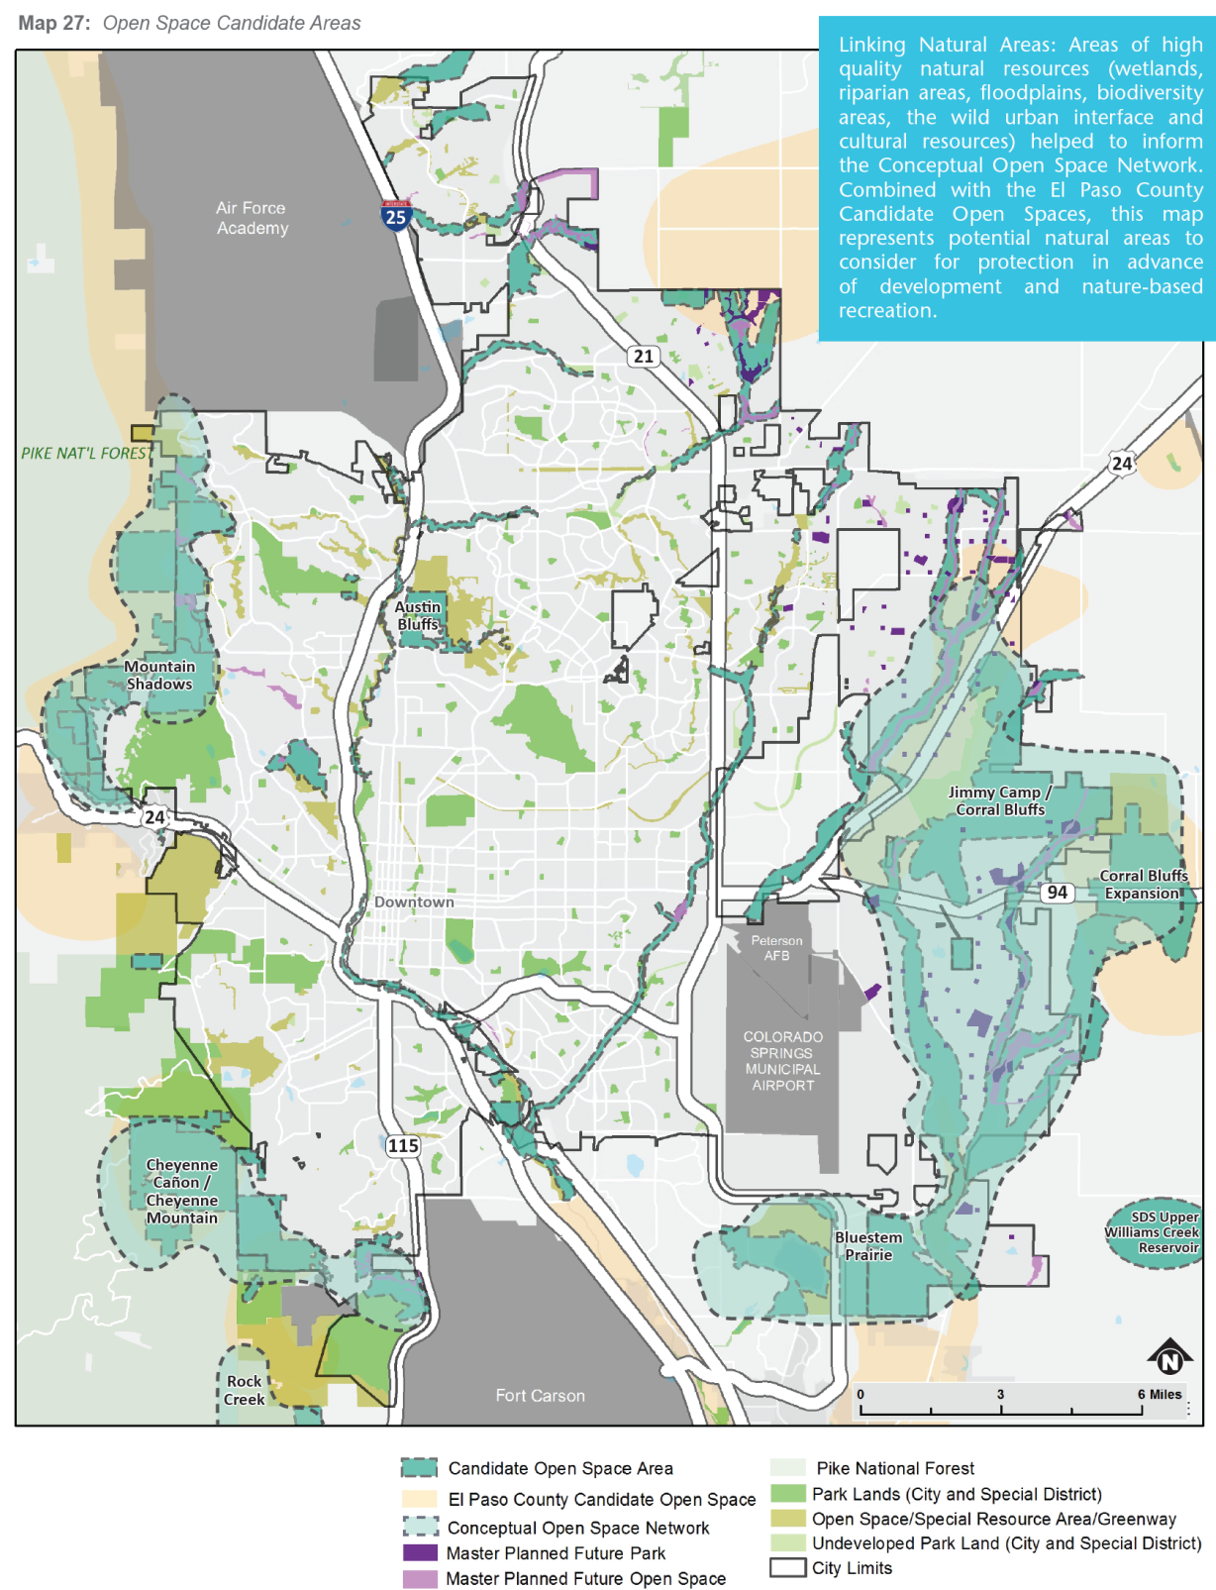

Overview from the Park System Master Plan
2014 Parks System Master Plan
Fill in gaps in the City of Colorado Springs
open space ring to create a network
of lands that are interconnected for
greater biodiversity, wildlife movement,
and scenic protection.
Identified as Candidate Open Space
Natural Resource Target Areas: Mountain backdrop, Grasslands,
Fulfills goal of achieving connectivity
Pursue opportunities for partnerships

Slide 3
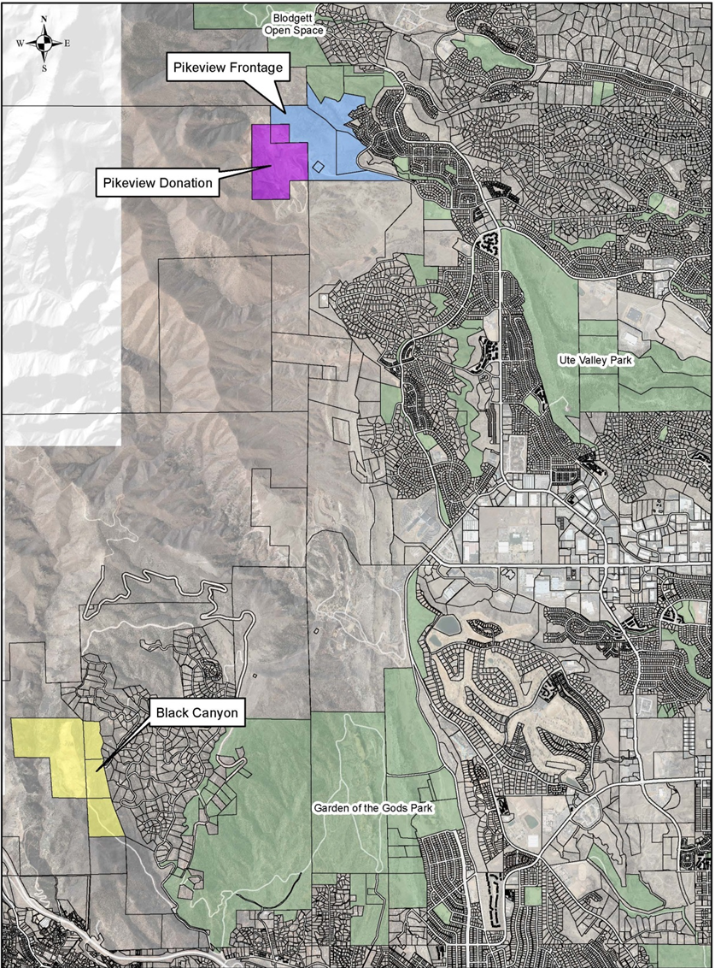
Vicinity map
Two properties are proposed for acquisition from Castle Concrete.
In light blue are 148.02 acres of property between Blodgett Open Space and the Flying W Ranch purchased by Castle Concrete to buffer the Pikeview Quarry in purple from the developing neighborhood (Oak Valley Ranch subdivision).
In yellow are the 193.47 acre Black Canyon Quarry Parcels west of the Cedar Heights neighborhood and adjacent to Williams Canyon north of State Highway 24.

Slide 4
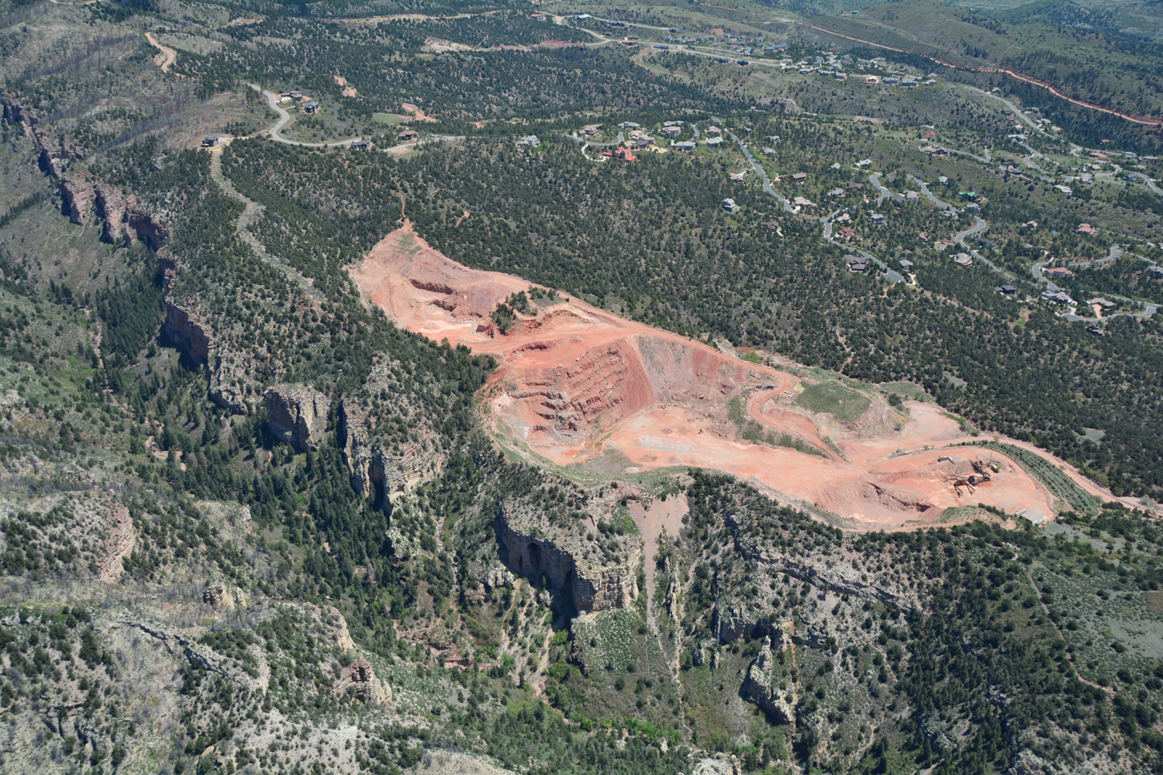

Slide 5
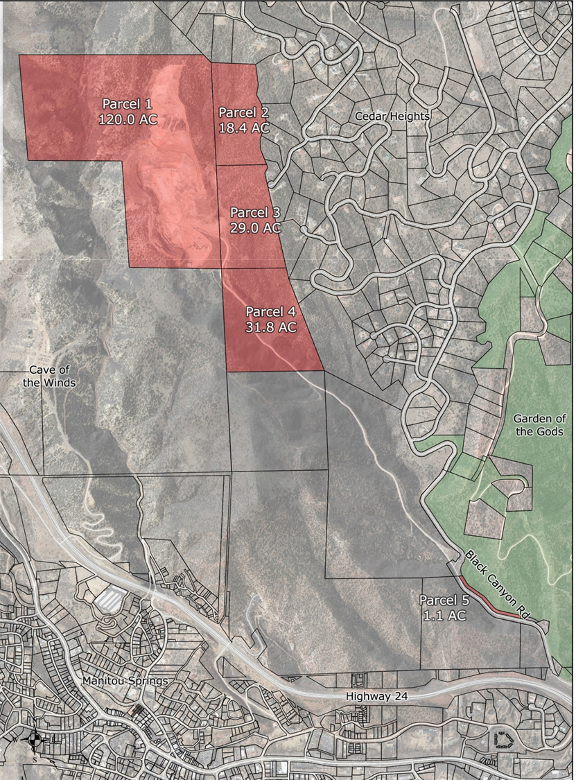
Black Canyon Quarry Properties
Black Canyon Quarry Parcels (appraised value $ 1,712,500)
It features impressive wildlife habitat, and expansive views over the City of Colorado Springs to the east and south. Looking to the west are beautiful views of Pikes Peak.
From a regional perspective, this property offers the potential to provide trail access to the Pike National Forest’s Waldo Canyon area. This area is in a planning process with the United States Forest Service to reopen to the public.
This property could be an important component to a successful reopening of Waldo Canyon for community recreation because the one trailhead for that area has been eliminated on State Highway 24 due to significant safety concerns.

Slide 6
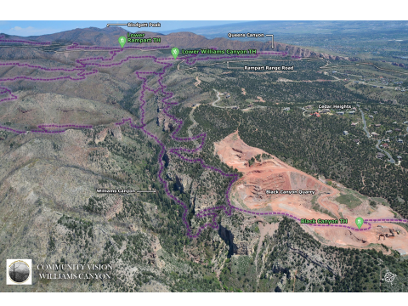

Slide 7
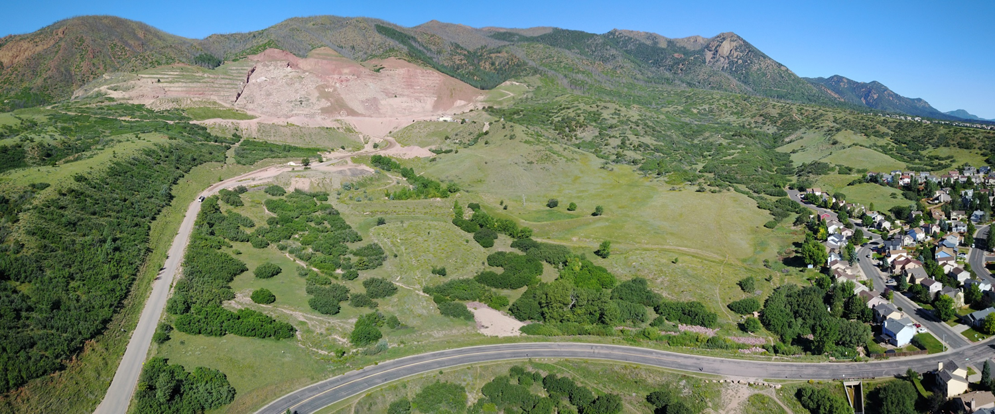
Pikeview Frontage Property

Slide 8
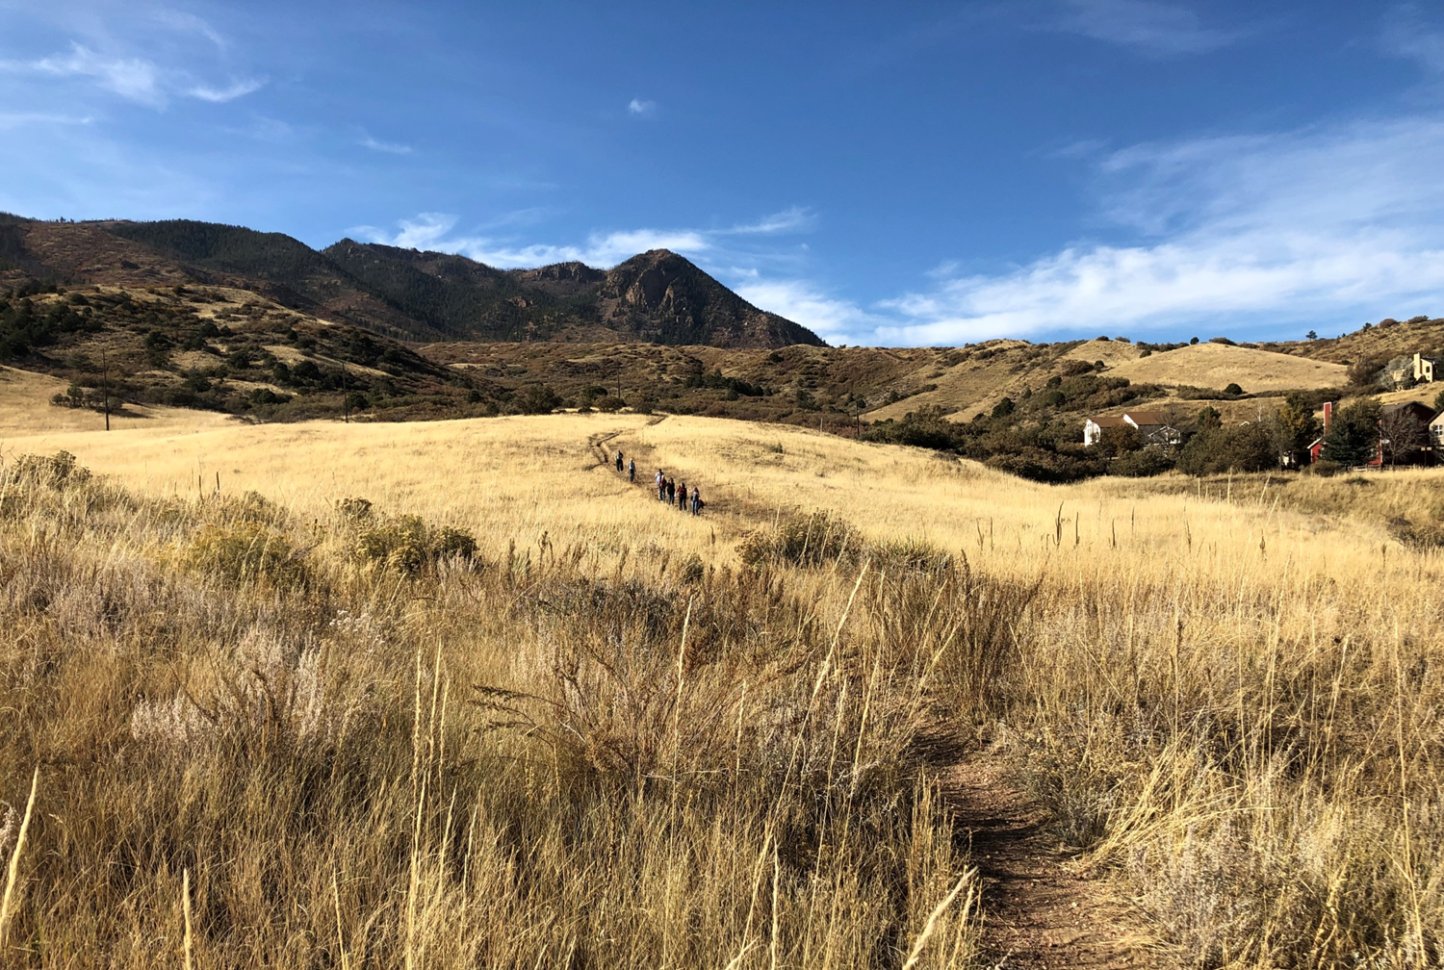

Slide 9
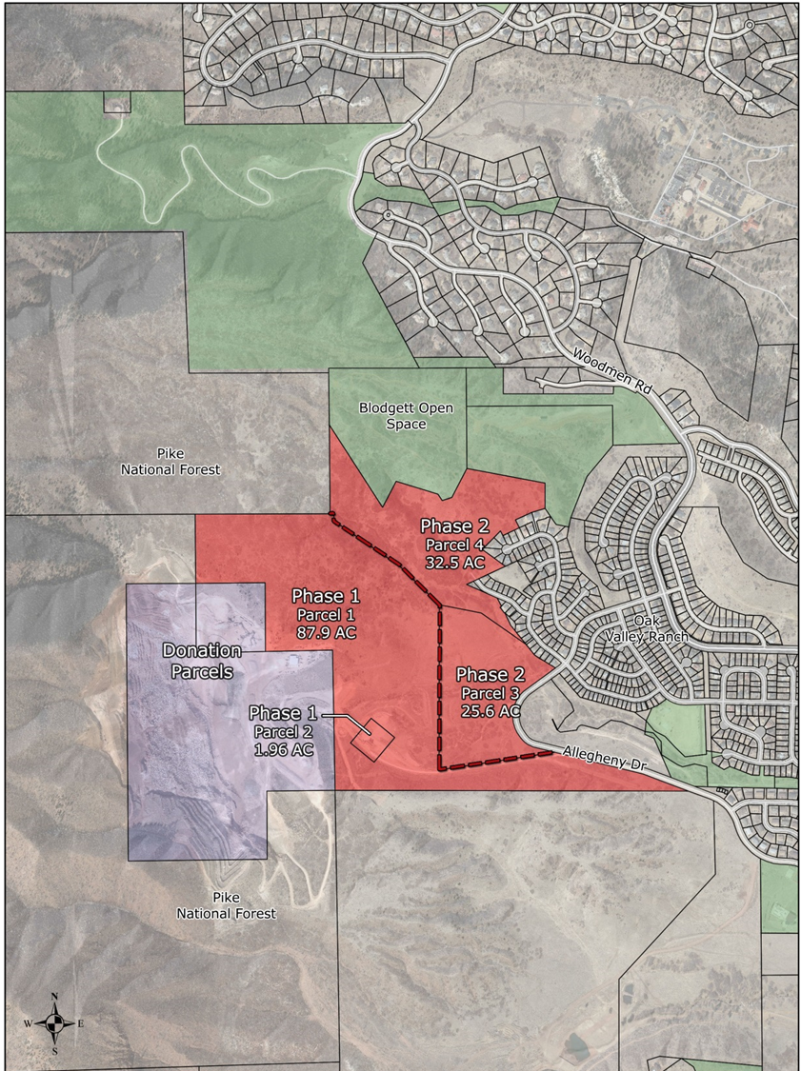
Pikeview Frontage Properties
Acquisition of the 148.02 acre Pikeview Frontage Property will require the appraised value of $6,660,000 from the TOPS Open Space Category.
These acres will be acquired with the assistance of The Conservation Fund and TCF will immediately transfer the Phase I property to TOPS for a cost of $4,043,250.
Finally, TCF agreed to reduce its standard professional service fee from 5% to 1.5% of the total value of the Phase I Frontage Property purchase which is approximately $60,650.00. For the Phase II acquisition of the Frontage Property the standard 5% will apply and that equals approximately $130,865.00.
Phase I acquisition total cost $4,103,900
Phase II acquisition total cost $3,175,115

Slide 10
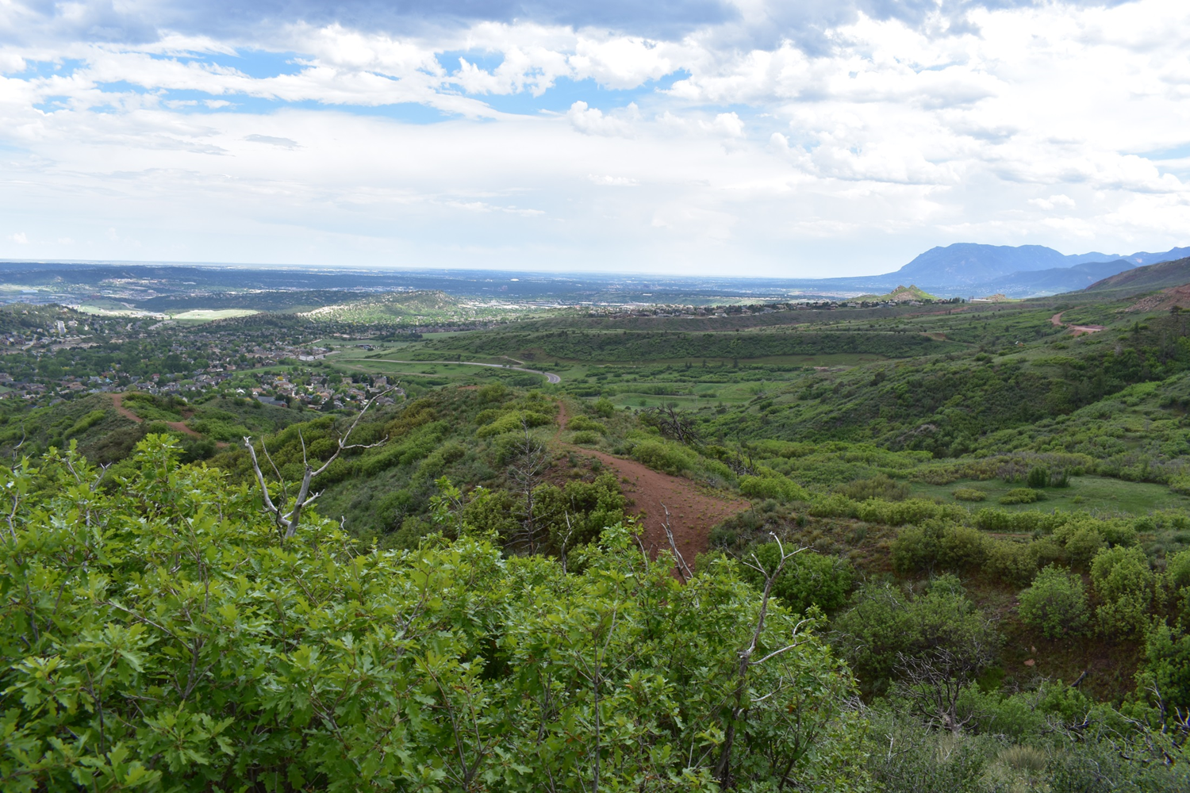

Slide 11
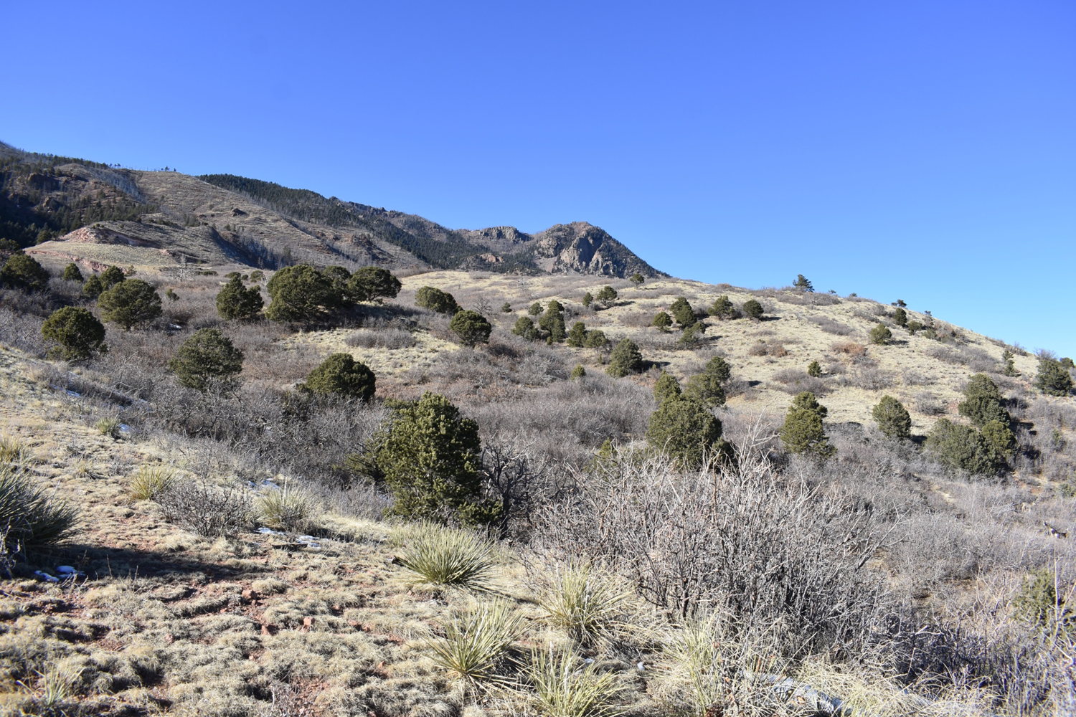

Slide 12
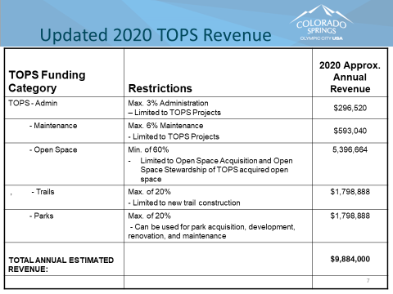

Slide 13
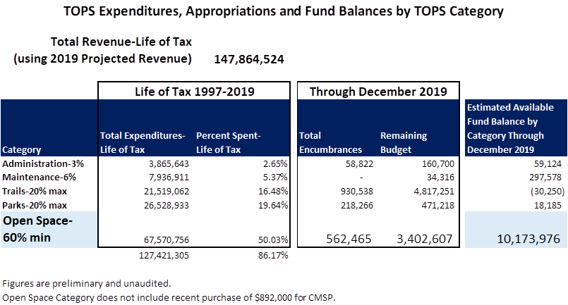

Slide 14
TOPS Estimated Fund Balance Summary
2019 estimated Fund Balance for the Open Space Category (unaudited/preliminary) $10,173,976
Appropriation authority for Jimmy Camp Creek parcels, $3,362,600 January 2020.
Making the estimated Fund Balance $6,811,376.
One more Jimmy Camp Creek property was authorized for purchase at a value of $241,300. making the estimated fund balance $6,570,076
2020 Funds previously projected for acquisition: $3,200,000.
Estimated Fund Balance including projected 2020 receipts: $9,770,076.
Phase I acquisition cost $6,243,900.
If no 2020 revenues are recognized, the remaining 2019 fund balance can accommodate this Phase I transaction. $6,570,076 – $6,243,900.
$326,176 remains in TOPS Open Space Fund Balance
Shows why the partnership with The Conservation Fund is key
All numbers are unaudited and represent estimates

Slide 15

October
Proposed Timeline for Approvals
May 6, 2020 TOPS Working Committee
May 12, 2020 City Council Budget Committee
May 14, 2020 Parks, Recreation and Cultural
Services Advisory Board
May 22, 2020 City Council Work Session
June 9, 2020 City Council Regular Session
June 23, 2020 City Council Second Reading Supplemental Appropriation

Slide 16
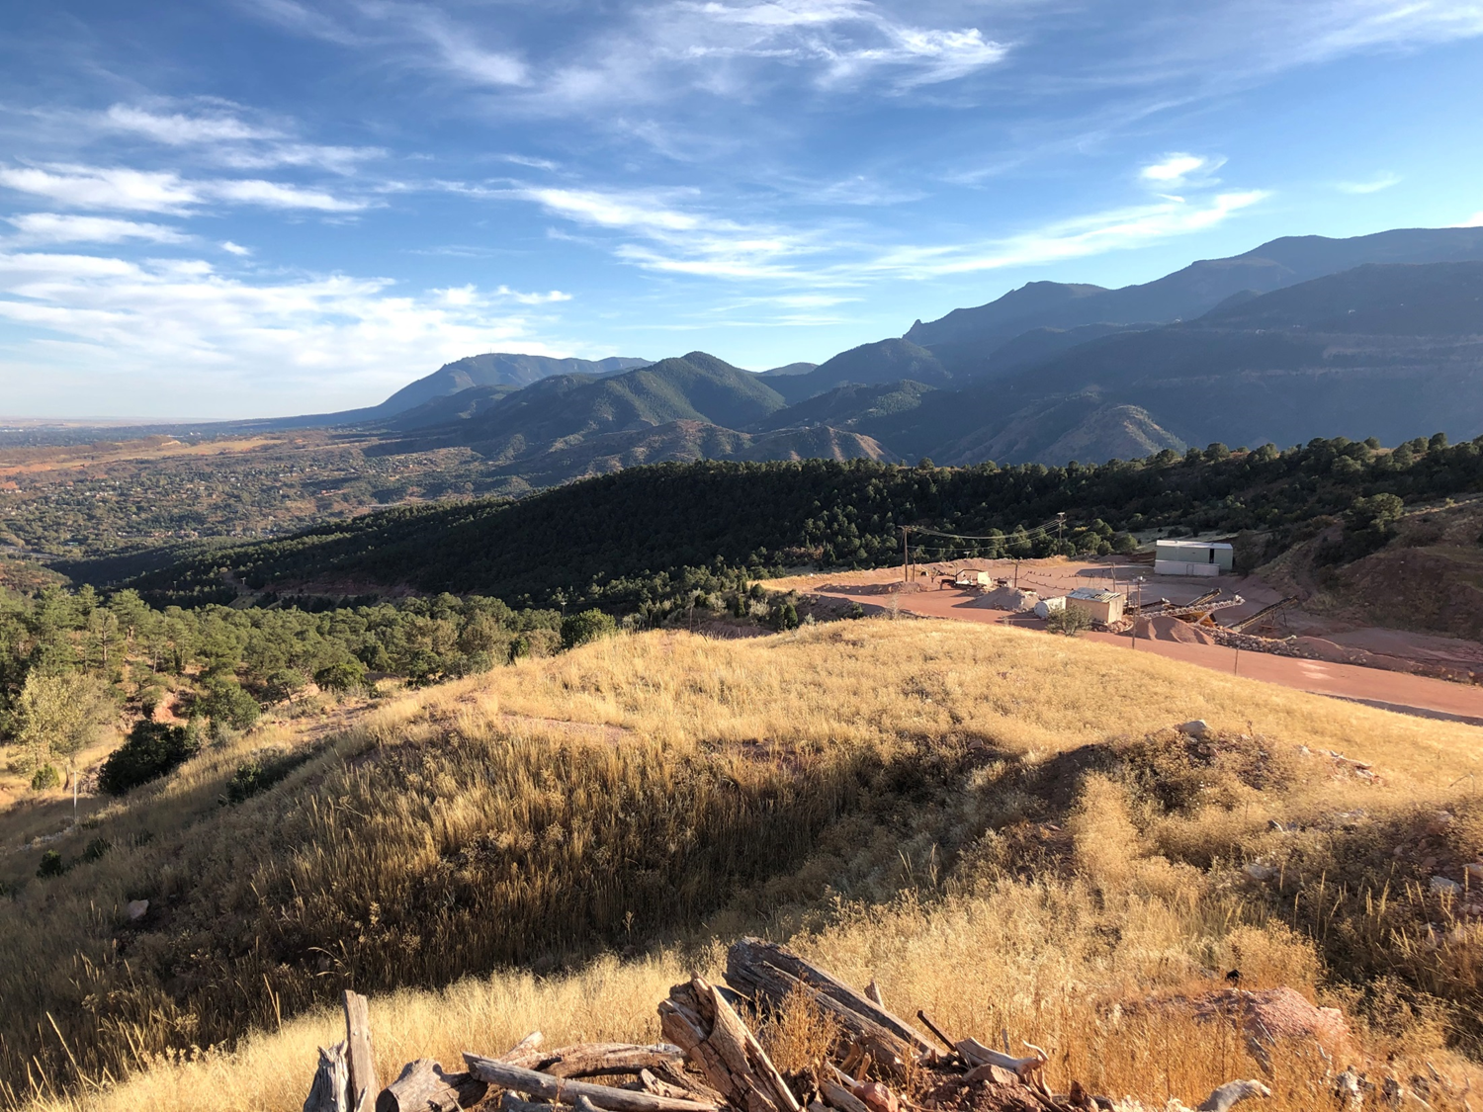
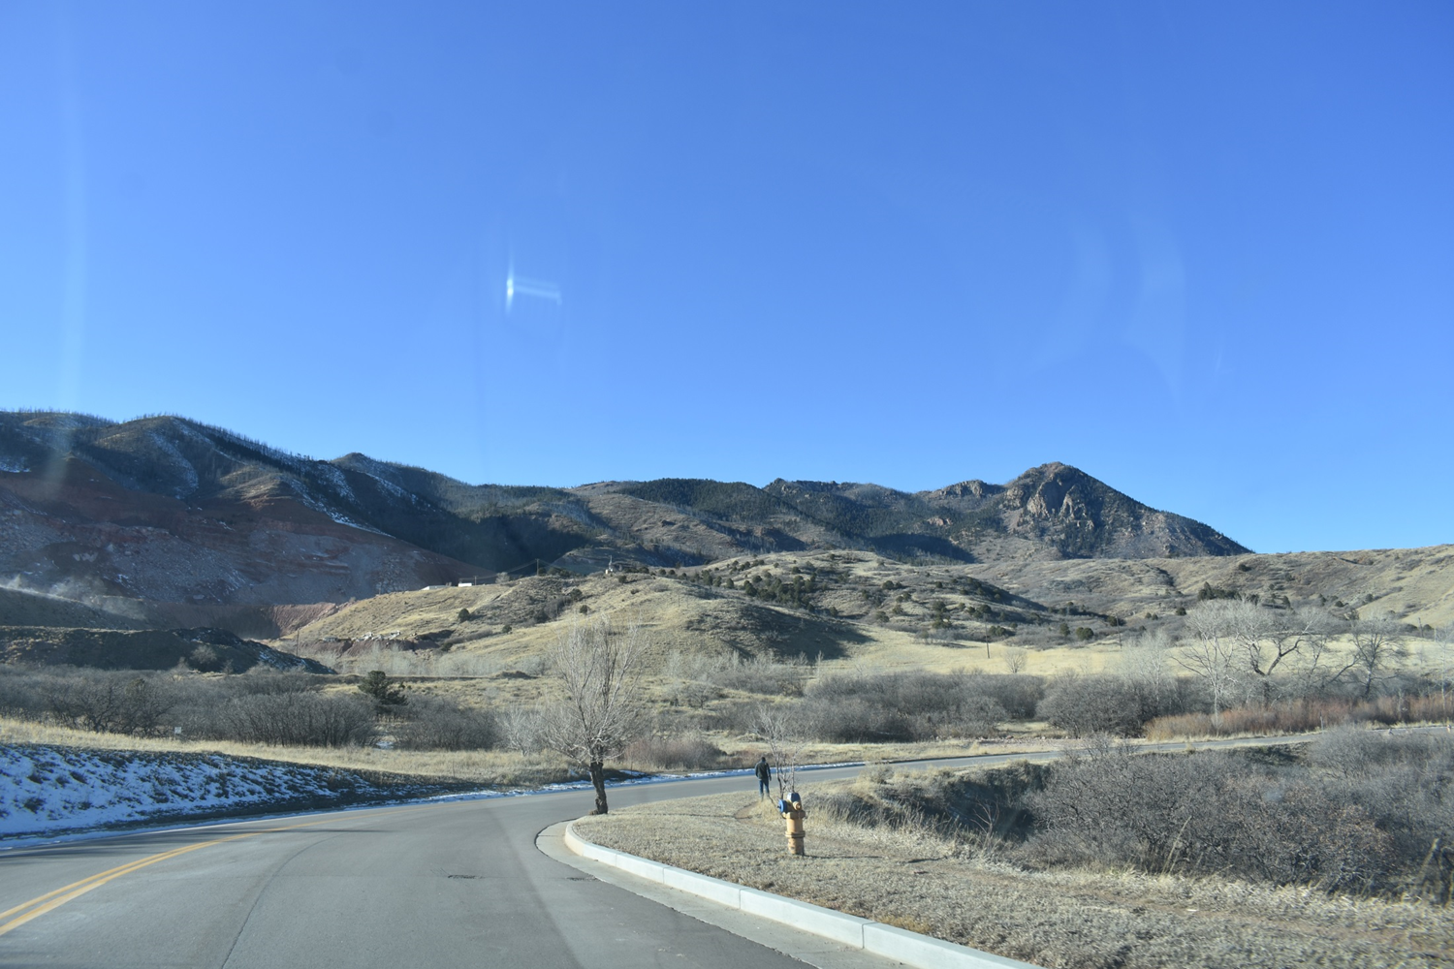
Proposed Motion
A motion to recommend acquisition of 193.47 acres known as the Black Canyon Quarry parcels and acquisition of 148.02 acres in two phases from The Conservation Fund of the Pikeview Frontage property to include the purchase prices, the administrative settlement, real estate transaction costs and professional services fees for a total cost of $9,419,015 with revenues from the TOPS Open Space Category.

